Slide 1
Life after levels: Principled assessment design
Dylan Wiliam (@dylanwiliam)
www.dylanwiliam.net

Slide 2
Initial assumptions
The assessment system should be designed to assess the school’s curriculum rather than having to design the curriculum to fit the school’s assessment system.
Since each school’s curriculum should be designed to meet local needs, there cannot be a one-size-fits-all assessment system—each school’s assessment system will be different.
There are, however, a number of principles that should govern the design of assessment systems, and
There is some science here—knowledge that people need in order to avoid doing things that are just wrong.

Slide 3
Outline
Assessment (and what makes it good)
Designing assessment systems
Recording and reporting

Slide 4
Before we can assess…
The ‘backward design’ of an education system
Where do we want our students to get to?
‘Big ideas’
What are the ways they can get there?
Learning progressions
When should we check on/report progress?
Inherent and useful checkpoints

Slide 5
Big ideas
A “big idea”
helps make sense of apparently unrelated phenomena
is generative in that is can be applied in new areas

Slide 6
Some big ideas of the school curriculum
Subject | Big idea
English | The “hero’s journey” as a useful framework for understanding myths and legends.
Geography | Patterns of human development are influenced by, and in turn influence, physical features of the environment.
History | Sources are products of their time, but knowing the circumstances of their creation helps resolve conflicts.
Mathematics | Fractions, decimals, percents and ratios are ways of expressing numbers that can be represented as points on a number line.
Science | All matter is made of very small particles
Sociology | The way people behave is the result of interplay between who they are (agency) and where they are (structure).

Slide 7
Learning progressions
Learning progressions
only make sense with respect to particular learning sequences;
are therefore inherently local; and consequently
those developed by national experts are likely to be difficult to use and often just plain wrong
have two defining properties
Empirical basis: almost all students demonstrating a skill must also demonstrate sub-ordinate skills
Logical basis: there must be a clear theoretical rationale for why the sub-ordinate skills are required

Slide 8
Significant stages in development
Rationales for assessing the learning journey
Intrinsic: developmental levels inherent in the discipline
Extrinsic: the need to inform decisions

Slide 9
Significant stages in development: intrinsic
Intrinsic: developmental levels inherent in the discipline
Stages of development (e.g., Piaget, Vygotsky)
Structure in the student’s work (e.g., SOLO taxonomy)
‘Troublesome knowledge’ (Perkins, 1999)
Conceptually difficult
Alien
Burdensome

Slide 10
Significant stages in development: extrinsic
Extrinsic: the need to inform decisions
Decision-driven data collection
key transitions in learning (years, key stages)
timely information for stakeholders
monitoring student progress
informing teaching and learning

Slide 11
Quality in assessment

Slide 12
What is an assessment?
An assessment is a process for making inferences
Key question: “Once you know the assessment outcome, what do you know?”
Evolution of the idea of validity
A property of a test
A property of students’ results on a test
A property of the inferences drawn on the basis of test results

Slide 13
Validity
For any test:
some inferences are warranted
some are not
“One validates not a test but an interpretation of data arising from a specified procedure”(Cronbach, 1971; emphasis in original)
Consequences
No such thing as a valid (or indeed invalid) assessment
No such thing as a biased assessment

Slide 14
Threats to validity
Construct-irrelevant variance
Systematic: good performance on the assessment requires abilities not related to the construct of interest
Random: good performance is related to chance factors, such as luck (effectively poor reliability)
Construct under-representation
Good performance on the assessment can be achieved without demonstrating all aspects of the construct of interest

Slide 15
Understanding reliability

Slide 16
The standard error of measurement
Classical test theory:
The score a student gets on any one occasion is what they “should” have got, plus or minus some error
The “standard error of measurement” (SEM) is just the standard deviation of the errors, so, on any given testing occasion
68% of students score within 1 SEM of their true score
96% of students score within 2 SEM of their true score

Slide 17
Relationship of reliability and error
For a test with an average score of 50, and a standard deviation of 15:
Reliability | Standard error of measurement
0.70 | 8.2
0.75 | 7.5
0.80 | 6.7
0.85 | 5.8
0.90 | 4.7
0.95 | 3.4

Slide 18
Reliability: 0.75

Slide 19
Reliability: 0.80

Slide 20
Reliability: 0.85

Slide 21
Reliability: 0.90

Slide 22
Reliability: 0.95

Slide 23
Indicative reliabilities
Assessment | Reliability | SEM
AS Chemistry | 0.92 | 4.2
AS Business studies | 0.79 | 6.9
GCSE Psychology (Foundation tier) | 0.89 | 5.0
GCSE Psychology (Higher tier) | 0.92 | 4.2
Ofqual (2014)
The standard error of measurement for GCSE and A-level is usually at least plus or minus half a grade, and often substantially more

Slide 24
Understanding what this means in practice

Slide 25
Using tests for grouping students by ability
Using a test with a reliability of 0.9, and with a predictive validity of 0.7, to group 100 students into four ability groups or “sets”:
 |  | should be in set
 |  | set 1 | set 2 | set 3 | set 4
students placed in | set 1 | 23 | 9 | 3
 | set 2 | 9 | 12 | 6 | 3
 | set 3 | 3 | 6 | 7 | 4
 | set 4 |  | 3 | 4 | 8
Only 50% of the students are in the “right” set

Slide 26
Reliability, standard errors, and progress
Grade | Reliability | SEM as a percentage of annual progress
1 | 0.89 | 26%
2 | 0.85 | 56%
3 | 0.82 | 76%
4 | 0.83 | 39%
5 | 0.83 | 55%
6 | 0.89 | 46%
Average | 0.85 | 49%
In other words, the standard error of measurement of this reading test is equal to six months’ progress by a typical student

Slide 27
If you must measure progress…
As rules of thumb:
For individual students, progress measures are meaningful only if the progress is more than twice the standard error of measurement of the test being used to measure progress
For a class of 30 students, progress measures are meaningful if the progress is more than half the standard error of measurement of the test being used to measure progress.

Slide 28
Recording and reporting

Slide 29
Sylvie and Bruno concluded (Carroll, 1893)
“That’s another thing we’ve learned from your Nation,” said Mein Herr, “map-making. But we’ve carried it much further than you. What do you consider the largest map that would be really useful?”
“About six inches to the mile.”
“Only six inches!” exclaimed Mein Herr. “We very soon got to six yards to the mile. Then we tried a hundred yards to the mile. And then came the grandest idea of all! We actually made a map of the country, on the scale of a mile to the mile!”
“Have you used it much?” I enquired.
“It has never been spread out, yet,” said Mein Herr: “the farmers objected: they said it would cover the whole country, and shut out the sunlight! So we now use the country itself, as its own map, and I assure you it does nearly as well.

Slide 30
Towards useful record-keeping
Development of science skills in eighth grade
Use of laboratory equipment
Metric unit conversion
Density calculations
Density applications
Density as a characteristic property
Phases of matter
Gas laws
Communication (graphing)
Communication (lab reports)
Inquiry skills

Slide 31
Assessment matrix
 | Equipment | Metric units | Density calculations | Density properties | Phases of matter | Gas laws | Communication (graph) | Communication (report)
Homework 1 |  | ✓
Homework 2 |  |  | ✓ | ✓
Laboratory 1 | ✓ |  |  | ✓ |  |  |  | ✓
Homework 3 |  |  |  |  | ✓
Module test |  | ✓ | ✓ | ✓
Laboratory 2 | ✓ |  |  |  | ✓ | ✓ | ✓ | ✓
Homework 4 |  |  |  |  | ✓
Final exam | ✓ | ✓ | ✓ | ✓ | ✓ | ✓ | ✓

Slide 32
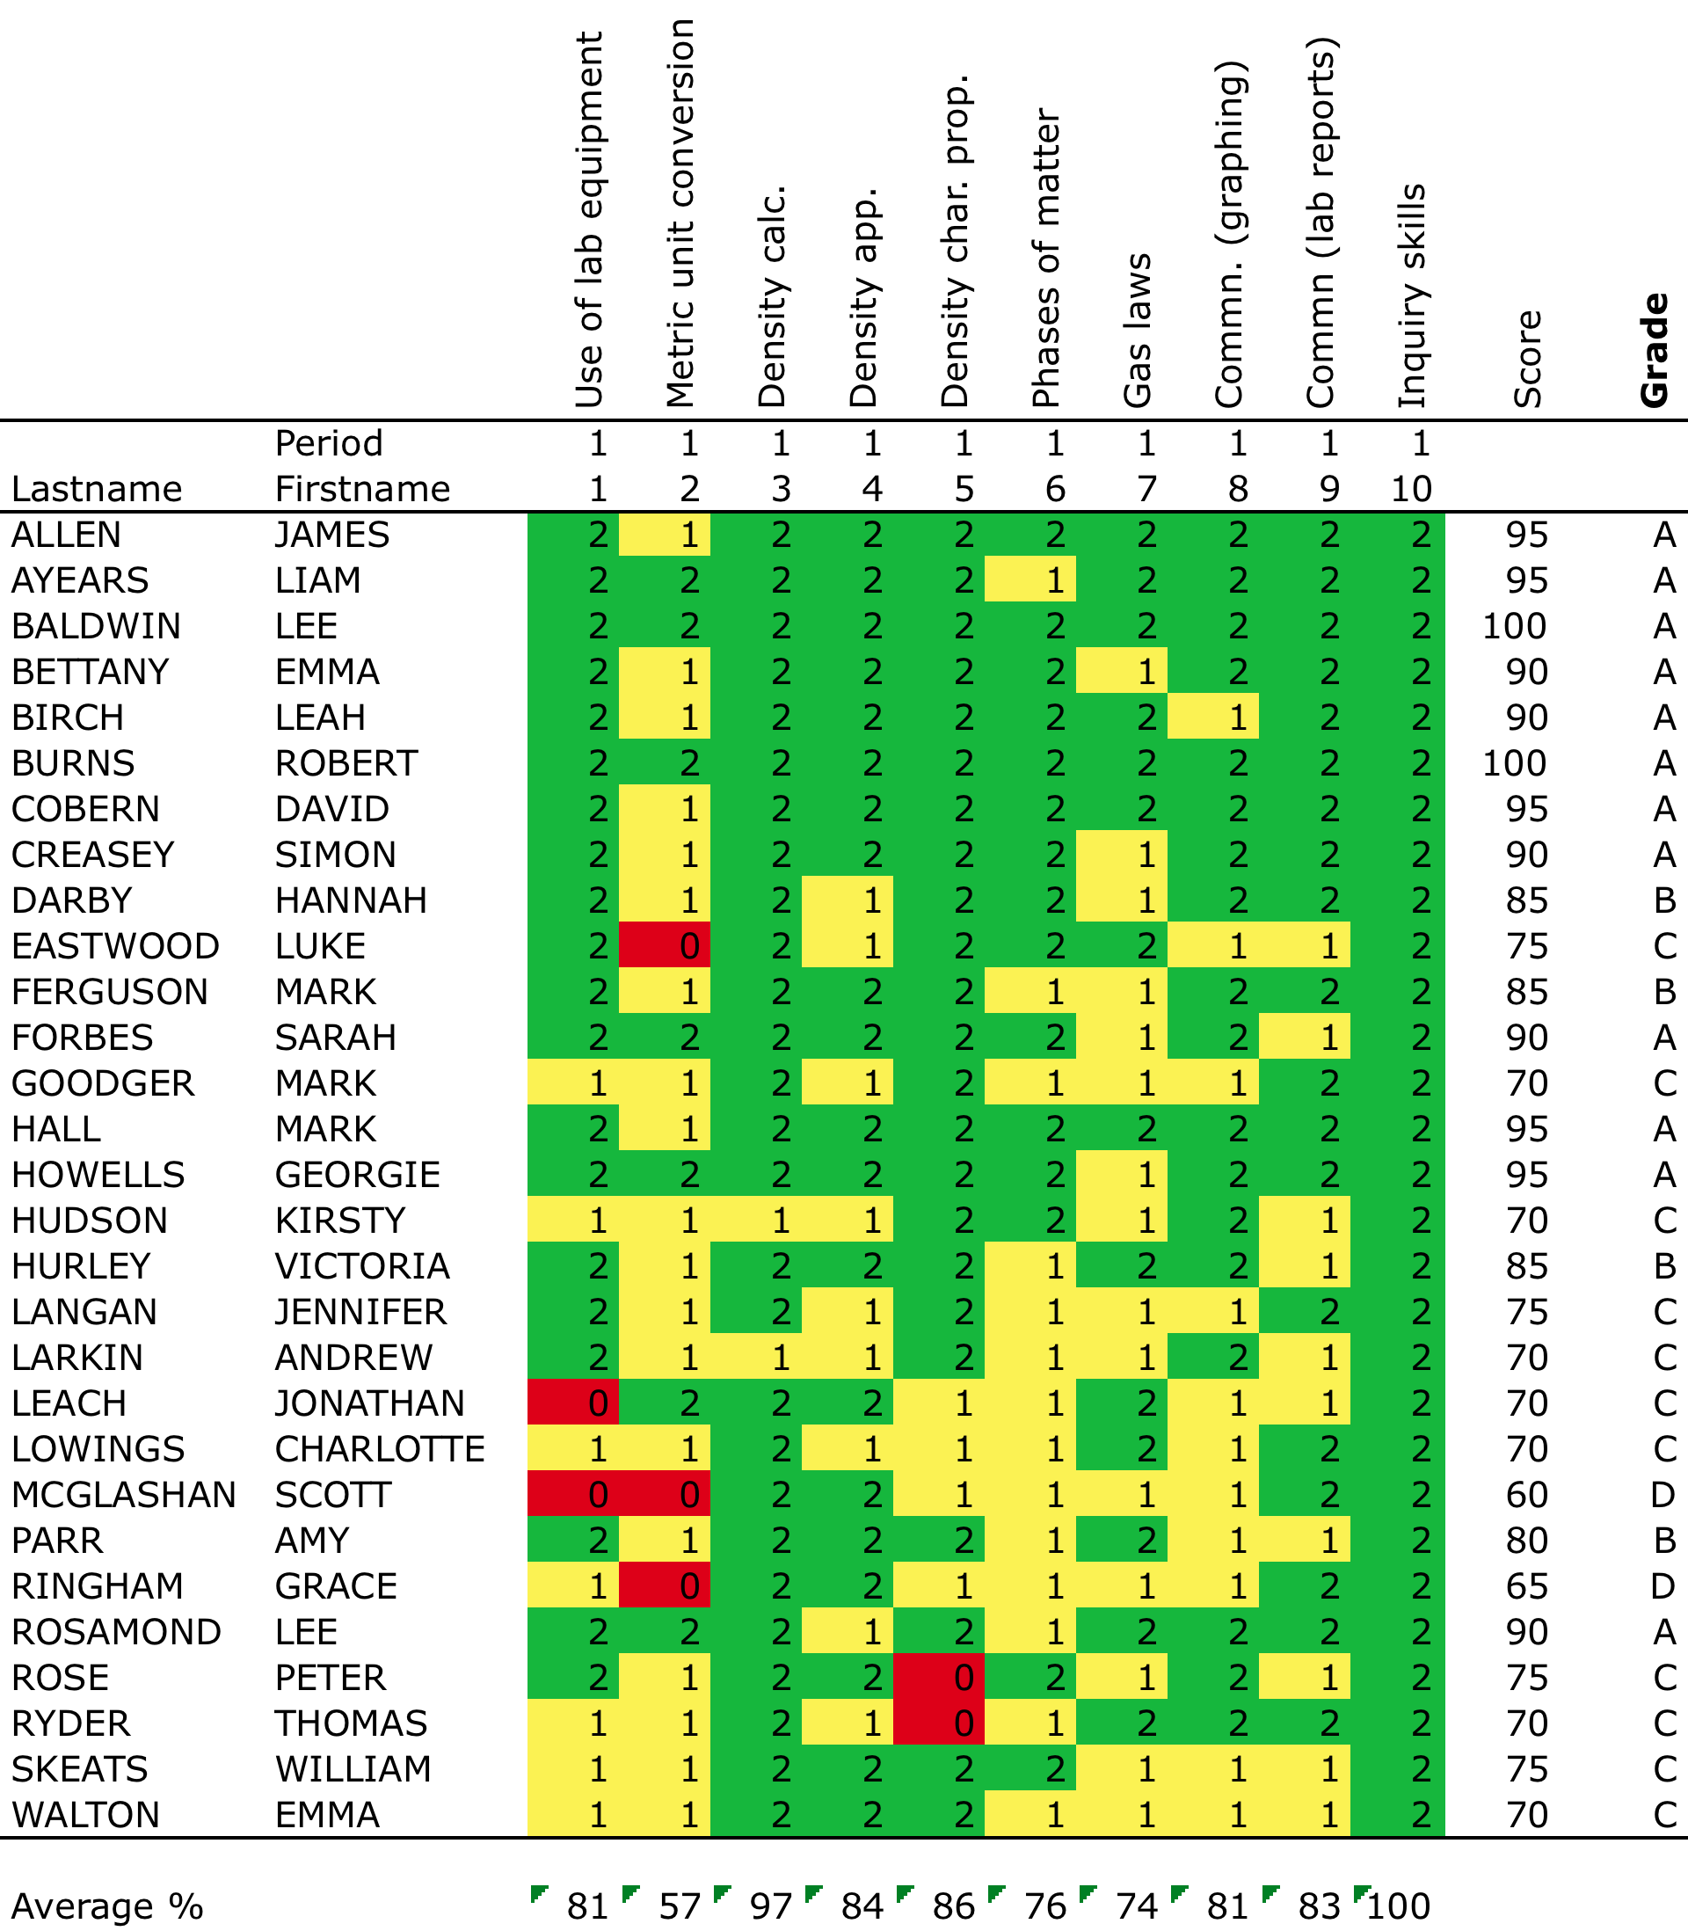

Slide 33
Target setting
 |  | Key stage 2 achievement
 |  | ≤3 | 3.3 | 3.7 | 4 | >4
GCSE grade | U | 3 | 1 | 1 | 0 | 0
 | G | 11 | 3 | 1 | 1 | 0
 | F | 26 | 10 | 5 | 2 | 0
 | E | 31 | 26 | 16 | 7 | 2
 | D | 20 | 35 | 33 | 22 | 7
 | C | 7 | 21 | 32 | 28 | 23
 | B | 1 | 4 | 10 | 24 | 35
 | A | 0 | 0 | 1 | 6 | 27
 | A* | 0 | 0 | 0 | 0 | 5

Slide 34
Scores versus grades
Precision is not the same as accuracy
The more precise the score, the lower the accuracy.
Less precise scores are more accurate, but less useful
Scores suffer from spurious precision
Given that no score is perfectly reliable, small differences in scores are unlikely to be meaningful
Grades suffer from spurious accuracy
When we use grades or categories, we tend to regard performance is different categories as qualitatively different

Slide 35
Recommendations: recording and reporting
Records should be kept at the finest manageable level
Where profiles of scores are aggregated this should be to a relatively fine scale
When assessment outcomes are reported, they are always accompanied by a margin of error, such as:
Standard error (SEM)
Probable error (0.675 x SEM)

