Slide 1
Dylan Wiliam (@dylanwiliam)
Bryanston Education Summit; 7 June 2017
Creating the schools our children need: Why what we’re doing right now won’t help much, and what we can do instead
www.dylanwiliamcenter.com www.dylanwiliam.org

Slide 2
Outline
Why we need to raise achievement?
How can we find out what might help?
What is likely to have the biggest impact?

Slide 3
What is the purpose of education?
Four main philosophies of education/development
Personal empowerment
Cultural transmission
Preparation for citizenship
Preparation for work
All are important
Any education system is a (sometimes uneasy) compromise between these four forces

Slide 4
Learning from research

Slide 5
Limitations of educational research
You can’t deduce an “ought” from an “is” (Hume, 1739)
Educational research can only tell you what was, not what might be
Ability grouping
Homework
Class-size reduction
Teachers’ aides
Educational leaders need to be critical consumers of educational research

Slide 6
Understanding meta-analysis
A technique for aggregating results from different studies by converting empirical results to a common measure (usually effect size)
Standardized effect size is defined as:
Problems with meta-analysis
The “file drawer” problem
Variations in intervention quality
Variation in population variability
Selection of studies
Sensitivity of outcome measures

Slide 7
Meta-analysis in education
Some problems are unavoidable:
Sensitivity to instruction
Selection of studies
Some problems are avoidable:
File-drawer problem
Quality
Variation in variability
Unfortunately, most of the people doing meta-analysis in education:
don’t discuss the unavoidable problems, and
don’t avoid the avoidable ones

Slide 8
Best-evidence synthesis

Slide 9
Which of these is the best predictor of academic achievement at age 18?
‘Grit’
Having a growth mindset
IQ measured at age 11
Parental education
Parental income

Slide 10
Things that don’t work
Getting smarter people into teaching
Paying good teachers more
Brain Gym®
Learning styles
Copying other countries

Slide 11
Things that might work
Lesson study/Learning study
Social and emotional aspects of learning
Educational neuroscience
Growth mindset
Differentiated instruction
Grit

Slide 12
“Ability”: Fixed or malleable?
‘Mindset’ (Dweck, 2000)
Implicit theory of intelligence
“Some believe that intelligence is more of an unchangeable, fixed ‘‘entity’’ (an entity theory). Others think of intelligence as a malleable quality that can be developed (an incremental theory).” (Blackwell, Dweck, & Trzesniewski, 2007 p. 247)
Issues
Impact on student achievement not significant (0.05 < p < 0.10)
Results have never been replicated (despite at least 3 attempts)
No examples of schools changing their own students’ mindsets
But,
None of this matters if we ignore Dweck and just focus on getting our students to believe that “Smart is not something you just are, smart is something you can get” (Howard, 1991 p. 7)

Slide 13
Mindset: Langridge and Ellis (2016 Olympics)

Slide 14
Things that do work—a bit, sometimes
Expanding school choice
Within the state sector
Academies
Free schools
By involving the private sector
Vouchers

Slide 15
Things that do work—a bit, most of the time
Firing bad teachers
Class size reduction

Slide 16
Things that do work—a lot
Curriculum improvement
Formative assessment

Slide 17
Curriculum

Slide 18
Why curriculum matters
Myths about curriculum
Standards tell us what to teach
Curriculum means textbooks
Knowledge isn’t important (“You can always Google it”)
Students should be involved in authentic tasks
We should be teaching skills, not content
Responding to students’ interests closes achievement gaps
What is the purpose of curriculum?
The real purpose of the curriculum is to increase the contents of long-term memory

Slide 19
Curriculum matters
The best curricula generate at least 25% more learning than the worst, irrespective of teacher quality
Unfortunately, while we know that curriculum makes a difference, we don’t know what makes the difference in curriculum.

Slide 20
Teacher quality

Slide 21
Teacher quality and student achievement
 |  | Correlation with progress in
Study | Location | Reading | Math
Rockoff (2004) | New Jersey | 0.10 | 0.11
Nye, Konstantopoulos, Hedges (2004) | Tennessee | 0.26 | 0.36
Rivkin, Hanushek, and Kain (2005) | Texas | 0.15 | 0.11
Aaronson, Barrow, and Sander (2007) | Chicago |  | 0.13
Kane, Rockoff, and Staiger (2008) | New York City | 0.08 | 0.11
Jacob and Lefgren (2008) |  | 0.12 | 0.26
Kane and Staiger (2008) |  | 0.18 | 0.22
Koedel and Betts (2009) | San Diego |  | 0.23
Rothstein (2010) | North Carolina | 0.11 | 0.15
Hanushek and Rivkin (2010) |  |  | 0.11
Chetty et al. (2014) |  | 0.12 | 0.16
Hanushek and Rivkin (2010)
Notes:
Obviously Chetty et al. was not included in Hanushek and Rivkin (2010)

Slide 22
What does this mean for student progress?
Take a group of 50 teachers:
Students taught by the most effective teacher in that group of 50 teachers learn in six months what those taught by the average teacher learn in a year
Students taught by the least effective teacher in that group of 50 teachers will take two years to achieve the same learning
And furthermore:
In the classrooms of the most effective teachers, students from disadvantaged backgrounds learn at the same rate as those from advantaged backgrounds (Hamre & Pianta, 2005)

Slide 23
Evaluation vs. improvement
Evaluation frameworks:
of necessity, have to be comprehensive
include all aspects of teachers work
at best, incentivize improvement on all aspects of practice
at worst, incentivize improvement on aspects of practice that are easy to improve
Improvement frameworks:
are selective
focus on those aspects of practice with the biggest payoff for students
To maximize improvement, evaluation frameworks have to be used selectively

Slide 24
Why formative assessment needs to be a priority

Slide 25
Bottom up: Research on formative assessment
Fuchs & Fuchs (1986)
Natriello (1987)
Crooks (1988)
Bangert-Drowns, et al. (1991)
Dempster (1991)
Dempster (1992)
Kluger & DeNisi (1996)
Black & Wiliam (1998)
Nyquist (2003)
Elshout-Mohr (1994)
Brookhart (2004)
Allal & Lopez (2005)
Köller (2005)
Brookhart (2007)
Wiliam (2007)
Hattie & Timperley (2007)
Shute (2008)
Kingston & Nash (2011)

Slide 26
Formative Assessment: A contested term
Long-cycle
Medium-cycle
Short-cycle
Across terms, teaching units
Within and between teaching units
Within and between lessons
Span
Four weeks to
one year
One to four weeks
Minute-by-minute and day-by-day
Length
Monitoring, curriculum alignment
Student-involved assessment
Engagement, responsiveness
Impact

Slide 27
Unpacking Formative Assessment
 | Where the learner is going | Where the learner is now | How to get the learner there
Teacher
Peer
Student
Clarifying, sharing, and understanding learning intentions
Eliciting evidence of learning
Providing feedback that moves learners forward
Activating students as learning
resources for one another
Activating students as
owners of their own learning

Slide 28
Unpacking Formative Assessment
 | Where the learner is going | Where the learner is now | How to get the learner there
Teacher
Peer
Student
Using evidence of achievement to adapt what happens in classrooms to meet learner needs

Slide 29
Educational Endowment Foundation toolkit
Intervention | Cost | Quality of evidence | Extra months of learning
Feedback | $$ | ★★★ | +8
Metacognition and self-regulation | $$ | ★★★★ | +8
Peer tutoring | $$ | ★★★★ | +6
Early years intervention | $$$$$ | ★★★★ | +6
One to one tuition | $$$$ | ★★★★ | +5
Homework (secondary) | $ | ★★★ | +5
Collaborative learning | $ | ★★★★ | +5
Phonics | $ | ★★★★ | +4
Small group tuition | $$$ | ★★★★ | +4
Behaviour interventions | $$$ | ★★ | +4
Digital technology | $$$$ | ★★★★ | +4
Social and emotional learning | $ | ★★★★ | +4

Slide 30
Educational Endowment Foundation toolkit
Intervention | Cost | Quality of evidence | Extra months of learning
Parental involvement | $$$ | ★★★ | +3
Reducing class size | $$$$$ | ★★★ | +3
Summer schools | $$$ | ★★ | +3
Sports participation | $$$ | ★★ | +2
Arts participation | $$ | ★★★ | +2
Extended school time | $$$ | ★★ | +2
Individualized instruction | $ | ★★★ | +2
After school programmes | $$$$ | ★★ | +2
Learning styles | $ | ★★★ | +2
Mentoring | $$$ | ★★★ | +1
Homework (primary) | $ | ★★★ | +1

Slide 31
Educational Endowment Foundation toolkit
Intervention | Cost | Quality of evidence | Extra months of learning
Teaching assistants | $$$$ | ★★ | 0
Performance pay | $$ | ★ | 0
Aspiration interventions | $$$ | ★ | 0
Block scheduling | $ | ★★ | 0
School uniform | $ | ★ | 0
Physical environment | $$ | ★ | 0
Ability grouping | $ | ★★★ | -1

Slide 32
Unpacking Formative Assessment
 | Where the learner is going | Where the learner is now | How to get the learner there
Teacher
Peer
Student
Clarifying, sharing, and understanding learning intentions
Eliciting evidence of learning
Providing feedback that moves learners forward
Activating students as
resources for one another
Activating students as
owners of their own learning

Slide 33
Supportive accountability
What is needed from teachers:
A commitment to:
The continual improvement of practice
Focus on those things that make a difference to students
What is needed from leaders:
A commitment to engineer effective learning environments for teachers by:
Creating expectations for continually improving practice
Keeping the focus on the things that make a difference to students
Providing the time, space, dispensation, and support for innovation
Supporting risk-taking

Slide 34
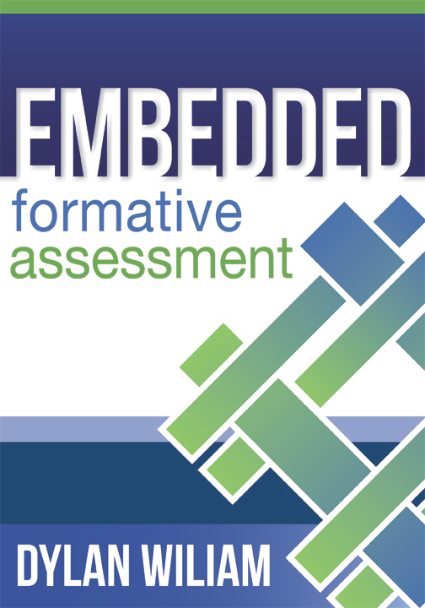
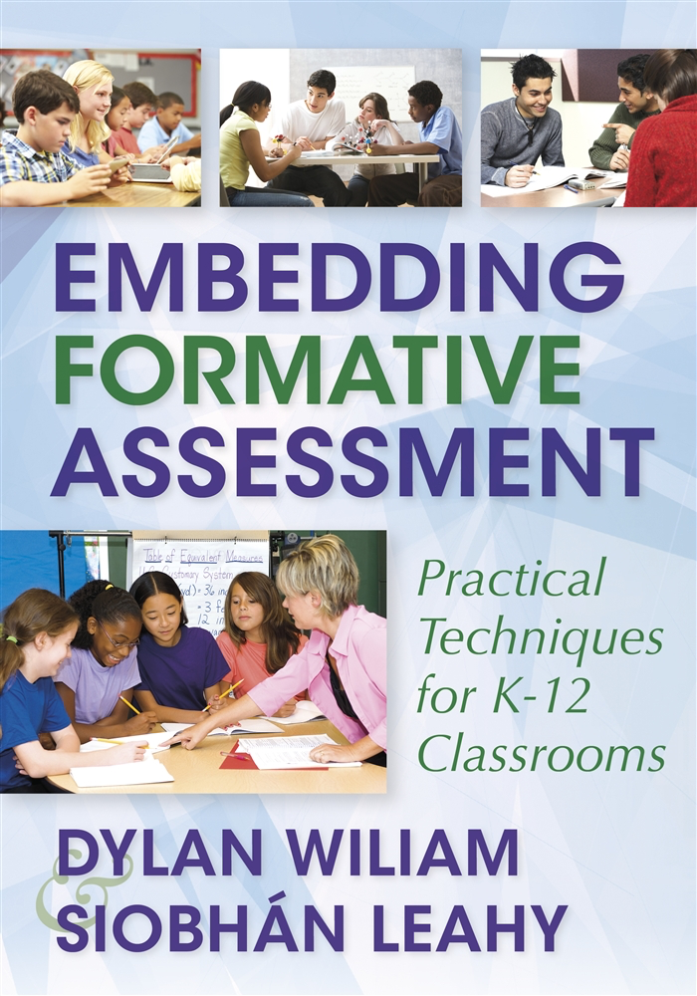
To find out more…
www.dylanwiliamcenter.com
www.dylanwiliam.net

