Slide 1
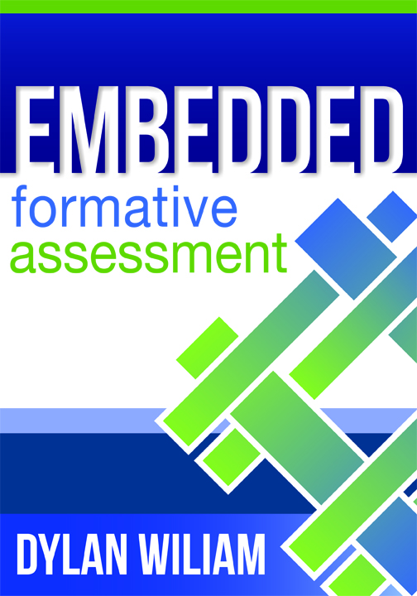
www.dylanwiliam.net
The Voices of Solution Tree
November 1–3, 2011 | Indianapolis
www.authorspeak2011.com

Slide 2
Benefits of education
For individuals
Increased lifespan
Improved health
Increased personal income
Reduced risk of
Unemployment
Suicide
For society
Increased economic growth
More pro-social behavior

Slide 3
A daunting target
Programme for International Student Asssessment (PISA)
United States 496
Canada 527
Finland 544
Shanghai 579

Slide 4
The Fox and the Hedgehog
Archilochus (c. 680 BCE — c. 645 BCE)
“The fox knows many tricks; the hedgehog one big one.”

Slide 5
What would the fox say?
Lots of ideas
Structures (school organization)
Governance (privatization, charters)
Curriculum
Technology
Some successes, but also many failures
So not a recipe for systemwide improvment

Slide 6
What would the hedgehog say?
Teacher quality is the most important variable
So improve the quality of teachers
By de-selecting ineffective teachers?
De-selecting least effective 10%:
2 points on PISA (right away)
By recruiting good ones?
Raising the entry bar to exclude lowest 30%:
5 points on PISA (in 30 years time)
By helping those already in our schools improve
Investing in high-quality PD for teachers:
But how much can teachers improve?

Slide 7
How do we help teachers Improve?
Improve teacher effort?
Bonus and merit pay
Improve team-work and systems
Professional learning communities
Regular meetings focused on data
16 points on PISA (in two to three years)
Improve classroom practice
Teacher learning communities
Investing in high-quality PD for teachers:
30 points on PISA (in two to three years)

Slide 8
What should we help teachers improve?
Brain gym?
Learning styles?
Subject knowledge?
Classroom formative assessment

Slide 9
Unpacking formative assessment
Where the learner is going
Where the learner is
How to get there
Engineering effective discussions, tasks, and activities that elicit evidence of learning
Providing feedback that moves learners forward
Teacher
Clarifying, sharing and understanding learning intentions
Peer
Activating students as learning
resources for one another
Learner
Activating students as owners of their own learning

Slide 10
Five “key strategies”…
Clarifying, understanding, and sharing learning intentions
curriculum philosophy
Engineering effective classroom discussions, tasks and activities that elicit evidence of learning
classroom discourse, interactive whole-class teaching
Providing feedback that moves learners forward
feedback
Activating students as learning resources for one another
collaborative learning, reciprocal teaching, peer-assessment
Activating students as owners of their own learning
metacognition, motivation, interest, attribution, self-assessment
(Wiliam & Thompson, 2007)

Slide 11
…and one big idea
Use evidence about learning to adapt instruction to meet student needs

Slide 12
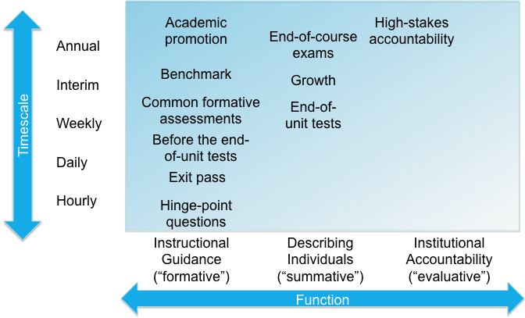
Mapping out the terrain

Slide 13
Practical techniques for classroom formative assessment

Slide 14
Clarifying, sharing and understanding learning intentions

Slide 15
Sharing learning intentions
3 teachers each teaching 4 7th grade science classes in two US schools
14 week experiment
7 two-week projects, each scored 2-10
All teaching the same, except:
For a part of each week
Two of each teacher’s classes discusses their likes and dislikes about the teaching (control)
The other two classes discusses how their work will be assessed
[White & Frederiksen, Cognition & Instruction, 16(1), 1998].

Slide 16
Sharing learning intentions
 | Comprehensive Test of Basic Skills
Group | Low | Middle | High
Likes and dislikes
Reflective assessment

Slide 17
Sharing learning intentions
 | Comprehensive Test of Basic Skills
Group | Low | Middle | High
Likes and dislikes | 4.6 | 5.9 | 6.6
Reflective assessment

Slide 18
Sharing learning intentions
 | Comprehensive Test of Basic Skills
Group | Low | Middle | High
Likes and dislikes | 4.6 | 5.9 | 6.6
Reflective assessment | 6.7 | 7.2 | 7.4

Slide 19
Share Learning Intentions
Explain learning intentions at start of lesson/unit:
Consider providing learning intentions and success criteria in students’ language.
Use posters of key words to talk about learning:
E.g., describe, explain, evaluate
Use planning and writing frames judiciously.
Use annotated examples of different standards to “flesh out” assessment rubrics (e.g., lab reports).
Provide opportunities for students to design their own tests.

Slide 20
Engineering effective discussion, tasks and classroom activities that elicit evidence of learning

Slide 21
Common errors in questioning
Asking:
too many questions at once
a question and answering it yourself
questions only of the brightest or most likeable
a difficult question too early
irrelevant questions
questions in a threatening way
the same kind of questions all the time
Failing to:
correct wrong answers
indicate a change in the type of question
give students the time to think
pay attention to answers
see the implications of answers
to build on answers
Brown, G., & Wragg, E. C. (1993). Questioning. London, UK: Routledge.

Slide 22
Elicit evidence of learning
Key idea: questioning should:
Cause thinking
Provide data that inform teaching
Improve your questioning:
Generate questions with colleagues.
Think high-order vs. low-order, not closed vs. open.
Give students appropriate wait time.
Get away from I-R-E (initiation-response-evaluation):
“No hands up” (except to ask a question)
Use all-student response systems regularly:
ABCD cards, mini whiteboards, exit passes

Slide 23
Providing feedback that moves learners forward

Slide 24
Effects of feedback
Kluger & DeNisi (1996) review of 3000 research reports
Excluding those:
without adequate controls
with poor design
with fewer than 10 participants
where performance was not measured
without details of effect sizes
left 131 reports, 607 effect sizes, involving 12652 individuals
On average, feedback increases achievement
Effect sizes highly variable
38% (50 out of 131) of effect sizes were negative

Slide 25
Provide feedback that moves learning on
Key idea: feedback should:
Cause thinking
Provide guidance on how to improve
Comment-only grading
Focused grading
Explicit reference to rubrics
Suggestions on how to improve:
Not giving complete solutions
Re-timing assessment:
E.g., three-fourths-of-the-way-through-a-unit test

Slide 26
Activating students as learning resources for one another

Slide 27
Benefits of structured interaction
15-yr-olds studying World History were tested on their understanding of material delivered in lectures
Half the students were trained to pose questions as they listened to the lectures
At the end of the lectures, students were given time to review their understanding of the material
 | Individual | Group
Unstructured | Independent review | Group discussion
Structured | Structured self-questioning | Structured peer-questioning

Slide 28
Impact on achievement
King, A. (1991). Applied Cognitive Psychology, 5(4), 331-346.

Slide 29
Help students be learning resources
Students assessing their peers’ work:
“Pre-flight checklist”
“Two stars and a wish”
Training students to pose questions/identifying group weaknesses
End-of-lesson students’ review

Slide 30
Activating students as owners of their own learning

Slide 31
Self-assessment: Portugal
45 teachers studying for a Masters degree in Education, matched in age, qualifications and experience using the same curriculum scheme for the same amount of time
Control group (N=20) follow regular MA program | Experimental group (N=25) develop self-assessment with their students
117 students aged 8 years | 125 students aged 8 years
119 students aged 9 years | 121 students aged 9 years
77 students aged 10 - 14 years | 108 students aged 10 - 14 years
[Fontana & Fernandes, Br. J. Educ. Psychol. 64: 407-417]

Slide 32
Details of the intervention
Weeks | Intervention
1 to 2 | Individual choice from a range of work provided by the teacher. Student self-assessment using materials provided
3 to 6 | Children construct own problems like those in weeks 1 and 2 and select structured math apparatus to aid solutions
7 to 10 | Children presented with a new learning objectives, and make up their own problems, without exemplars by the teacher
11 to 14 | Children set their own learning objectives, construct appropriate problems, and use appropriate self-assessment
15 to 20 | As weeks 1 to 14, but with less monitoring from the teacher and increased freedom of choice and personal responsibility

Slide 33
Impact on student achievement
 | Pre-test | Post-test | Gain | Effect size
Control | 65.1 | 72.9 | 7.8 | 0.34
Experimental | 58.7 | 73.7 | 15.0 | 0.66

Slide 34
Help students own their learning
Students assessing their own work:
With rubrics
With exemplars
Self-assessment of understanding:
Traffic lights
Red/green discs
Colored cups

