Slide 1
How to prepare students for a world we cannot possibly imagine
Salzburg Global Seminar, December 2011
Dylan Wiliam
www.dylanwiliam.net

Slide 2
Impact of education on economic growth
Net present value of a 25-point increase on PISA
Country | NPV
United States | $40,647 billion
Mexico | $4,000 billion
Turkey | $3,500 billion
Hanushek and Wößman (2010)

Slide 3
Non-economic benefits of education
More educated students
live longer
are healthier
have less disability towards the end of their lives
are less likely to be teenage parents
are less likely to be incarcerated
are less likely to commit suicide
Centre for Research on the Wider Benefits of Education (www.learningbenefits.net)

Slide 4
The world of work is changing
Skill category | Percentage change 1969-1999
Complex communication | +14%
Expert thinking/problem solving | +8%
Routine manual | –3%
Non-routine manual | –5%
Routine cognitive | –8%
Autor, Levy & Murnane (2003)

Slide 5
How flat is the world?
Percentage crossing national boundaries:
1%
5%
10%
20%
50%
Physical mail:
Telephone minutes:
Internet traffic:
First generation immigrants:
University students:
People, ever in their lives
Goods and services:

Slide 6
Mostly round; some flat bits (Ghemawat, 2011)
Percentage crossing national boundaries
Physical mail: 1
Telephone minutes: 2
Internet traffic: 17
First generation immigrants: 3
University students: 2
People, ever in their lives: 10
Goods and services: 10

Slide 7
There is only one 21st century skill
So the model that says learn while you’re at school, while you’re young, the skills that you will apply during your lifetime is no longer tenable. The skills that you can learn when you’re at school will not be applicable. They will be obsolete by the time you get into the workplace and need them, except for one skill. The one really competitive skill is the skill of being able to learn. It is the skill of being able not to give the right answer to questions about what you were taught in school, but to make the right response to situations that are outside the scope of what you were taught in school. We need to produce people who know how to act when they’re faced with situations for which they were not specifically prepared. (Papert, 1998)

Slide 8
Some basic precepts
We are in uncharted territory
The developing world will not follow the same paths to prosperity as those taken by rich countries
Education will be increasingly important in all countries
In terms of intervention, it’s never too early and it’s never too late…

Slide 9
Meaningful differences
Hour-long samples of family talk in 42 US families
Number of words spoken to children by adults by the age of 36 months
In professional families: 35 million
In other working-class families: 20 million
In families on welfare: 10 million
Kinds of reinforcements:
positive negative
professional 500,000 50,000
working-class 200,000 100,000
welfare 100,000 200,000
Hart & Risley (1995)
Notes:
Analysis of transcripts of hour-long samples of family talk in 42 American families suggests that by the age of 36 months, approximately 10 million words were uttered to children in families on welfare, 20 million to children in other working-class families, and 35 million to children in professional families. By the same age, children in professional, working-class and welfare families will have received 500,000, 200,000 and 100,000 encouraging remarks or positive reinforcements respectively, while the number of negative reinforcements and discouragements were 50,000, 100,000 and 200,000 respectively.

Slide 10
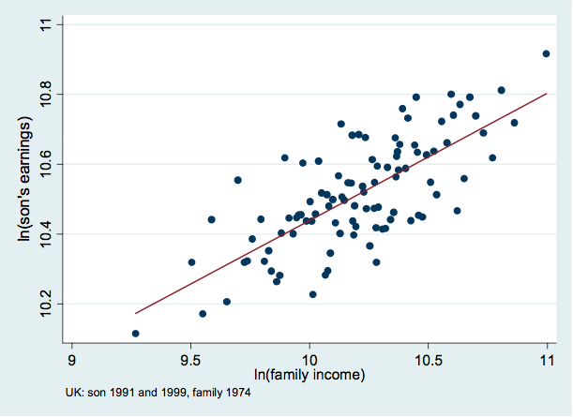
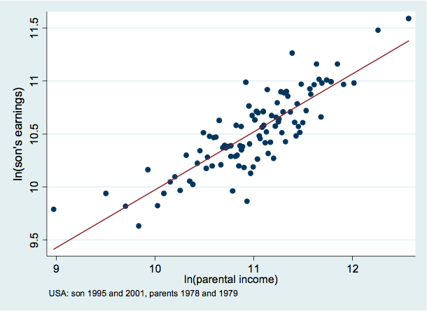
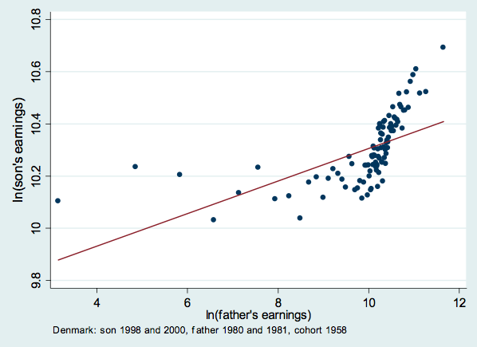
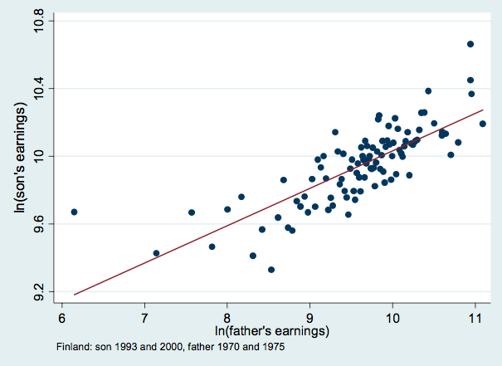

Slide 11
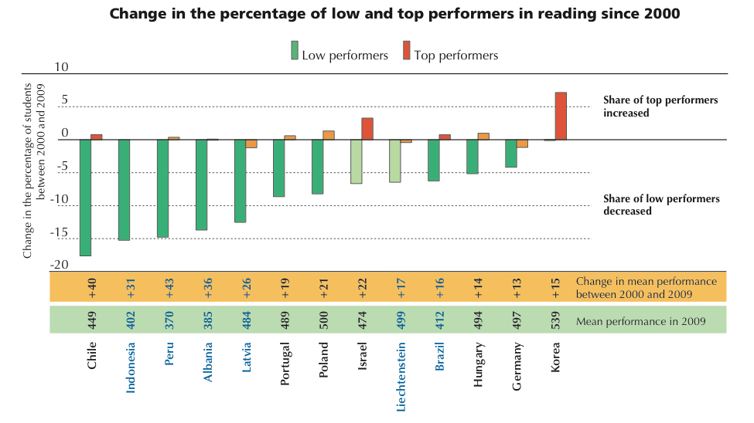
Improving usually starts at the bottom…
PISA 2009 Database, tables V.2.1 and V.2.2

Slide 12
In place of achievement gaps
An alternative aspiration:
All students reaching proficiency
Many students excellent
All sub-groups of students properly represented in the excellent

Slide 13
Curriculum
A selection from culture (Lawton, 1970)
Broad views on curriculum (Williams, 1961)
Transmission of culture (e.g., Arnold)
Preparation for work (e.g., OECD)
Preparation for effective citizenship (e.g., Freire)
Preparation for life
Any school curriculum is a sometimes messy and always political compromise between these forces

Slide 14
What kinds of schools do we need?
School model | Ethos | Key process
Talent refineries | School must provide opportunities for students to show what they can do | Ensuring good teaching and syllabus coverage
Talent incubators | All students students can learn, but not all students can achieve at high levels | Drawing out what is within the student
Talent factories | All students can achieve at high levels | Whatever it takes

Slide 15
The importance of teacher quality
Take a group of 50 teachers:
Students taught by the most effective teacher in that group of 50 teachers learn in six months what those taught by the average teacher learn in a year.
Students taught by the least effective teacher in that group of 50 teachers will take two years to achieve the same learning
(Hanushek & Rivkin, 2006)
And furthermore:
In the classrooms of the most effective teachers, students from disadvantaged backgrounds learn at the same rate as those from advantaged backgrounds
(Hamre & Pianta, 2005).

Slide 16
The ‘dark matter’ of teacher quality
We know that teachers make a difference
But what makes the difference in teachers?
Components of teacher quality | %
What teachers know | 10-30%
What teachers do | 10-15%
Total (given overlaps) | 30-40%

Slide 17
Replace existing teachers with better ones?
Raising the bar for entry into the profession?
Exclude the lowest performing 30% from getting in
5 points on PISA (in 30 years time)
Firing ineffective teachers?
De-selecting least effective 10% and replace them with average teachers
2 points on PISA (right away, if it can be done)

Slide 18
How do we speed up teacher improvement?
Merit pay for effective teachers?
Can’t be done fairly, and doesn’t work
Create a culture of continuous improvement
Responsibilities of teachers
To continue to improve classroom skill for the whole career
To focus the improvement on ideas supported by evidence
Responsibilities of leaders
Create the expectation for continuous improvement
Keep the focus on what is likely to improve achievement
Provide support
Encourage risk taking

