Slide 1
Stopping people doing good things: The essence of effective leadership
Dylan Wiliam
www.dylanwiliam.net
Notes:
Outline: It is increasingly important that our schools prepare young people for the world of work, not least because this is where things are changing fastest. For every job in the USA, there are 10 people in the world who want one. Some skills will always be needed locally, but as many as half of the jobs in the US economy may be capable of being offshored or automated over the working lives of our current students. New jobs will, of course,
be created to replace the jobs that are disappearing. but they will require higher levels of educational achievement than those being lost. The key to the U.S.'s future economic prosperity is increasing student achievement, which requires increasing teacher quality. What matters is that our educators have a passion for their students' learning and make a lifelong commitment to improving their practice. Given these criteria, there appears to be no limit to what U.S. educators can achieve.

Slide 2
How do we improve teacher quality?
A classic labour force issue with two (non-exclusive) solutions:
Replace existing teachers with better ones.
Help existing teachers become even more effective.

Slide 3
Here’s what we know about teaching
We don’t know who will be good teachers
We can’t tell good teaching:
when we see it
by looking at “value-added” test scores

Slide 4
The ‘dark matter’ of teacher quality
 | Mathematics |  |  | Reading
 | Primary | Middle | High | Primary | Middle | High
General theory of education courses
Teaching practice courses
Pedagogical content courses
Advanced university courses
Aptitude test scores
 | Mathematics |  |  | Reading
 | Primary | Middle | High | Primary | Middle | High
General theory of education courses |  |  |  |  | —
Teaching practice courses |  |  |  | — | +
Pedagogical content courses | + | +
Advanced university courses |  |  | — |  |  | +
Aptitude test scores |  |  | —
Harris and Sass (2007)

Slide 5
Observations and teacher quality
So, the highest rated teachers are 30% more productive than the lowest rated
But the best teachers are 400% more productive than the least effective
Sartain, Stoelinga, Brown, Luppescu, Matsko, Miller, Durwood, Jiang, and Glazer (2011)

Slide 6
So what’s to be done?

Slide 7
Expertise
Grandmaster chess players don’t have higher IQs than average chess players
Top surgeons don’t have higher IQs, medical school grades, or higher manual dexterity than average surgeons
In general, measures of general ability account for 4% of the variability in performance

Slide 8
The role of deliberate practice
Music professors at the Hochschule der Kuenst (Academy of Music) Berlin identified 10 violin students who had the potential for careers as international soloists (“best” students)
The professors also identified a sample of 10 good, but not outstanding students (“good” students)
Researchers recruited another 10 students training to be music teachers who specialised in the violin (“Music Ed” students)
An additional 10 middle-aged professional violinists from two local orchestras were recruited to the study
Groups were matched in sex (7f, 3m) and for the first three groups, age

Slide 9
How much do violinists practice?
Ericsson, Krampe, and Tesch-Römer (1993)

Slide 10
Violinists’ hours of practice (cumulative)

Slide 11
These differences are substantial…
 | Hours of practice by age 18
Music Education students | 3420
Good violin students | 5301
Best violin students | 7410
Professional musicians | 7336
By the age of 18, the best violinists have accumulated 40% more practice than good violinists
Since the amount of deliberate practice being undertaken by the best students once they are adults is close to the maximum possible, it is, essentially, impossible for the good students to catch up to the best.

Slide 12
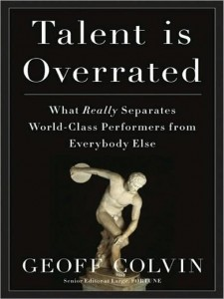
Talent is over-rated…

Slide 13
General conclusions about expertise
Elite performance is the result of at least a decade of maximal efforts to improve performance through an optimal distribution of deliberate practice
What distinguishes experts from others is the commitment to deliberate practice
Deliberate practice is
an effortful activity that can be sustained only for a limited time each day
neither motivating nor enjoyable—it is instrumental in achieving further improvement in performance

Slide 14
Effects of experience in teaching
Mathematics
Reading
Rivkin, Hanushek and Kain (2005)

Slide 15
Implications for education systems
Pursuing a strategy of getting the “best and brightest” into teaching is unlikely to succeed
Currently all teachers slow, and most actually stop, improving after two or three years in the classroom
Expertise research therefore suggests that they are only beginning to scratch the surface of what they are capable of
What we need is to persuade those with a real passion for working with young people to become teachers, and to continue to improve as long as they stay in the job.

Slide 16
So what should teachers improve?

Slide 17
Formative assessment…
Fuchs & Fuchs (1986)
Natriello (1987)
Crooks (1988)
Bangert-Drowns et al. (1991)
Kluger & DeNisi (1996)
Black & Wiliam (1998)
Nyquist (2003)
Dempster (1991, 1992)
Elshout-Mohr (1994)
Brookhart (2004)
Allal & Lopez (2005)
Köller (2005)
Brookhart (2007)
Wiliam (2007)
Hattie & Timperley (2007)
Shute (2008)

Slide 18
Unpacking classroom formative assessment
Where the learner is going
Where the learner is
How to get there
Engineering effective discussions, tasks, and activities that elicit evidence of learning
Providing feedback that moves learners forward
Teacher
Clarifying, sharing and understanding learning intentions
Peer
Activating students as learning
resources for one another
Learner
Activating students as owners of their own learning

Slide 19
So much for the easy bit

Slide 20
A model for teacher learning
Content, then process
Content (what we want teachers to change):
Evidence
Ideas (strategies and techniques)
Process (how to go about change):
Choice
Flexibility
Small steps
Accountability
Support
Science
Design

Slide 21
Choice

Slide 22
A strengths-based approach to change
Belbin inventory (Management teams: Why they succeed or fail):
Eight team roles (defined as “a tendency to behave, contribute and interrelate with others in a particular way”):
Company worker; innovator; shaper; chairperson; resource investigator; monitor/evaluator; completer/finisher; team worker
Key ideas:
People rarely sustain “out-of-role” behaviour, especially under stress
Each role has strengths and allowable weaknesses
Each teacher’s personal approach to teaching is similar:
Some teachers’ weaknesses require immediate attention
For most, however, students benefit more from the development of teachers’ strengths

Slide 23
Flexibility

Slide 24
Strategies vs. techniques
Distinguish between strategies and techniques:
Strategies define the territory of formative assessment (no-brainers)
Teachers are responsible for choice of techniques:
Allows for customization; caters for local context
Creates ownership; shares responsibility
Key requirements of techniques:
They embody the deep cognitive and affective principles that research shows are important
They are seen as relevant, feasible and acceptable

Slide 25
Small steps

Slide 26
Why is teacher change so slow?
Because of the nature of teacher expertise
According to Berliner (1994), experts:
excel mainly in their own domain
develop automaticity for operations needed for their goals
are more sensitive to the task demands and social situations
are more opportunistic and flexible than novices
represent problems in qualitatively different ways than novices
have faster and more accurate pattern recognition capabilities
see richer patterns in the areas of their expertise
begin to solve problems slower but bring richer and more personal sources of information to bear

Slide 27
Knowing more than we can say
Six video extracts of a person delivering cardiopulmonary resuscitation (CPR):
Five of the video extracts feature students
One of the video extracts feature an expert
Videos shown to three groups:
students, experts, instructors
Success rate in identifying the expert:
Experts 90%
Students 50%
Instructors 30%
Klein & Klein (1981)

Slide 28
Looking at the wrong knowledge
The most powerful teacher knowledge is not explicit:
That’s why telling teachers what to do doesn’t work
What we know is more than we can say
And that is why most professional development has been relatively ineffective
Improving practice involves changing habits, not adding knowledge:
That’s why it’s hard
And the hardest bit is not getting new ideas into people’s heads
It’s getting the old ones out
That’s why it takes time
But it doesn’t happen naturally:
If it did, the most experienced teachers would be the most productive, and that’s not true (Hanushek & Rivkin, 2006)

Slide 29
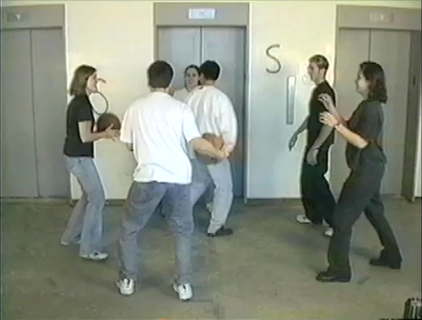

Slide 31
Most of what we do is unconscious
Sensory system | Total bandwidth (in bits/second) | Conscious bandwidth (in bits/second)
Eyes | 10,000,000 | 40
Ears | 100,000 | 30
Skin | 1,000,000 | 5
Taste | 1,000 | 1
Smell | 100,000 | 1
Nørretranders, 1998

Slide 32
Hand hygiene in hospitals
Study | Focus | Compliance rate
Preston, Larson, & Stamm (1981) | Open ward | 16%
 | ICU | 30%
Albert & Condie (1981) | ICU | 28% to 41%
Larson (1983) | All wards | 45%
Donowitz (1987) | Pediatric ICU | 30%
Graham (1990) | ICU | 32%
Dubbert (1990) | ICU | 81%
Pettinger & Nettleman (1991) | Surgical ICU | 51%
Larson, et al. (1992) | Neonatal ICU | 29%
Doebbeling, et al. (1992) | ICU | 40%
Zimakoff, et al. (1992) | ICU | 40%
Meengs, et al. (1994) | ER (Casualty) | 32%
Pittet, Mourouga, & Perneger (1999) | All wards | 48%
 | ICU | 36%
Pittet, 2001

Slide 33
Accountability

Slide 34
Making a commitment
Action planning:
Forces teachers to make their ideas concrete and creates a record
Makes the teachers accountable for doing what they promised
Requires each teacher to focus on a small number of changes
Requires the teachers to identify what they will give up or reduce
A good action plan:
Does not try to change everything at once
Spells out specific changes in teaching practice
Relates to the five “key strategies” of AFL
Is achievable within a reasonable period of time
Identifies something that the teacher will no longer do or will do less of

Slide 35
And being held to it
“I think specifically what was helpful was the ridiculous NCR [No Carbon Required] forms. I thought that was the dumbest thing, but I’m sitting with my friends and on the NCR form I write down what I am going to do next month.
“Well, it turns out to be a sort of ‘I’m telling my friends I’m going to do this’ and I really actually did it and it was because of that. It was because I wrote it down.
“I was surprised at how strong an incentive that was to do actually do something different…that idea of writing down what you are going to do and then because when they come by the next month you better take out that piece of paper and say ‘Did I do that?’…just the idea of sitting in a group, working out something, and making a commitment…I was impressed about how that actually made me do stuff.”
—Tim, Spruce Central High School

Slide 36
Support

Slide 37
Supportive accountability
What is needed from teachers:
A commitment to:
The continual improvement of practice
Focus on those things that make a difference to students
What is needed from leaders:
A commitment to engineer effective learning environments for teachers by:
Creating expectations for continually improving practice
Keeping the focus on the things that make a difference to students
Providing the time, space, dispensation, and support for innovation
Supporting risk-taking

Slide 38
Teacher learning communities

Slide 39
We need to create time and space for teachers to reflect on their practice in a structured way, and to learn from mistakes.
Bransford, Brown & Cocking (1999)
“Always make new mistakes.”
Esther Dyson
“Ever tried. Ever failed. No matter. Try again. Fail again. Fail better.”
Beckett (1984)

Slide 40
Teacher learning communities
Plan that the TLC will run for two years
Identify 10 to 12 interested colleagues:
Conscripts vs. volunteers
Composition:
Similar assignments (e.g., early years, math/science)
Mixed subject/mixed phase
Hybrid
Secure institutional support for:
Monthly workshops (75–120 minutes each, inside or outside school time)
Time between workshops (two hours per month in school time) for collaborative planning and peer observation
Any necessary waivers from school policies

Slide 41
A “signature pedagogy” for teacher learning
Every monthly TLC workshop should follow the same structure and sequence of activities:
Activity 1: Introduction (5 minutes)
Activity 2: Starter activity (5 minutes)
Activity 3: Feedback (25–50 minutes)
Activity 4: New learning about formative assessment (20–40 minutes)
Activity 5: Personal action planning (15 minutes)
Activity 6: Review of learning (5 minutes)

Slide 42
Activities 1, 2, 3, 5, 6: “Bookends”
For each of these five activities, the process is exactly the same at each TLC meeting
This provides a familiar structure for teachers to get better together
As the structure fades into the background,
The learning comes into the foreground
Teachers come to the meeting knowing what is expected of them

Slide 43
Ground-rules for TLCs
Norms of collaboration (Garmston & Wellman, 1999)
Seven powerful Ps
Pausing
Paraphrasing
Probing
Putting ideas on the table (and pulling them off!)
Paying attention to self and others
Presuming positive intentions
Pursuing a balance between advocacy and inquiry

Slide 44
Activity 1: Introduction
Sharing learning intentions for the meeting

Slide 45
Activity 2: Starter
A variety of warm-up activities to get participants’ minds to the meeting:
Think of something you are looking forward to this year
30-seconds to get “things off your chest” about what infuriates you about your job
30 seconds to tell the group about something that happened within the last month and made you feel good
Think of something that happened in a lesson this year that made you smile
Think of something that one of your colleagues did last term that supported you
Go back to the TLC ‘ground rules’

Slide 46
Activity 3: Feedback
Routines need to be established, expectations shared, and structure maintained.
Similar expectations regarding preparation and engagement.
Come to the meeting knowing you will be sharing your own AfL experiences.
Be prepared to offer constructive, thoughtfully conceived feedback to colleagues.
Be prepared to challenge ideas that may be good classroom practice but are not necessarily tightly related to formative assessment.

Slide 47
Activity 4: New learning about AfL
Drip-feed’ of new ideas, to increase knowledge, and to produce variety
Watch videos of classroom practice
Book study (one chapter each month)
New AfL techniques

Slide 48
Activity 5: Personal action planning
Each teacher updates his or her personal action plan
Makes a specific commitment about what they will do over the coming month
Arranges any support needed from colleagues
Specific date and time for peer observation

Slide 49
Activity 6: Wrap
Did the meeting meet its intended objectives
If yes, great
If no, time to plan what to do about it

Slide 50
Every TLC needs a leader
The job of the TLC leader(s):
To ensure that all necessary resources (including refreshments!) are available at workshops
To ensure that the agenda is followed
To maintain a collegial and supportive environment
But most important of all:
It is not to be the formative assessment “expert”

Slide 51
Peer observation
Run to the agenda of the observed, not the observer:
Observed teacher specifies focus of observation:
e.g., teacher wants to increase wait time
Observed teacher specifies what counts as evidence:
Provides observer with a stopwatch to log wait times
Observed teacher owns any notes made during the observation

Slide 52
Summary
Raising achievement is important
Raising achievement requires improving teacher quality
Improving teacher quality requires teacher professional development
To be effective, teacher professional development must address:
What teachers do in the classroom
How teachers change what they do in the classroom
Classroom formative assessment + teacher learning communities:
A point of (uniquely?) high leverage

Slide 53
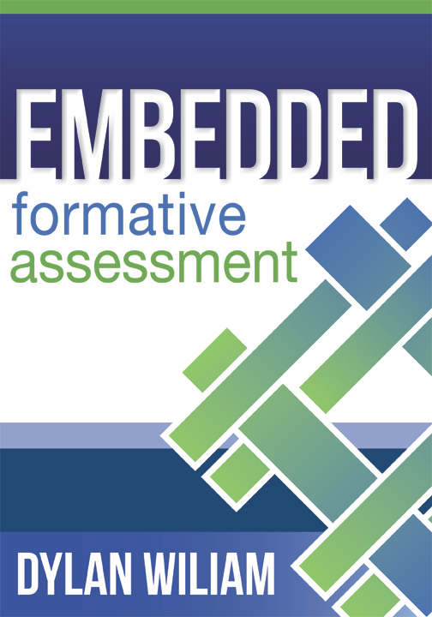
To find out more…
www.dylanwiliam.net

Slide 54
Thank you

