Slide 1
Assessment: the bridge between teaching and learning
Dylan Wiliam
www.dylanwiliam.net
Notes:
In this interactive breakout session, Dylan Wiliam will explain why effective assessment is at the heart of effective learning. It is only through assessment that we can find out whether the educational activities in which learners have engaged do, indeed, result in the intended learning. However, assessment that is designed to support learning needs to be designed very differently from assessment that is intended simply to measure performance. Participants will learn about the five key strategies of formative assessment, and will also find out how to support educators in developing their assessment practices with teacher learning communities.

Slide 2
Effective learning environments
A prevalent, mistaken, view
Teachers create learning
The teacher’s job is to do the learning for the learner
A not so prevalent, not quite so mistaken, but equally dangerous view
Only learners can create learning
The teacher’s job is to “facilitate” learning
A difficult to negotiate, middle path
Teaching as the engineering of effective learning environments
Key features:
Create student engagement (pedagogies of engagement)
Well-regulated (pedagogies of contingency)
Develop disciplinary habits of mind (pedagogies of formation)

Slide 3
The formative assessment hijack
Long-cycle:
Span: across units, terms
Length: four weeks to one year
Impact: student monitoring; curriculum alignment
Medium-cycle:
Span: within and between teaching units
Length: one to four weeks
Impact: improved, student-involved assessment; teacher cognition about learning
Short-cycle:
Span: within and between lessons
Length:
day-by-day: 24 to 48 hours
minute-by-minute: five seconds to two hours
Impact: classroom practice; student engagement

Slide 4
Unpacking formative assessment
Where the learner is going
Where the learner is
How to get there
Engineering effective discussions, tasks, and activities that elicit evidence of learning
Providing feedback that moves learners forward
Teacher
Clarifying, sharing and understanding learning intentions
Peer
Activating students as learning
resources for one another
Learner
Activating students as owners of their own learning

Slide 5
And one big idea
Where the learner is going
Where the learner is
How to get there
Teacher
Using evidence of achievement to adapt what happens in classrooms to meet learner needs
Peer
Learner

Slide 6
An educational positioning system
A good teacher:
Establishes where the students are in their learning
Identifies the learning destination
Carefully plans a route
Begins the learning journey
Makes regular checks on progress on the way
Makes adjustments to the course as conditions dictate

Slide 7
Strategies and practical techniques for classroom formative assessment

Slide 8
Clarifying, sharing and understanding learning intentions

Slide 9
Sharing learning intentions
Explain learning intentions at start of lesson/unit:
Learning intentions
Success criteria
Consider providing learning intentions and success criteria in students’ language.
Use posters of key words to talk about learning:
e.g., describe, explain, evaluate
Use planning and writing frames, judiciously
Use annotated examples of different levels to “flesh out” mark schemes (e.g., lab reports)
Provide opportunities for students to design their own tests

Slide 10
Engineering effective discussions, activities and classroom tasks that elicit evidence of learning

Slide 11
Finding out where learners are…
Key idea: questioning should
cause thinking
provide data that informs teaching
Improving teacher questioning
generating questions with colleagues
closed v open
low-order v high-order
appropriate wait-time
Getting away from I-R-E
basketball rather than serial table-tennis
‘no hands up’ (except to ask a question)
‘hot seat’ questioning
All-student response systems
class poll, ABCD cards, mini white-boards, exit passes

Slide 13
Questioning in English: Diagnosis (3)
Identify the adverbs in these sentences:
The boy ran across the street quickly. (A) (B) (C) (D) (E)
Jayne usually crossed the street in a leisurely fashion. (A) (B) (C) (D) (E)
Fred ran the race well but unsuccessfully. (A) (B) (C) (D) (E)

Slide 14
Real-time test: Figurative language
Alliteration
Hyperbole
Onomatopoeia
Personification
Simile
He was like a bull in a china shop.
This backpack weighs a ton.
The sweetly smiling sunshine…
He honked his horn at the cyclist.
He was as tall as a house.

Slide 15
Providing feedback that moves learners forward

Slide 16
Kinds of feedback: Israel
264 low and high ability grade 6 students in 12 classes in 4 schools; analysis of 132 students at top and bottom of each class
Same teaching, same aims, same teachers, same classwork
Three kinds of feedback: scores, comments, scores+comments
 | Achievement | Attitude
Scores | no gain | High scorers : positive Low scorers: negative
Comments | 30% gain | High scorers : positive Low scorers : positive
Butler (1988)

Slide 17
Responses
17
 | Achievement | Attitude
Scores | no gain | High scorers : positive Low scorers: negative
Comments | 30% gain | High scorers : positive Low scorers : positive
What do you think happened for the students given both scores and comments?
Gain: 30%; Attitude: all positive
Gain: 30%; Attitude: high scorers positive, low scorers negative
Gain: 0%; Attitude: all positive
Gain: 0%; Attitude: high scorers positive, low scorers negative
Something else

Slide 18
Kinds of feedback: Israel (2)
200 grade 5 and 6 Israeli students
Divergent thinking tasks
4 matched groups
experimental group 1 (EG1); comments
experimental group 2 (EG2); grades
experimental group 3 (EG3); praise
control group (CG); no feedback
Achievement
EG1>(EG2≈EG3≈CG)
Ego-involvement
(EG2≈EG3)>(EG1≈CG)
Butler (1987)

Slide 19
Effects of feedback
Kluger and DeNisi (1996) review of 3000 research reports
Excluding those:
without adequate controls
with poor design
with fewer than 10 participants
where performance was not measured
without details of effect sizes
left 131 reports, 607 effect sizes, involving 12652 individuals
On average, feedback increases achievement
Effect sizes highly variable
38% (50 out of 131) of effect sizes were negative

Slide 20
Getting feedback right is hard
Response type | Feedback indicates performance…
 | falls short of goal | exceeds goal
Change behavior | Increase effort | Exert less effort
Change goal | Reduce aspiration | Increase aspiration
Abandon goal | Decide goal is too hard | Decide goal is too easy
Reject feedback | Feedback is ignored | Feedback is ignored

Slide 21
Providing feedback that moves learning on
Key idea: feedback should:
Cause thinking
Provide guidance on how to improve
Comment-only marking
Focused marking
Explicit reference to mark schemes/scoring guides
Suggestions on how to improve:
Not giving complete solutions
Re-timing assessment:
e.g., three-quarters-of-the-way-through-a-unit test

Slide 22
Activating students as learning resources for one another

Slide 23
Students as learning resources
Students assessing their peers’ work:
“Pre-flight checklist”
“Two stars and a wish”
“Choose-swap-choose”
“Daily sign-in”
Training students to pose questions/identifying group weaknesses
End-of-lesson students’ review

Slide 24
Activating students as owners of their own learning

Slide 25
Students owning their own learning
Students assessing their own work:
With mark schemes or scoring guides
With exemplars
Self-assessment of understanding:
Traffic lights
Red/green discs
Coloured cups
Learning portfolio
+/—/interesting

Slide 26
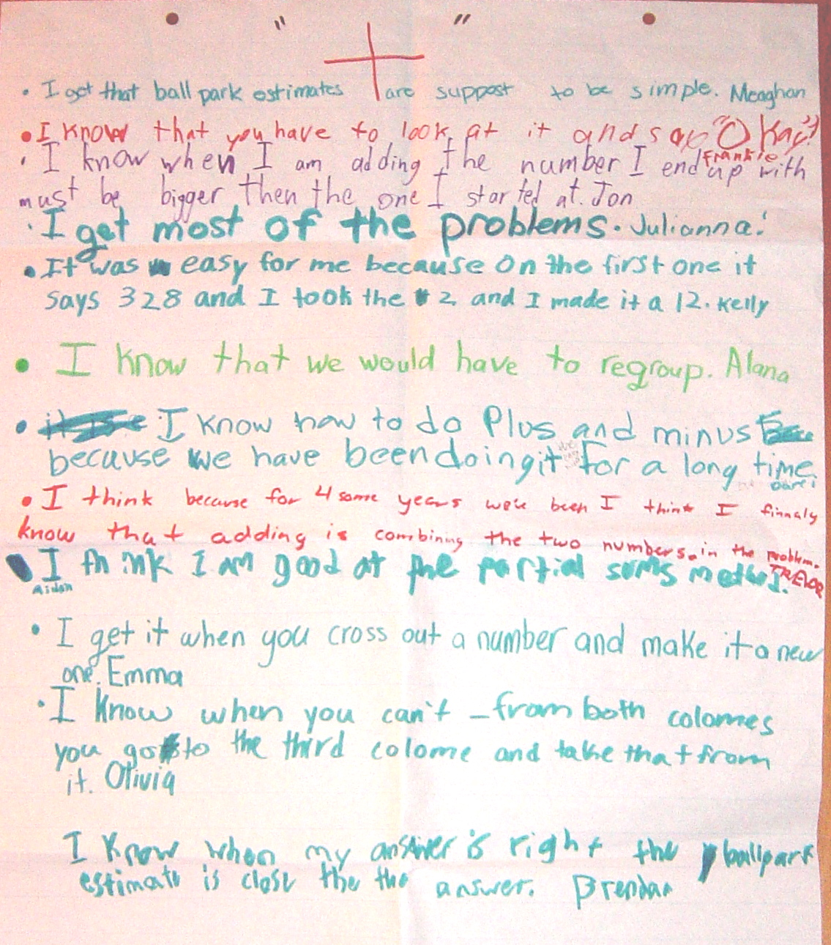

Slide 27
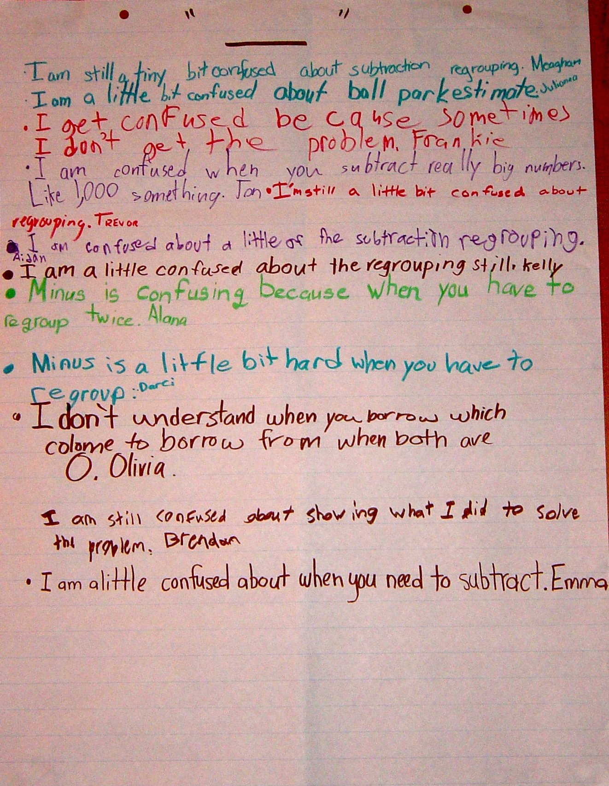

Slide 28
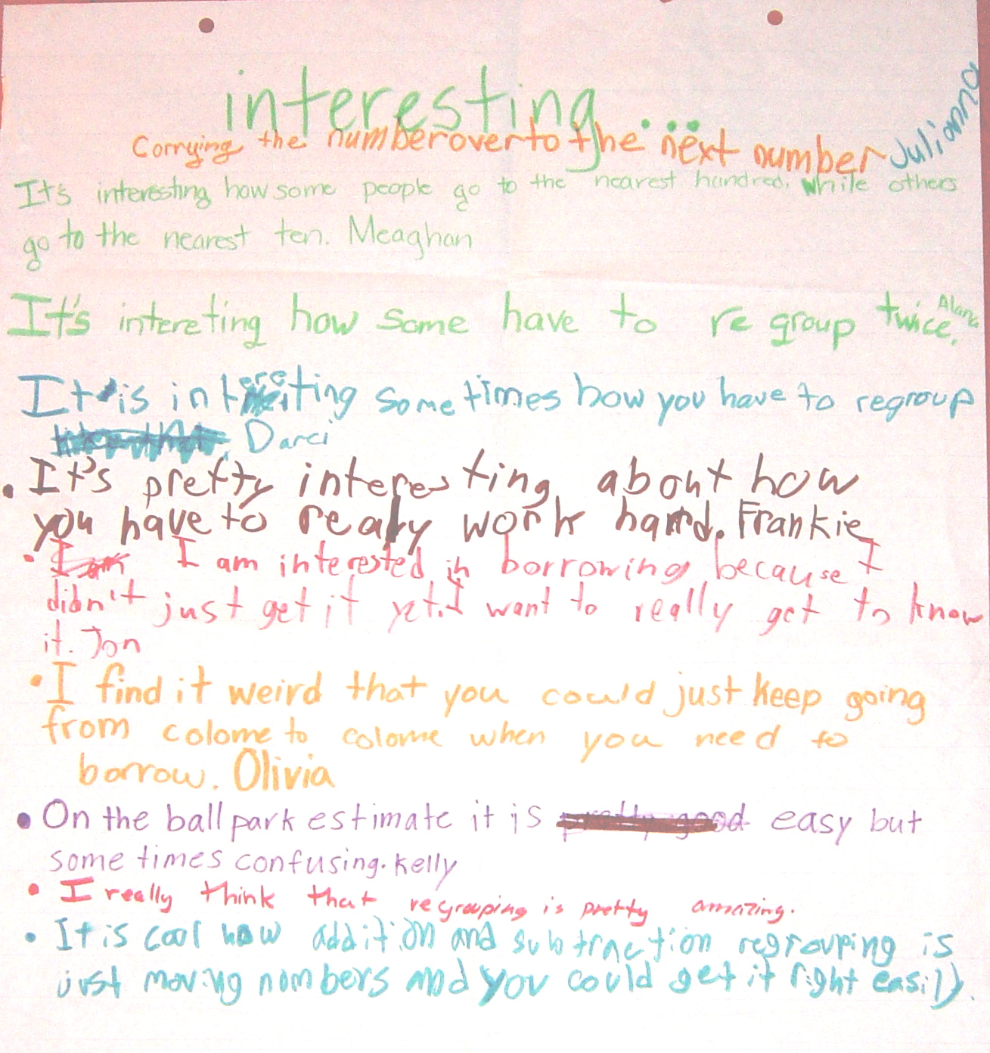

Slide 29
+/–/interesting: responses for “+”
I got that ball-park estimates are supposed to be simple
I know that you have to look at it and say “OK”
I know that when I am adding the number I end up with must be bigger than the one I started at
I get most of the problems
It was easy for me because on the first one it says 328 so I took the 2 and made it a 12
I know that we would have to regroup
I know how to do plus and minus because we have been doing it for a long time
I get it when you cross out a number and make it a new one
I know that when you can’t – from both colomes you go to the third colome and take that from it
I know that when my answer is right the ball park estimate is close to it

Slide 30
+/–/interesting: responses for “–”
I am still a tiny bit confused about subtraction regrouping
I am a little bit confused about ball park estimates
I get confused because sometimes I don’t get the problem
I am confused when you subtract really big numbers like 1,000 something
I’m still a little bit confused about regrouping
Minus is confusing when you have to regroup twice
Minus is a little bit hard when you have to regroup
I don’t understand when you borrow which colome you borrow from when both are 0
I am still confused about showing what I did to solve the problem
I am a little confused about when you need to subtract

Slide 31
+/–/interesting: responses for “interesting”
Carrying the number over to the next number
It’s interesting how some people go to the nearest hundred while some go to the nearest ten
It’s interesting how some have to regroup twice
It’s pretty interesting about how you have to work really hard
I am interested in borrowing because I didn’t just get it yet. I want to really get to know it
I find it weird that you could just keep going from colome to colome when you need to borrow
On the ball park estimate it is easy but sometimes hard
I really think that regrouping is pretty amazing
It is cool how addition and subtraction regrouping is just moving numbers and you could get it right easily

Slide 34
All ready for action…

Slide 35
Tell me about you…

Slide 36
IKEA mats…

Slide 37
Technique review

Slide 38
So much for the easy bit

Slide 39
A model for teacher learning
Content, then process
Content (what we want teachers to change):
Evidence
Ideas (strategies and techniques)
Process (how to go about change):
Choice
Flexibility
Small steps
Accountability
Support
Science
Design

Slide 40
Choice

Slide 41
A strengths-based approach to change
Belbin inventory (Management teams: Why they succeed or fail):
Eight team roles (defined as “a tendency to behave, contribute and interrelate with others in a particular way”):
Company worker; innovator; shaper; chairperson; resource investigator; monitor/evaluator; completer/finisher; team worker
Key ideas:
People rarely sustain “out-of-role” behaviour, especially under stress
Each role has strengths and allowable weaknesses
Each teacher’s personal approach to teaching is similar:
Some teachers’ weaknesses require immediate attention
For most, however, students benefit more from the development of teachers’ strengths

Slide 42
Flexibility

Slide 43
Strategies vs. techniques
Distinguish between strategies and techniques:
Strategies define the territory of formative assessment (no-brainers)
Teachers are responsible for choice of techniques:
Allows for customization; caters for local context
Creates ownership; shares responsibility
Key requirements of techniques:
They embody the deep cognitive and affective principles that research shows are important
They are seen as relevant, feasible and acceptable

Slide 44
Small steps

Slide 45
Why is teacher change so slow?
Because of the nature of teacher expertise
According to Berliner (1994), experts:
excel mainly in their own domain
develop automaticity for operations needed for their goals
are more sensitive to the task demands and social situations
are more opportunistic and flexible than novices
represent problems in qualitatively different ways than novices
have faster and more accurate pattern recognition capabilities
see richer patterns in the areas of their expertise
begin to solve problems slower but bring richer and more personal sources of information to bear

Slide 46
Knowing more than we can say
Six video extracts of a person delivering cardiopulmonary resuscitation (CPR):
Five of the video extracts feature students
One of the video extracts feature an expert
Videos shown to three groups:
students, experts, instructors
Success rate in identifying the expert:
Experts 90%
Students 50%
Instructors 30%
Klein & Klein (1981)

Slide 47
Looking at the wrong knowledge
The most powerful teacher knowledge is not explicit:
That’s why telling teachers what to do doesn’t work
What we know is more than we can say
And that is why most professional development has been relatively ineffective
Improving practice involves changing habits, not adding knowledge:
That’s why it’s hard
And the hardest bit is not getting new ideas into people’s heads
It’s getting the old ones out
That’s why it takes time
But it doesn’t happen naturally:
If it did, the most experienced teachers would be the most productive, and that’s not true (Hanushek & Rivkin, 2006)

Slide 50
Most of what we do is unconscious
Sensory system | Total bandwidth (in bits/second) | Conscious bandwidth (in bits/second)
Eyes | 10,000,000 | 40
Ears | 100,000 | 30
Skin | 1,000,000 | 5
Taste | 1,000 | 1
Smell | 100,000 | 1
Nørretranders, 1998

Slide 51
Hand hygiene in hospitals
Study | Focus | Compliance rate
Preston, Larson, & Stamm (1981) | Open ward | 16%
 | ICU | 30%
Albert & Condie (1981) | ICU | 28% to 41%
Larson (1983) | All wards | 45%
Donowitz (1987) | Pediatric ICU | 30%
Graham (1990) | ICU | 32%
Dubbert (1990) | ICU | 81%
Pettinger & Nettleman (1991) | Surgical ICU | 51%
Larson, et al. (1992) | Neonatal ICU | 29%
Doebbeling, et al. (1992) | ICU | 40%
Zimakoff, et al. (1992) | ICU | 40%
Meengs, et al. (1994) | ER (Casualty) | 32%
Pittet, Mourouga, & Perneger (1999) | All wards | 48%
 | ICU | 36%
Pittet, 2001

Slide 52
Accountability

Slide 53
Making a commitment
Action planning:
Forces teachers to make their ideas concrete and creates a record
Makes the teachers accountable for doing what they promised
Requires each teacher to focus on a small number of changes
Requires the teachers to identify what they will give up or reduce
A good action plan:
Does not try to change everything at once
Spells out specific changes in teaching practice
Relates to the five “key strategies” of AFL
Is achievable within a reasonable period of time
Identifies something that the teacher will no longer do or will do less of

Slide 54
And being held to it
“I think specifically what was helpful was the ridiculous NCR [No Carbon Required] forms. I thought that was the dumbest thing, but I’m sitting with my friends and on the NCR form I write down what I am going to do next month.
“Well, it turns out to be a sort of ‘I’m telling my friends I’m going to do this’ and I really actually did it and it was because of that. It was because I wrote it down.
“I was surprised at how strong an incentive that was to do actually do something different…that idea of writing down what you are going to do and then because when they come by the next month you better take out that piece of paper and say ‘Did I do that?’…just the idea of sitting in a group, working out something, and making a commitment…I was impressed about how that actually made me do stuff.”
—Tim, Spruce Central High School

Slide 55
Support

Slide 56
Supportive accountability
What is needed from teachers:
A commitment to:
The continual improvement of practice
Focus on those things that make a difference to students
What is needed from leaders:
A commitment to engineer effective learning environments for teachers by:
Creating expectations for continually improving practice
Keeping the focus on the things that make a difference to students
Providing the time, space, dispensation, and support for innovation
Supporting risk-taking

Slide 57
Teacher learning communities

Slide 58
We need to create time and space for teachers to reflect on their practice in a structured way, and to learn from mistakes.
Bransford, Brown & Cocking (1999)
“Always make new mistakes.”
Esther Dyson
“Ever tried. Ever failed. No matter. Try again. Fail again. Fail better.”
Beckett (1984)

Slide 59
Teacher learning communities
Plan that the TLC will run for two years
Identify 10 to 12 interested colleagues:
Conscripts vs. volunteers
Composition:
Similar assignments (e.g., early years, math/science)
Mixed subject/mixed phase
Hybrid
Secure institutional support for:
Monthly workshops (75–120 minutes each, inside or outside school time)
Time between workshops (two hours per month in school time) for collaborative planning and peer observation
Any necessary waivers from school policies

Slide 60
A “signature pedagogy” for teacher learning
Every monthly TLC workshop should follow the same structure and sequence of activities:
Activity 1: Introduction (5 minutes)
Activity 2: Starter activity (5 minutes)
Activity 3: Feedback (25–50 minutes)
Activity 4: New learning about formative assessment (20–40 minutes)
Activity 5: Personal action planning (15 minutes)
Activity 6: Review of learning (5 minutes)

Slide 61
Every TLC needs a leader
The job of the TLC leader(s):
To ensure that all necessary resources (including refreshments!) are available at workshops
To ensure that the agenda is followed
To maintain a collegial and supportive environment
But most important of all:
It is not to be the formative assessment “expert”

Slide 62
Peer observation
Run to the agenda of the observed, not the observer:
Observed teacher specifies focus of observation:
e.g., teacher wants to increase wait time
Observed teacher specifies what counts as evidence:
Provides observer with a stopwatch to log wait times
Observed teacher owns any notes made during the observation

Slide 63
Summary
Raising achievement is important
Raising achievement requires improving teacher quality
Improving teacher quality requires teacher professional development
To be effective, teacher professional development must address:
What teachers do in the classroom
How teachers change what they do in the classroom
Formative assessment + teacher learning communities:
A point of (uniquely?) high leverage

Slide 64
Force-field analysis (Lewin, 1954)
What are the forces that will support or drive the adoption of formative assessment practices in your school/authority?
What are the forces that will constrain or prevent the adoption of formative assessment practices in your school/authority?
+
—

Slide 65
To find out more…
www.dylanwiliam.net

Slide 66
Thank You
www.dylanwiliam.net

