Slide 1
Principled curriculum and assessment design:
Tools for schools
Dylan Wiliam
British Columbia School Superintendents Association Fall Conference
November 2013, Vancouver, BC.
21 Nov 2013
www.dylanwiliam.org @dylanwiliam

Slide 2
Outline
Curriculum
  What is curriculum?
  Seven principles for curriculum design
Assessment
  Assessment for accountability
  Quality in assessment

Slide 3
Why do we educate young people?
Broad views on the philosophy of education (Williams, 1961)
  Transmission of culture (e.g., Arnold)
  Preparation for work (e.g., OECD)
  Preparation for effective citizenship (e.g., Freire)
  Preparation for life
Any curriculum is a sometimes messy compromise between all of these

Slide 4
Curriculum: an evolving concept
The courses taken (Scottish HE, late 17th century)
Four questions (Tyler, 1949)
  What educational purposes should the school seek to attain?
  What educational experiences … are likely to attain these purposes?
  How can these educational experiences be effectively organized?
  How can we determine whether these purposes are being attained?
“All the learning which is planned or guided by the school, whether it is carried on in groups or individually inside or outside the school.” (Kerr, 1968 p. 16)
“the school curriculum (in the wider sense) is essentially a selection from the culture of a society.” (Lawton 1975 p. 7)

Slide 5
What is curriculum really?
Three levels of curriculum
  The intended curriculum
    The curriculum mandated by government agencies
  The implemented curriculum
    The curriculum realized in textbooks, schemes of work, lesson plans, etc.
  The achieved curriculum
    The lived daily experience of learners in schools
Each of these has explicit and tacit (hidden) aspects

Slide 6
And what is not there is also important…
The null curriculum:
  “the options students are not afforded; the perspectives they may never know about, much less be able to use; the concepts and skills that are not part of their intellectual repertoire” (Eisner 1985, p.107).

Slide 7
The role of teachers (Stenhouse, 1975)
“A curriculum is an attempt to communicate the essential principles and features of an educational proposal in such a form that it is open to critical scrutiny and capable of effective translation into practice.” (p. 5)
The proposal should have three parts:
  In planning
  In empirical study
  In relation to justification

Slide 8
Principles of curriculum design
A good curriculum is:
  Balanced
  Rigorous
  Coherent
  Vertically integrated
  Appropriate
  Focused/parsimonious
  Relevant

Slide 9
Balanced: which subjects?
English
Mathematics
Science
Technology
Modern foreign languages
Geography
History
Music
Art
Physical education
Religious education
Drama
Dance
Chess
Engineering
Geology
Astronomy
Media studies
Law
Psychology
Sociology
Politics

Slide 10
Rigorous: subjects, disciplines, or skills?
Disciplinary habits of mind are important, specific, powerful ways of thinking that are developed through sustained engagement with the discipline.
  Mathematics: transformation and invariance
  History: provenance and context
  Statistics: dispersion as well as central tendency
  Sociology: structure and agency

Slide 11
21st Century skills
Cognitive competencies
  Cognitive processes and strategies
  Knowledge
  Creativity
Intra-personal competencies
  Intellectual openness
  Work ethic/conscientiousness
  Positive core self-evaluation
Inter-personal competencies
  Team-work
  Leadership
Pellegrino and Hilton (2012)

Slide 12
Coherent: subjects or themes?
Subject-based curricula support disciplines but tend to undermine coherence across different aspects of learning
Theme-based curricula support coherence, but tend to undermine disciplinary development

Slide 13
Reading skills: what are they really?
A manifold, contained in an intuition which I call mine, is represented, by means of the synthesis of the understanding, as belonging to the necessary unity of self-consciousness; and this is effected by means of the category.
What is the main idea of this passage? 1. Without a manifold, one cannot call an intuition ‘mine.’ 2. Intuition must precede understanding. 3. Intuition must occur through a category. 4. Self-consciousness is necessary to understanding
Hirsch (2006)
Notes:
In the philosophy of Kant the manifold is the unorganized flux presented to the senses, but not experienced, since experience results from the mind structuring the manifold by means of concepts. The nature of the unstructured manifold is unknowable (transcendental).

Slide 14
John walked to first, stole second, got bunted over to third, and reached home on a sacrifice fly.
How many outs were there when John got to the plate?
  0
  1
  2

Slide 15
Lost in translation?
Comprehension depends on constructing a mental model that makes the elements fall into place and, equally important, enables the listener or reader to supply essential information that is not explicitly stated. In language use, there is always a great deal that is left unsaid and must be inferred. This means that communication depends on both sides, writer and reader, sharing a basis of unspoken knowledge. This large dimension of tacit knowledge is precisely what is not being taught adequately in our schools.
Hirsch (2009 loc. 176)

Slide 16
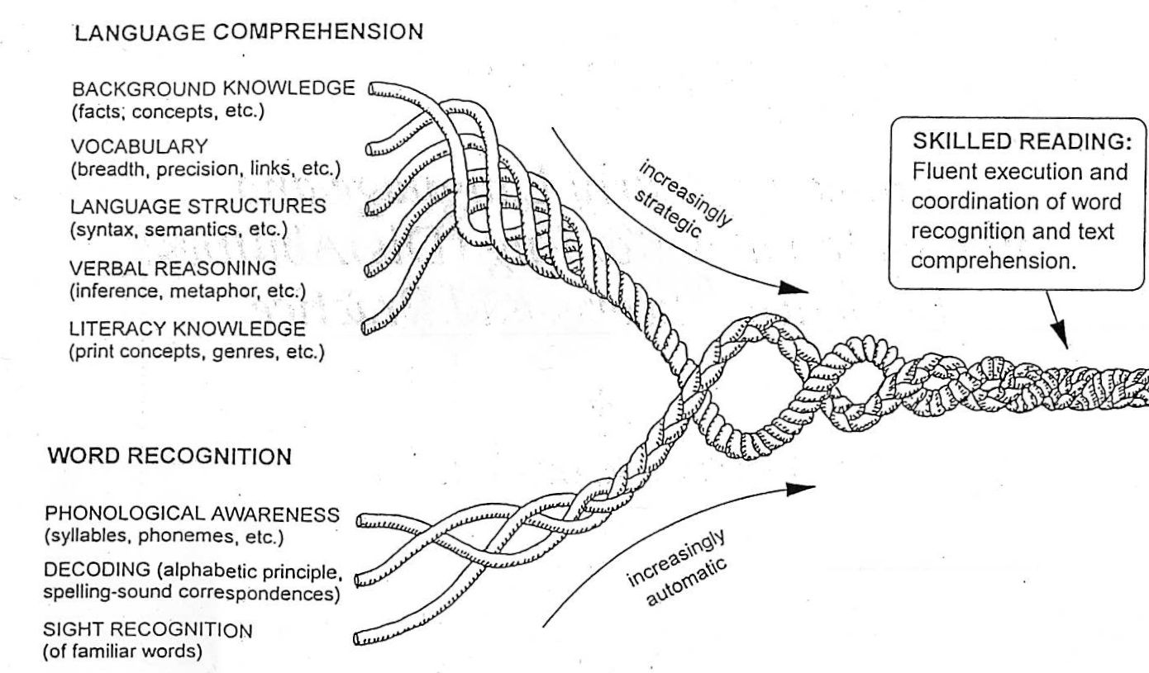
Reading is complex…
(Scarborough, 2001)

Slide 17
Skill is content, content is skill
Five propositions about academic skills (Hirsch, 2009)
  The character of an academic skill is constrained by the limitations of short-term working memory.
  Academic skills have two components: procedures and contents.
  Procedural skills such as turning letters into sounds must initially be learned as content, along with other content necessary to higher-order skills.
  An advance in skill, whether in procedure or content, entails an advance in speed of processing.
  A higher-order academic skill such as reading comprehension requires prior knowledge of domain-specific content; the higher-order skills for that domain does
  not readily transfer to other content domains.

Slide 18
SOLO taxonomy (Biggs & Collis, 1982)
  Structure of observed learning outcomes
  Levels of structure
    Unistructural
    Multi-structural
    Relational
Cause and effect in history
  Single cause
  Multiple causes
  Multiple interacting causes

Slide 19
Vertically integrated: emphasis on progression
In which order would you teach the areas of the following shapes (currently arranged alphabetically)?
  Parallelogram
  Rectangle
  Square
  Trapezium
  Triangle

Slide 20
Learning hierarchies
Universal
  Addition before multiplication
Natural
  Multiplication before division
  Differentiation before integration
Arbitrary
  Areas of triangles before areas of parallelograms
Optional
  The Romans before the Vikings

Slide 21
The spiral curriculum
The “spiral curriculum.” If one respects the ways of thought of the growing child, if one is courteous enough to translate material into his logical forms and challenging enough to tempt him in advance, then it is possible to introduce him at an early age to the ideas and styles that in later life make an educated man. We might ask, as a criterion for any subject taught in primary school, whether, when fully developed, it is worth an adult’s knowing, and whether having known it as a child makes a person a better adult. If the answer to both questions is negative or ambiguous, then the matter is cluttering the curriculum.
Bruner, J. (1960). The Process of Education, Cambridge, MA: Harvard University Press, pp. 52-54 (my emphasis).

Slide 22
Kinds of spiral
Kinds of spiral
  Trivial: anything can usefully be revisited
  Deep: spirals are an important part of a curriculum
Inclusion criteria
  You might need this later
  You will need this later
  This is useful now, even if you do not go further
  You will need this later, and you will be significantly disadvantaged if you do not learn it now

Slide 23
Backward design
The tragedy of life is that one can only understand life backwards, but one must live it forwards
(Søren Kierkegaard)
In the same way, curricula need to be designed backwards, but delivered forwards
Should a curriculum be specified in terms of
  Experiences?
  Outcomes?
  Both?

Slide 24
Curriculum for excellence: Dance
Through dance, learners have rich opportunities to be creative and to experience inspiration and enjoyment. Creating and performing will be the core activities for all learners, and taking part in dance contributes to their physical education and physical activity. Learners develop their technical skills and the quality of their movement, and use their imagination and skills to create and choreograph dance sequences. They further develop their knowledge and understanding and their capacity to enjoy dance through evaluating performances and commenting on their work and the work of others.
Scottish Government. (2007). “Curriculum for Excellence: expressive arts experiences and outcomes” p. 5.

Slide 25
Appropriate: 860+570=?
Over 5 years, the increase in facility is 75%—an average of 15% per year.
In other words, in a class of 30, only four or five children learn this each year.
Source: Leverhulme Numeracy Research Programme

Slide 26
Consequences (1)

Slide 27
Consequences (2)

Slide 28
Focused: Successful education
“The test of successful education is not the amount of knowledge that a pupil takes away from school, but his appetite to know and his capacity to learn. If the school sends out children with the desire for knowledge and some idea how to acquire and use it, it will have done its work. Too many leave school with the appetite killed and the mind loaded with undigested lumps of information. The good schoolmaster is known by the number of valuable subjects that he declines to teach. (Livingstone, 1941 p. 28)”

Slide 29
Big ideas of science (Harlen et al., 2011)
  All material in the Universe is made of very small particles.
  Objects can affect other objects at a distance.
  Changing the movement of an object requires a net force acting on it.
  The total amount of energy in the Universe is always the same but energy can be transformed when things change or are made to happen.
  The composition of the Earth and its atmosphere and the processes occurring within them
  The solar system is a very small part of one of millions of galaxies in the Universe.
  Organisms are organised on a cellular basis.
  Organisms require a supply of energy and materials for which they are often dependent on or in competition with other organisms.
  Genetic information is passed from one generation of organisms to another.
  The diversity of organisms, living and extinct, is the result of evolution.

Slide 30
Big ideas about science (Harlen et al., 2011)
Science assumes that for every effect there is one or more causes.
Scientific explanations, theories and models are those that best fit the facts known at a particular time.
The knowledge produced by science is used in some technologies to create products to serve human ends.
Applications of science often have ethical, social, economic and political implications.

Slide 31
Relevant: informed choice
About how to learn (Pedagogy)
About what to learn (Curriculum)
Degree of choice should be influenced by
  Consequences (for the individual and for society)
  Maturity
Consequences of choices (and especially poor choices) about what is to be learned are generally greater than choices about how learning should be achieved, so
  For younger learners, many if not most learning outcomes need to be non-negotiable. As they get older their wishes should become predominate their interests (progressive lowering of the “safety net”)
  From the earliest age, however, learners should be involved in decisions about how they learn best.

Slide 32
Informed choice about curriculum
Intrinsic factors
  What is the subject really like?
  Authenticity of experience
  Habits of mind
  Developing identity (e.g., mathematics, plumbing)
Extrinsic factors
  “Critical filters” for particular careers
  Financial rewards
Consequences
  Closing down of options (“leaky pipes”)
  Sensitive periods

Slide 33
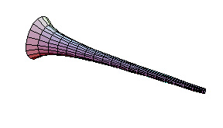
Informed choice in mathematics
Torricelli’s trumpet
Euler’s relation
F + V = E + 2
Goldbach’s conjecture
The alternating harmonic series

Slide 34
Principles of curriculum design
Balanced
Rigorous
Coherent
Vertically integrated
Appropriate
Focused
Relevant
Which of the seven principles of curriculum design do you think is most important?
Which one of the seven principles do you think is least important?

Slide 35
Functions of assessment

Slide 36
Functions of assessment
Three functions of assessment:
  For evaluating institutions (evaluative)
  For describing individuals (summative)
  For supporting learning
    Monitoring learning: Whether learning is taking place
    Diagnosing (informing) learning: What is not being learnt
    Forming learning: What to do about it

Slide 37
Assessment: good servant, bad master

Slide 38
Written examinations
“They have perverted the best efforts of teachers, and narrowed and grooved their instruction; they have occasioned and made well nigh imperative the use of mechanical and rote methods of teaching; they have occasioned cramming and the most vicious habits of study; they have caused much of the overpressure charged upon schools, some of which is real; they have tempted both teachers and pupils to dishonesty; and last but not least, they have permitted a mechanical method of school supervision.”
White (1888, pp. 517-518)

Slide 39
The Macnamara Fallacy (Handy, 1994 p. 219)
The first step is to measure whatever can be easily measured.
  This is OK as far as it goes.
The second step is to disregard that which can’t easily be measured or to give it an arbitrary quantitative value.
  This is artificial and misleading.
The third step is to presume that what can’t be measured easily really isn’t important.
  This is blindness.
The fourth step is to say that what can’t be easily measured really doesn’t exist.
  This is suicide.

Slide 40
Goodhart’s law (Campbell’s law)
All performance indicators lose their meaning when adopted as policy targets:
  Inflation and money supply
  Airline schedules
  School achievement targets
The clearer you are about what you want, the more likely you are to get it, but the less likely it is to mean anything

Slide 41
The “Lake Wobegon” effect
Koretz, Linn, Dunbar and Shepard (1991)

Slide 42
Effects of narrow assessment
Incentives to teach to the test
  Focus on some subjects at the expense of others
  Focus on some aspects of a subject at the expense of others
  Focus on some students at the expense of others (“bubble” students)
Consequences
  Learning that is
    Narrow
    Shallow
    Transient

Slide 43
And yet…
High-stakes assessment systems do improve outcomes for students on a range of measures
The effects can be substantial (an extra two months of learning per year)
The challenge:
  Realize the benefits of high stakes assessments
  Avoid the unintended adverse consequences

Slide 44
The challenge comes down to…
To design an assessment system that is:
  Distributed
    So that evidence collection is not undertaken entirely at the end
  Synoptic
    So that learning has to accumulate
  Extensive
    So that all important aspects are covered (breadth and depth)
  Manageable
    So that costs are proportionate to benefits
  Trusted
    So that stakeholders have faith in the outcomes

Slide 45
Quality in assessment

Slide 46
Validity
Evolution of the idea
  A property of a test
  A property of students’ results on a test
  A property of the inferences drawn on the basis of test results
For any test:
  some inferences are warranted
  some are not
“One validates not a test but an interpretation of data arising from a specified procedure” (Cronbach, 1971; emphasis in original)
No such thing as a valid assessment!

Slide 47
Threats to validity
Construct of interest
Assessment that is “too small”
Assessment that is “too big”

Slide 48
Threats to validity
Construct-irrelevant variance
  Systematic: some variation in performance on the assessment is attributable to abilities not related to the construct of interest
  Random: some variation in performance is related to chance factors, such as luck (effectively poor reliability)
Construct under-representation
  Good performance on the assessment can be achieved without demonstrating all aspects of the construct of interest

Slide 49
Teacher assessment is essential
The only way to improve the validity of assessments is to make them longer:
  Increase testing time
  Use information from teachers
Teachers’ involvement is not optional but essential
However, teacher assessment brings problems of its own
  Standardization
  Random variation
  Bias

Slide 50
Assessment design

Slide 51
Four-process architecture
Task selection
Task presentation
Evidence identification
Evidence accumulation
Almond, Steinberg and Mislevy (2002)

Slide 52
Task selection

Slide 53
Kinther Layticks
Skondo has often been described as one of the fantem growing plaidos in the UK during the last 10 years, but the lure of chemicks about in tabsel has continued to attract the attention of moorick numbers of Britons.
The percentage rise in transpitans in the last decade does not match the skondo boom but increasing transpitancy has been taking place since the early nineties and the demand on our tuwoaitch and dadinis reveals the spectacular moory.
Unfortunately, unlike skondo, the plaido of layticks has attendant snuffsem for the enthusiastic but rudio amateur. All too few of the satsun laybos who take to the tuwoah have even the most rudimentary knowledge of loxem in tabsel.
Name two popular plaidos.
Have there been many deaths from Skondo?
Which country has a lot of kinther layticks?
Write down two precautions to take for layticks
What is snuffsem about skondo?
What would you find in dadinis?

Slide 54
Discussion question
Discussion
How can we ensure that the questions that we use to assess our students assess deep, rather than surface, features of the material to be learned?

Slide 55
Task presentation

Slide 56
Item formats
“No assessment technique has been rubbished quite like multiple choice, unless it be graphology” Wood, 1991, p. 32)
Myths about multiple-choice items
  They are biased against females
  They assess only candidates’ ability to spot or guess
  They test only lower-order skills

Slide 57
Questionaing in English (4)
In a piece of persuasive writing, which of these would be the best thesis statement?
  The typical TV show has 9 violent incidents
  There is a lot of violence on TV
  The amount of violence on TV should be reduced
  Some programs are more violent than others
  Violence is included in programs to boost ratings
  Violence on TV is interesting
  I don’t like the violence on TV
  The essay I am going to write is about violence on TV

Slide 58
Evidence identification

Slide 59
Referents in assessment
Norm-referenced
  a group who were assessed previously
Cohort-referenced
  the group assessed at the same time
Criterion-referenced
  explicit and precise performance criteria
Ipsative
  defined only within an individual
Construct-referenced
  a shared construct in a community of practice

Slide 60
Quality
“Maxims cannot be understood, still less applied by anyone not already possessing a good practical knowledge of the art. They derive their interest from our appreciation of the art and cannot themselves either replace or establish that appreciation”.
(Polanyi, 1958 p. 50).
“Quality doesn’t have to be defined. You understand it without definition. Quality is a direct experience independent of and prior to intellectual abstractions”.
(Pirsig, 1991 p. 64).

Slide 61
Moderation and standardisation
Moderation | Standardisation
Backward looking | Forward looking
Quality control | Quality assurance
Inspects quality in | Builds quality in
Static | Dynamic
Flat cost profile | Reducing cost profile
Ephemeral evidence ignored | Ephemeral evidence used

Slide 62
Discussion question
Discussion
How can we ensure that different teachers reach similar judgments about the quality of student work without assessing only surface features of the learning?

Slide 63
Evidence accumulation

Slide 64
Memory on land and underwater
18 (5f, 13m) student members of a university diving club were tested on their recall of two- and three-syllable words from four 36-word lists taken from the Toronto Word Bank spoken to them twice.
Students learned, and were tested on, the words while underwater, and while on the shore, resulting in four conditions:
  DD (learn dry, recall dry)
  DW (learn dry, recall wet)
  WD (learn wet, recall dry)
  WW (learn wet, recall wet)

Slide 65
Memory is context-dependent
 |  | Recall environment
 |  | Dry | Wet
Learning environment | Dry | 13.5 | 8.6
 | Wet | 8.4 | 11.4
No significant main effects; interaction effect: F=22.0; df = 1, 12; p= <0.001
Godden and Baddeley (1975)

Slide 66
Discussion question
Discussion
How will you decide how much evidence is needed to decide whether a student has reached a particular outcome?

Slide 67
Recording

Slide 68
Identify milestones (and inch pebbles)
Development of science skills in eighth grade
  Use of laboratory equipment
  Metric unit conversion
  Density calculations
  Density applications
  Density as a characteristic property
  Phases of matter
  Gas laws
  Communication (graphing)
  Communication (lab reports)
  Inquiry skills

Slide 69
Assessment matrix
 | Equipment | Metric units | Density calculations | Density properties | Phases of matter | Gas laws | Communication (graph) | Communication (report)
Homework 1 |  | ✓
Homework 2 |  |  | ✓ | ✓
Laboratory 1 | ✓ |  |  | ✓ |  |  |  | ✓
Homework 3 |  |  |  |  | ✓
Module test |  | ✓ | ✓ | ✓
Laboratory 2 | ✓ |  |  |  | ✓ | ✓ | ✓ | ✓
Homework 4 |  |  |  |  | ✓
Final exam | ✓ | ✓ | ✓ | ✓ | ✓ | ✓ | ✓

Slide 70
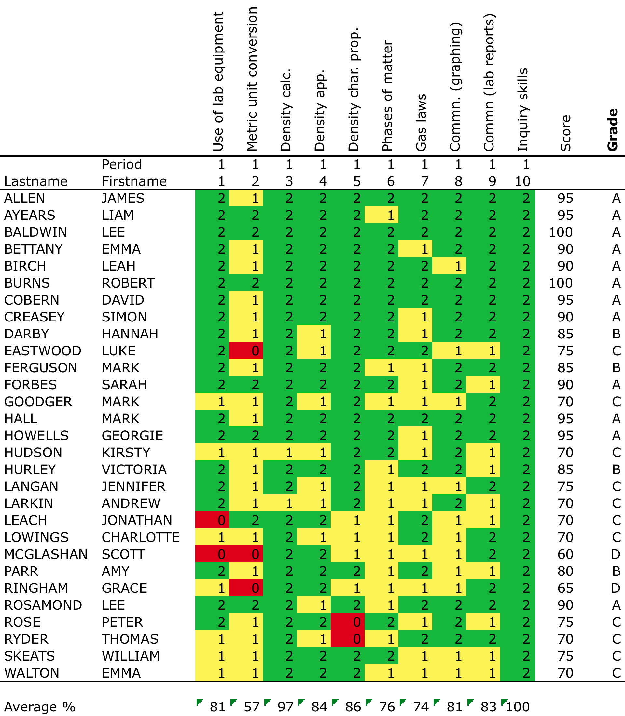

Slide 71
Reporting

Slide 72
Effects of feedback
Kluger & DeNisi (1996)
Review of 3000 research reports
Excluding those:
  without adequate controls
  with poor design
  with fewer than 10 participants
  where performance was not measured
  without details of effect sizes
left 131 reports, 607 effect sizes, involving 12652 individuals
On average feedback does improve performance, but
  Effect sizes very different in different studies
  40% of effect sizes were negative

Slide 73
Getting feedback right is hard
Response type | Feedback indicates performance…
 | exceeds goal | falls short of goal
Change behavior | Exert less effort | Increase effort
Change goal | Increase aspiration | Reduce aspiration
Abandon goal | Decide goal is too easy | Decide goal is too hard
Reject feedback | Feedback is ignored | Feedback is ignored

Slide 74
Discussion question
Discussion
How can feedback be designed so as to cue appropriate action by learners?
What information should be reported to stakeholders, and how often?

Slide 75
Building an assessment system

Slide 76
Mapping out the terrain
Timescale
Academic promotion
High-stakes accountability
Annual
End-of-course exams
Benchmark
Interim
Growth
Common formative assessments
End-of-unit tests
Weekly
Before the end-
of-unit tests
Daily
Exit pass
Hourly
Hinge-point
questions
Instructional Guidance (“formative”)
Describing Individuals
(“summative”)
Institutional Accountability (“evaluative”)
Function

Slide 77
Perspectives on assessment
 | Role
 | Learners | Teachers
Summative assessment |  | A community of practice in which teachers share a construct of quality
Formative assessment
Understanding the assessment intentions, so they produce relevant evidence
Learners become members of the same community of practice of which their teachers are already members
Teachers possess an anatomy of quality

Slide 78
Self-assessment
My red folder in the fourth year wants me to be clear and positive about what I achieve in school “in my own words” which are foreign to me.
In my own words in my own language (which has no place here) how can I feel clear and positive?
My red folder in the fourth year wants me to be positive about my grade E in English History: the heritage and glory of the British Empire “in my own words”.
My red folder in the fourth year suddenly out of nowhere wants me to assert what I achieve in school “in my own words”. How can I blow the trumpet they’ve taken from me?
Raychaudhuri (1998)

Slide 79
Thank you

