Slide 1
Establishing successful teacher learning communities: Lessons learned
Dylan Wiliam
International Conference on Assessment for Learning
Fredericton, NB: 12 April 2014
www.dylanwiliam.net
Notes:
There is now substantial evidence that there is a “knowing-doing” gap in education. The problem is not that we do not know how to improve schools. The problem is implementing what is known to work in more classrooms. This is why approaches based on “sharing good practice” have been relatively ineffective. Teachers do not lack knowledge—rather they lack support in putting into practice changes in what they do in their classrooms, and this requires time. In this session, Dylan Wiliam will reflect on lessons he and his colleagues have learned over the last 10 years in establishing over 1500 teacher learning communities focused on classroom formative assessment all over the world. In particular, the session will examine the role of five central process elements in teacher learning: choice, flexibility, small steps, accountability, and support.

Slide 2
Outline: five questions
Where does formative assessment fit in?
What makes effective teacher learning?
How should teacher meetings be organized?
What doesn’t get done?
How do we know it’s working?

Slide 3
What makes effective teacher learning?

Slide 4
The knowing-doing gap (Pfeffer 2000)
Statement | We know we should do this | We are doing this
Getting ideas from other units in the chain | 4.9 | 4.0
Instituting an active suggestions program | 4.8 | 3.9
Using a detailed assessment process for new hires | 5.0 | 4.2
Posting all jobs internally | 4.2 | 3.5
Talking openly about learning from mistakes | 4.9 | 4.3
Providing employees with frequent feedback | 5.7 | 5.2
Sharing information on financial performance | 4.3 | 3.8

Slide 5
A model for teacher learning
Content, then process
Content (what we want teachers to change):
Evidence
Ideas (strategies and techniques)
Process (how to go about change):
Choice
Flexibility
Small steps
Accountability
Support

Slide 6
Choice

Slide 7
Teamwork
Belbin inventory (Management teams: Why they succeed or fail):
Eight team roles (defined as “a tendency to behave, contribute and interrelate with others in a particular way”):
Company worker; innovator; shaper; chairperson; resource investigator; monitor/evaluator; completer/finisher; team worker
Key ideas:
Each role has strengths and allowable weaknesses.
People rarely sustain “out-of-role” behavior, especially under stress.

Slide 8
Principle strengths and allowable weaknesses
 | Principal strengths | Allowable weaknesses
Company worker | Disciplined, hard-working | Lack of flexibility
Chairman | Valuing contributions | Not particularly creative
Shaper | Drive | Impatience
Plant | Thinking “outside the box” | Impractical
Resource investigator | Openness to new ideas | Short attention-span
Monitor-evaluator | Hard-headed | Poor motivator
Team worker | Responsive to others | Not good in crises
Completer finisher | Detail-oriented | Obsessive

Slide 9
Flexibility

Slide 10
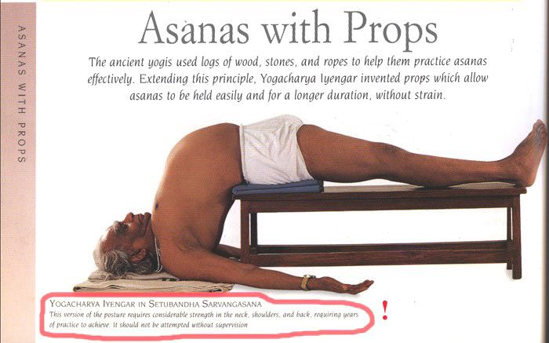
Context matters…

Slide 11
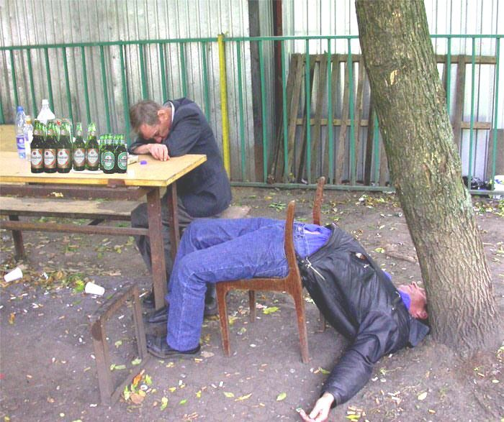

Slide 12
Tight, but loose
Two opposing factors in any school reform
Need for flexibility to adapt to local constraints and affordances
Implies there is appropriate flexibility built into the reform
Need to maintain fidelity to the theory of action of the reform, to minimise “lethal mutations”
So you have to have a clearly articulated theory of action
Different innovations have different approaches to flexibility
Some reforms are too loose (e.g., ‘Effective schools’ movement)
Others are too tight (e.g., Montessori Schools)
The “tight but loose” formulation:
… combines an obsessive adherence to central design principles (the “tight” part) with accommodations to the needs, resources, constraints, and affordances that occur in any school or district (the “loose” part), but only where these do not conflict with the theory of action of the intervention.

Slide 13
Design and intervention
Our design process
cognitive/affective
insights
synergy/
comprehensiveness
set of components
Teachers’ implementation process
set of
components
synergy/
comprehensiveness
cognitive/affective
insights

Slide 14
Strategies vs. techniques
Distinguish between strategies and techniques:
Strategies define the territory of formative assessment (no-brainers)
Teachers are responsible for choice of techniques:
Allows for customization; caters for local context
Creates ownership; shares responsibility
Key requirements of techniques:
They embody the deep cognitive and affective principles that research shows are important
They are seen as relevant, feasible and acceptable

Slide 15
Small steps

Slide 16
Why is teacher change so slow?
Because of the nature of teacher expertise
According to Berliner (1994), experts:
excel mainly in their own domain
develop automaticity for operations needed for their goals
are more sensitive to the task demands and social situations
are more opportunistic and flexible than novices
represent problems in qualitatively different ways than novices
have faster and more accurate pattern recognition capabilities
see richer patterns in the areas of their expertise
begin to solve problems slower but bring richer and more personal sources of information to bear

Slide 17
Knowing more than we can say
Six video extracts of a person delivering cardiopulmonary resuscitation (CPR):
Five of the video extracts feature students
One of the video extracts feature an expert
Videos shown to three groups:
students, experts, instructors
Success rate in identifying the expert:
Experts 90%
Students 50%
Instructors 30%
Klein & Klein (1981)

Slide 18
Looking at the wrong knowledge
The most powerful teacher knowledge is not explicit:
That’s why telling teachers what to do doesn’t work
What we know is more than we can say
And that is why most professional development has been relatively ineffective
Improving practice involves changing habits, not adding knowledge:
That’s why it’s hard
And the hardest bit is not getting new ideas into people’s heads
It’s getting the old ones out
That’s why it takes time
But it doesn’t happen naturally:
If it did, the most experienced teachers would be the most productive, and that’s not true (Hanushek & Rivkin, 2006)

Slide 19
Changing, not sharing, practice
The knowing-doing gap
Teachers don’t need new ideas
Teachers need support in implementing the ideas they already have

Slide 20
Most of what we do is unconscious
Sensory system | Total bandwidth (in bits/second) | Conscious bandwidth (in bits/second)
Eyes | 10,000,000 | 40
Ears | 100,000 | 30
Skin | 1,000,000 | 5
Taste | 1,000 | 1
Smell | 100,000 | 1
Nørretranders, 1998

Slide 21
Hand hygiene in hospitals
Study | Focus | Compliance rate
Preston, Larson, & Stamm (1981) | Open ward | 16%
 | ICU | 30%
Albert & Condie (1981) | ICU | 28% to 41%
Larson (1983) | All wards | 45%
Donowitz (1987) | Pediatric ICU | 30%
Graham (1990) | ICU | 32%
Dubbert (1990) | ICU | 81%
Pettinger & Nettleman (1991) | Surgical ICU | 51%
Larson, et al. (1992) | Neonatal ICU | 29%
Doebbeling, et al. (1992) | ICU | 40%
Zimakoff, et al. (1992) | ICU | 40%
Meengs, et al. (1994) | ER (Casualty) | 32%
Pittet, Mourouga, & Perneger (1999) | All wards | 48%
 | ICU | 36%
Pittet, 2001

Slide 22
Accountability/Support

Slide 23
Supportive accountability
What is needed from teachers:
A commitment to:
The continual improvement of practice
Focus on those things that make a difference to students
What is needed from leaders:
A commitment to engineer effective learning environments for teachers by:
Creating expectations for continually improving practice
Keeping the focus on the things that make a difference to students
Providing the time, space, dispensation, and support for innovation
Supporting risk-taking

Slide 24
Planning question:
What are the most important things you can do to support teachers in taking risks to improve their teaching?

Slide 25
Teacher learning communities

Slide 26
Professional learning communities
Professional
Decision-making under uncertainty
Accountable to a community of peers
Learning
Focused on improvement in student outcomes
Communities
Joint enterprise
Mutual engagement
Shared repertoire

Slide 27
Professional learning communities
Professional Learning Communities (PLCs) are
“…an inclusive group of people, motivated by a shared learning vision, who support and work with each other, finding ways, inside and outside their immediate community, to enquire on their practice and together learn new and better approaches that will enhance all pupils’ learning.” (Stoll et al., 2006)
PLCs therefore represent essentially any team-based approach to educational improvement

Slide 28
Foci for professional learning communities
PLCs can be focused on almost anything, including
Curriculum design and planning
New initiatives
Instructional data teams (DuFour)
Improving teachers’ classroom practice

Slide 29
Complementary processes
Data-driven PLCs
Classroom FA TLCs
Quality control
Common assessments
Improvement through better team work and systems
Focus on individual outcomes for students
Regular meetings focused on data
16 points on PISA (in two to three years)
Quality assurance
Highly structured meetings
Improvement through increased teacher capacity
Focus on teachers’ individual accountability for change
Regular meetings focused on teacher change
30 points on PISA (in two to three years)

Slide 30
Strategies for teacher change
Direct the rider
Follow the bright spots (volunteers vs. conscripts)
Script the critical moves (structured meetings)
Point to the destination (NCLB)
Motivate the elephant
Find the feeling (the moral imperative)
Shrink the change (small steps)
Grow your people (all teachers can improve)
Shape the path
Tweak the environment (time for teacher learning)
Build habits (create routines and structures)
Rally the herd (make new mistakes)
Notes:
Direct the rider
Follow the bright spots (malnutrition in Vietnam)
Script the critical moves (1% milk; 25 points)
Point to the destination (No dry holes)
Motivate the elephant
Find the feeling (Gloves on the table)
Shrink the change (5-minute room makeover)
Grow your people (Dweck’s mindset)
Shape the path
Tweak the environment (popcorn study, one-click ordering)
Build habits (action triggers: don’t tax the rider; checklists)
Rally the herd (free spaces in hospitals)

Slide 31
Teacher learning communities
Plan that the TLC will run for two years.
Identify 10 to 12 interested colleagues:
Selection
Volunteers, or conscripts?
Composition:
Similar assignments (e.g., early years, math/science)
Mixed subject/mixed phase
Hybrid
Secure institutional support for:
Monthly meetings (75–120 minutes each, inside or outside school time)
Time between meetings (two hours per month in school time):
Collaborative planning
Peer observation
Any necessary waivers from school policies

Slide 32
A “signature pedagogy” for teacher learning
Every monthly TLC meeting should follow the same structure and sequence of activities:
Introduction (5 minutes)
Starter activity (5 minutes)
Feedback (25–50 minutes)
New learning about formative assessment (20–40 minutes)
Personal action planning (15 minutes)
Review of learning (5 minutes)

Slide 33
Activities 1, 2, 3, 5, 6: “Bookends”
For each of these five activities, the process is exactly the same at each TLC meeting
This provides a familiar structure for teachers to get better together
As the structure fades into the background,
The learning comes into the foreground
Teachers come to the meeting knowing what is expected of them

Slide 34
Ground-rules for TLCs
Norms of collaboration (Garmston & Wellman, 1999)
Seven powerful Ps
Pausing
Paraphrasing
Probing
Putting ideas on the table (and pulling them off!)
Paying attention to self and others
Presuming positive intentions
Pursuing a balance between advocacy and inquiry

Slide 35
Activity 1: Introduction
Sharing learning intentions for the meeting

Slide 36
Activity 2: Starter
A variety of warm-up activities to get participants’ minds to the meeting:
Think of something you are looking forward to this year
30 seconds to get “things off your chest” about what infuriates you about your job
30 seconds to tell the group about something that happened within the last month and made you feel good
Think of something that happened in a lesson this year that made you smile
Think of something that one of your colleagues did last term that supported you
Go back to the TLC ‘ground rules’

Slide 37
Activity 3: Feedback
Routines need to be established, expectations shared, and structure maintained.
Similar expectations regarding preparation and engagement.
Come to the meeting knowing you will be sharing your own AfL experiences.
Be prepared to offer constructive, thoughtfully conceived feedback to colleagues.
Be prepared to challenge ideas that may be good classroom practice but are not necessarily tightly related to formative assessment.

Slide 38
Activity 4: New learning about formative assessment
‘Drip-feed’ of new ideas, to increase knowledge, and to produce variety
Watch videos of classroom practice
Book study (e.g., one chapter each month)
New formative assessment techniques

Slide 39
Activity 5: Personal action planning
Each teacher updates his or her personal action plan
Makes a specific commitment about what they will do over the coming month
Arranges any support needed from colleagues
Specific date and time for peer observation

Slide 40
Activity 6: Wrap
Did the meeting meet its intended objectives
If yes, great
If no, time to plan what to do about it

Slide 41
Every TLC needs a leader
The job of the TLC leader(s):
To ensure that all necessary resources (including refreshments!) are available at meetings
To ensure that the agenda is followed
To maintain a collegial and supportive environment
But most important of all:
It is not to be the formative assessment “expert.”

Slide 42
Peer observation
Run to the agenda of the observed, not the observer:
Observed teacher specifies focus of observation:
E.g., teacher wants to increase wait time.
Observed teacher specifies what counts as evidence:
Provides observer with a stopwatch to log wait times.
Observed teacher owns any notes made during the observation.

Slide 43
Making time to “sharpen the saw”

Slide 44
A case study in one district
Cannington
Urban school district serving ~20,000 students
Approximately 20% of the population non-white
No schools under threat of re-constitution, but all under pressure to improve test scores
Funding for a project on “better learning through smarter teaching”
Focus on mathematics, science and modern foreign languages (MFL)
Commitment from Principals in November 2007
Initial workshops in July 2008

Slide 45
Progress of TLCs in Cannington
 | Maths |  | Science |  | MFL
Ash | 1 | — | 1 | — | 0 | —
Cedar | 5 | ▮ | 1 | ▮ | 3 | ▮ ▮
Hawthorne | 4 | ▮ ▮ | 10 | ▮ ▮ | 5 | ▮ ▮ ▮ ▮
Hazel | 7 | — | 12 | — | 2 | —
Larch | 1 | ▮ ▮ ▮ ▮ | 0 | ▮ | 0 | ▮
Mallow | 6 | ▮ ▮ ▮ | 7 | ▮ | 3 | ▮ ▮
Poplar | 11 | ▮ | 3 | ▮ ▮ ▮ | 1 | ▮ ▮ ▮
Spruce | 7 | ▮ ▮ ▮ ▮ | 8 | ▮ ▮ ▮ | 5 | ▮ ▮ ▮
Willow | 2 | ▮ | 5 | ▮ | 2 | ▮ ▮ ▮ ▮
Totals | 44 |  | 47 |  | 21
Black nos. show teachers attending launch event; blue bars show progress of TLC

Slide 46
Planning Question:
What activities within your control will you give up or do less of to make formative assessment a priority?

Slide 47
How will we know if it’s working?

Slide 48
We’ll know when it’s working when…
Leading indicators of success
Teachers are given time to meet, and do so
Teachers increasingly act as “critical friends” to others
The prevalence of classroom formative assessment practices is increasing
Students are more engaged in classrooms
Teachers modify the techniques in appropriate ways, indicating an understanding of the underlying theory
There is a shift in the ownership of the reform
Lagging indicators of success
Increased student achievement

Slide 49
Possible foci for “Learning walks”
Foci
Rating
Clear, valuable learning intentions for lesson
Success criteria understood by students
Students chosen at random
Questions that make students think
Students, not teacher, dominate discussions
At least 80% students involved in answering questions
All-student response system used
Teacher waits three seconds after question
Students support each others’ learning
Students take responsibility for own learning
Teacher gives oral formative feedback
Evidence of comments that advance learning
Teacher finds out what students learned
Teaching adjusted after data collection
Exemplary practice
Good practice
Seen, but weak
Non-existent
Used inappropriately

Slide 50
Force-field analysis (Lewin, 1954)
What are the forces that will support or drive the adoption of formative assessment practices in your school/authority?
What are the forces that will constrain or prevent the adoption of formative assessment practices in your school/authority?
+
—

Slide 51
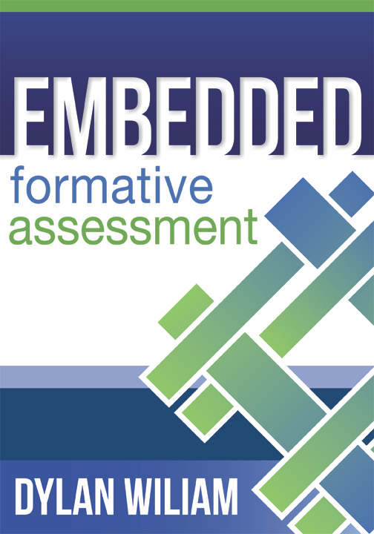
To find out more…
www.dylanwiliam.net

Slide 52
Thank You
www.dylanwiliam.net

