Slide 1
Practical techniques for embedding classroom formative assessment in reading instruction
Dylan Wiliam
Wisconsin State Reading Association, February 2015
www.dylanwiliam.net
www.dylanwiliamcenter.com
@dylanwiliam

Slide 2
Unpacking formative assessment
Where the learner is going
Where the learner is
How to get there
Engineering effective discussions, tasks, and activities that elicit evidence of learning
Providing feedback that moves learners forward
Teacher
Clarifying, sharing and understanding learning intentions
Peer
Activating students as learning
resources for one another
Learner
Activating students as owners
of their own learning

Slide 3
And one big idea
Where the learner is going
Where the learner is
How to get there
Teacher
Using evidence of achievement to adapt what happens in classrooms to meet learner needs
Peer
Learner

Slide 4
The “Rough guide” to English teachers
Five groups of English teachers
  Old grammarians
    Civilizing power of literature
  Pragmatists
    Giving students tools to analyze text
  Liberals
    Personal response to text
  Technicians
    Comprehension as a key skill
  Critical dissenters
    Personal empowerment, literary theory
Marshall (2000)

Slide 5
Strategies and practical techniques for classroom formative assessment

Slide 6
Clarifying, sharing and understanding learning intentions

Slide 7
Can reading comprehension be taught?
Reading comprehension strategy does not improve general-purpose comprehension skills (much)
Common causes of failure
  Not knowing words
  Not realizing that one hasn’t comprehended the text
  Failing to make inferences
    “The Nebraska Supreme Court court just dropped the Keystone XL pipeline decision back onto John Kerry’s lap. That means the secretary of state will have a chance to show just how committed he is to tackling climate change, environmentalists say, just a month after Kerry jetted to Peru to press for the world to act.” (Politico, Jan 10, 2015)
How helpful would it be to be told the following?
    “Put stuff together. Every so often, stop, look at it, and evaluate how it’s going. It may also help to think back on other pieces of furniture you’ve built before.”
Willingham and Lovette (2014)

Slide 8
Share learning intentions
Explain learning intentions at start of lesson/unit:
  Learning intentions
  Success criteria
Consider providing learning intentions and success criteria in students’ language
Use posters of key words to talk about learning:
  E.g., describe, explain, evaluate
Use planning and writing frames judiciously
Use annotated examples of different standards to “flesh out” assessment rubrics
Provide opportunities for students to design their own tests

Slide 9

Sharing success criteria (English)

Slide 10
Engineering effective discussions, activities, and classroom tasks that elicit evidence of learning

Slide 11
What psychology tells us about learning
Review of the research on techniques that help students learn better
Focus on techniques that are relatively easy to use
Evaluation in terms of generalizability of findings across
  different material to be learned
  different learning conditions
  different kinds of student
  different measures of learning
Dunlosky, Rawson, Marsh, Nathan, and Willingham (2013)

Slide 12
1. Elaborative interrogation | Generating an explanation for why an explicitly stated fact or concept is true
2. Self-explanation | Explaining how new information is related to known information, or explaining steps taken during problem solving
3. Summarization | Writing summaries (of various lengths) of to-be-learned texts
4. Highlighting/underlining | Marking potentially important portions of to-be-learned materials while reading
5. Keyword mnemonic | Using keywords and mental imagery to associate verbal materials
6. Imagery for text | Attempting to form mental images of text materials while reading or listening
7. Rereading | Restudying text material again after an initial reading
8. Practice testing | Self-testing or taking practice tests over to-be-learned material
9. Distributed practice | Implementing a schedule of practice that spreads out study activities over time
10. Interleaved practice | Practice that mixes different kinds of problems, or study that mixes different kinds of material, within a single study session

Slide 13
Which of these improves learning?
Elaborative interrogation
Self-explanation
Summarization
Highlighting/underlining
Keyword mnemonic
Imagery for text
Rereading
Practice testing
Distributed practice
Interleaved practice

Slide 14
Finding out where learners are…
Key idea: questioning should
  cause thinking
  provide data that informs teaching
Improving teacher questioning
  generating questions with colleagues
  closed v open
  low-order v high-order
  appropriate wait-time
Getting away from I-R-E
  basketball rather than serial table-tennis
  ‘no hands up’ (except to ask a question)
  ‘hot seat’ questioning
All-student response systems
  class poll, ABCD cards, mini white-boards, exit passes

Slide 15
Questioning in English: Diagnosis (1)
Where is the verb in this sentence?
The dog ran across the road
A
B
C
D

Slide 16
Questioning in English: Diagnosis (2)
Which of these is correct?
  Its on its way.
  It’s on its way.
  Its on it’s way.
  It’s on it’s way.

Slide 17
Questioning in English: Diagnosis (3)
Identify the adverbs in these sentences:
  The boy ran across the street quickly.
  (A) (B) (C) (D) (E)
  Jayne usually crossed the street in a leisurely fashion.
  (A) (B) (C) (D) (E)
  Fred ran the race well but unsuccessfully.
  (A) (B) (C) (D) (E)

Slide 18
Providing feedback that moves learners forward

Slide 19
Kinds of feedback: Israel
264 low and high ability grade 6 students in 12 classes in 4 schools; analysis of 132 students at top and bottom of each class
Same teaching, same aims, same teachers, same classwork
Three kinds of feedback: grades, comments, grades+comments
 | Achievement | Attitude
Grades | no gain | High scorers: positive Low scorers: negative
Comments | 30% gain | High scorers: positive Low scorers: positive
Butler (1988)

Slide 20
Responses
20
 | Achievement | Attitude
Grades | no gain | High scorers: positive Low scorers: negative
Comments | 30% gain | High scorers: positive Low scorers: positive
What do you think happened for the students given both grades and comments?
  Gain: 30%; Attitude: all positive
  Gain: 30%; Attitude: high scorers positive, low scorers negative
  Gain: 0%; Attitude: all positive
  Gain: 0%; Attitude: high scorers positive, low scorers negative
  Something else

Slide 21
Effects of feedback
Kluger & DeNisi (1996) review of 3000 research reports
Excluding those:
  without adequate controls
  with poor design
  with fewer than 10 participants
  where performance was not measured
  without details of effect sizes
left 131 reports, 607 effect sizes, involving 12652 individuals
On average feedback does improve performance, but
  Effect sizes very different in different studies
  38% of effect sizes were negative

Slide 22
Getting feedback right is hard
Response type | Feedback indicates performance…
 | exceeds goal | falls short of goal
Change behavior | Exert less effort | Increase effort
Change goal | Increase aspiration | Reduce aspiration
Abandon goal | Decide goal is too easy | Decide goal is too hard
Reject feedback | Feedback is ignored | Feedback is ignored

Slide 23
“Flow” (Csikszentmihalyi, 1990, pp. 53–54)
A dancer describes how it feels when a performance is going well: “Your concentration is very complete. Your mind isn’t wandering, you are not thinking of something else; you are totally involved in what you are doing. […] Your energy is flowing very smoothly. You feel relaxed, comfortable and energetic.”
A rock climber describes how it feels when he is scaling a mountain: “You are so involved in what you are doing [that] you aren’t thinking of yourself as separate from the immediate activity. … You don’t see yourself as separate from what you are doing.”
A chess player tells of playing in a tournament: “… the concentration is like breathing—you never think of it. The roof could fall in and, if it missed you, you would be unaware of it.”

Slide 24
Motivation: cause or effect?
high
arousal
Flow
anxiety
challenge
worry
control
apathy
relaxation
low
boredom
low
high
competence
Csikszentmihalyi (1990)

Slide 25
Engagement and learning
Attribution (Dweck, 2000)
  Personalization (internal vs. external)
  Permanence (stable vs. unstable)
  Good learners attribute failure and success to internal, unstable causes. (It’s down to you, and you can do something about it.)
Views of ‘ability’
  Fixed (IQ)
  Incremental (untapped potential)
  Essential that teachers inculcate in students a view that ‘ability’ is incremental rather than fixed (by working, you’re getting smarter).

Slide 26
Dual-pathway theory (Boekaerts, 2006)
Long-term learning goals are translated into short-term learning intentions
Dynamic comparisons of task and situational demands with personal resources
Resulting activation of energy along one of two pathways:
  Well-being
  Growth

Slide 27
Provide feedback that moves learning on
Key idea: feedback should:
  Cause thinking
  Provide guidance on how to improve
Comment-only grading
Focused feedback
Explicit reference to scoring rubrics/marking guides
Suggestions on how to improve:
  Not giving complete solutions
Re-timing assessment:
  E.g., three-fourths-of-the-way-through-a-unit test

Slide 28
Activating students as learning resources for one another

Slide 29
Collaborative learning: a research success story
Four mechanisms
  Motivation: students help their peers to learn because, in well-structured cooperative learning settings, it is in their own interests to do so, and so effort is increased;
  Social cohesion: students help their peers because they care about the group, again leading to increased effort;
  Personalization: students learn more because more able peers can engage with the particular difficulties a student is having;
  Cognitive elaboration: those who provide help in group settings are forced to think through the ideas more clearly.

Slide 30
Help students be learning resources
Students assessing their peers’ work:
  “Pre-flight checklist”
  “Two stars and a wish”
  Choose-swap-choose
  Daily sign-in
Training students to pose questions/identifying group weaknesses
End-of-lesson students’ review

Slide 31

Students leading the lesson

Slide 32
Activating students as owners of their own learning

Slide 33
Help students own their own learning
Students assessing their own work:
  With rubrics
  With exemplars
Self-assessment of understanding:
  Plus/minus/interesting
  Learning portfolio
  Traffic lights
  Red/green discs
  Colored cups

Slide 34
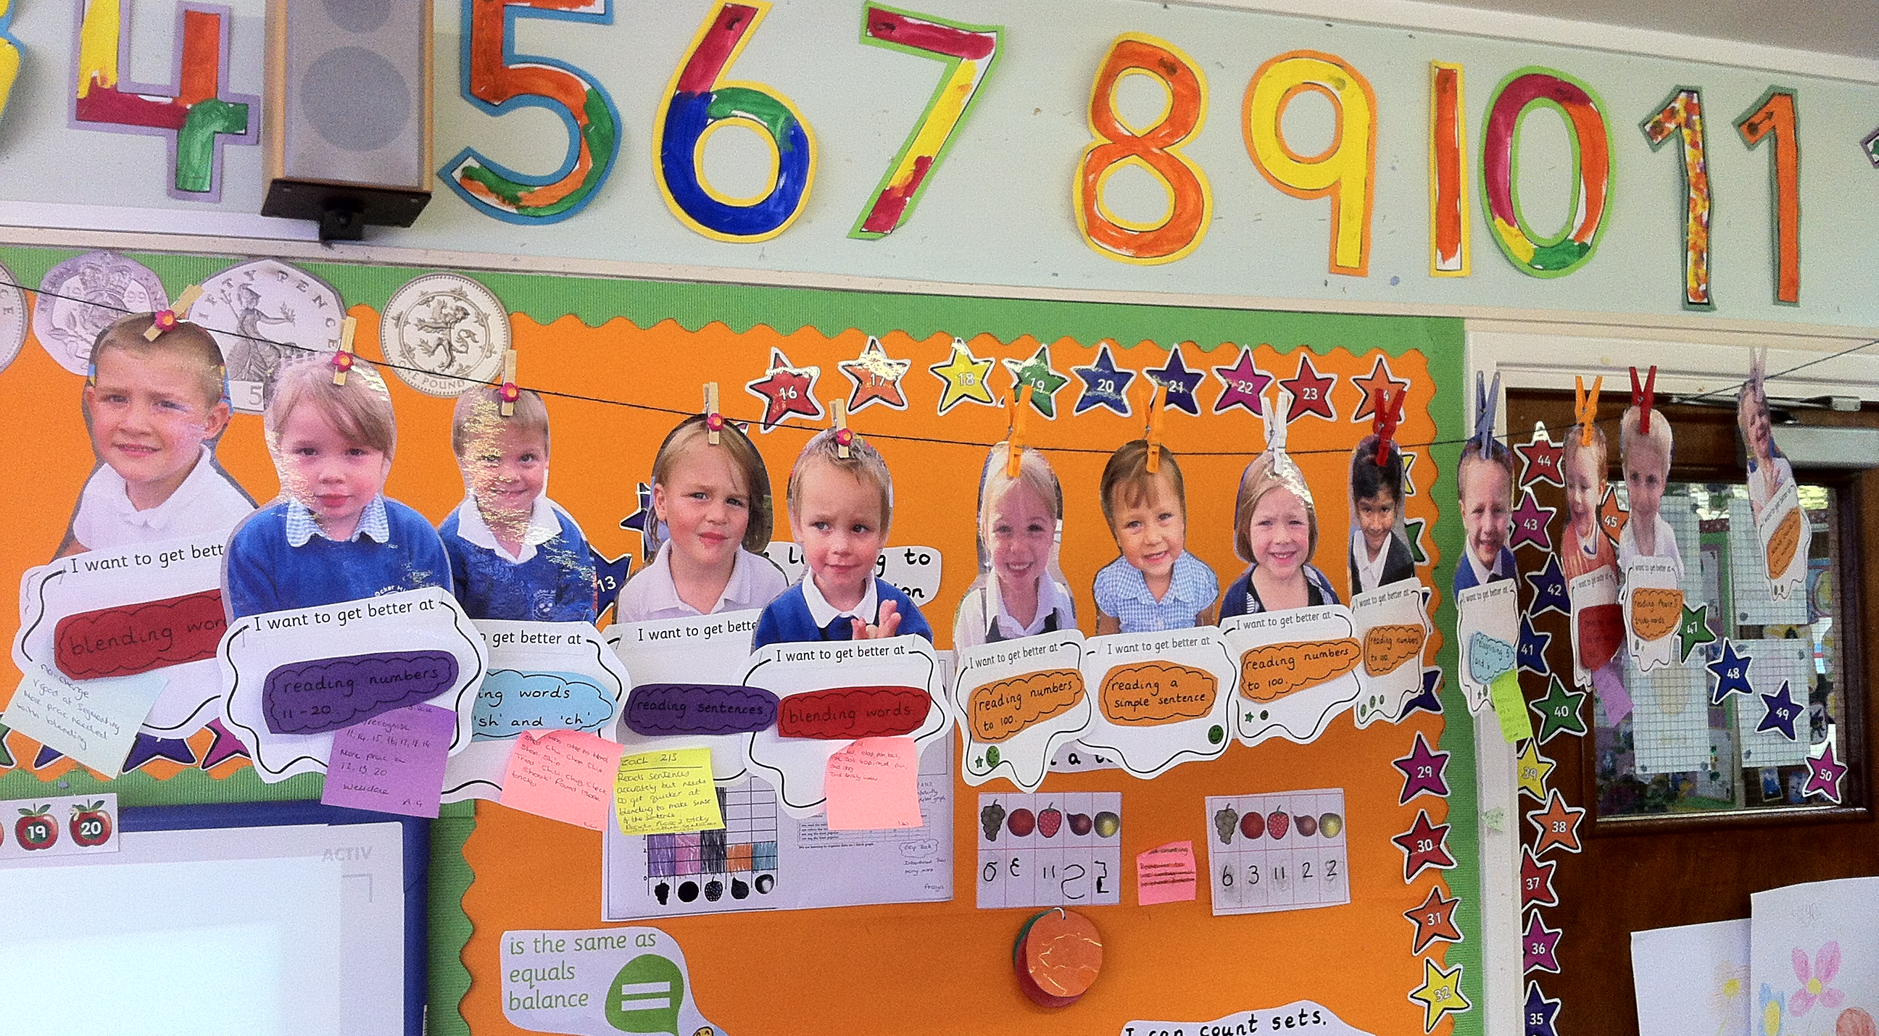

Slide 35
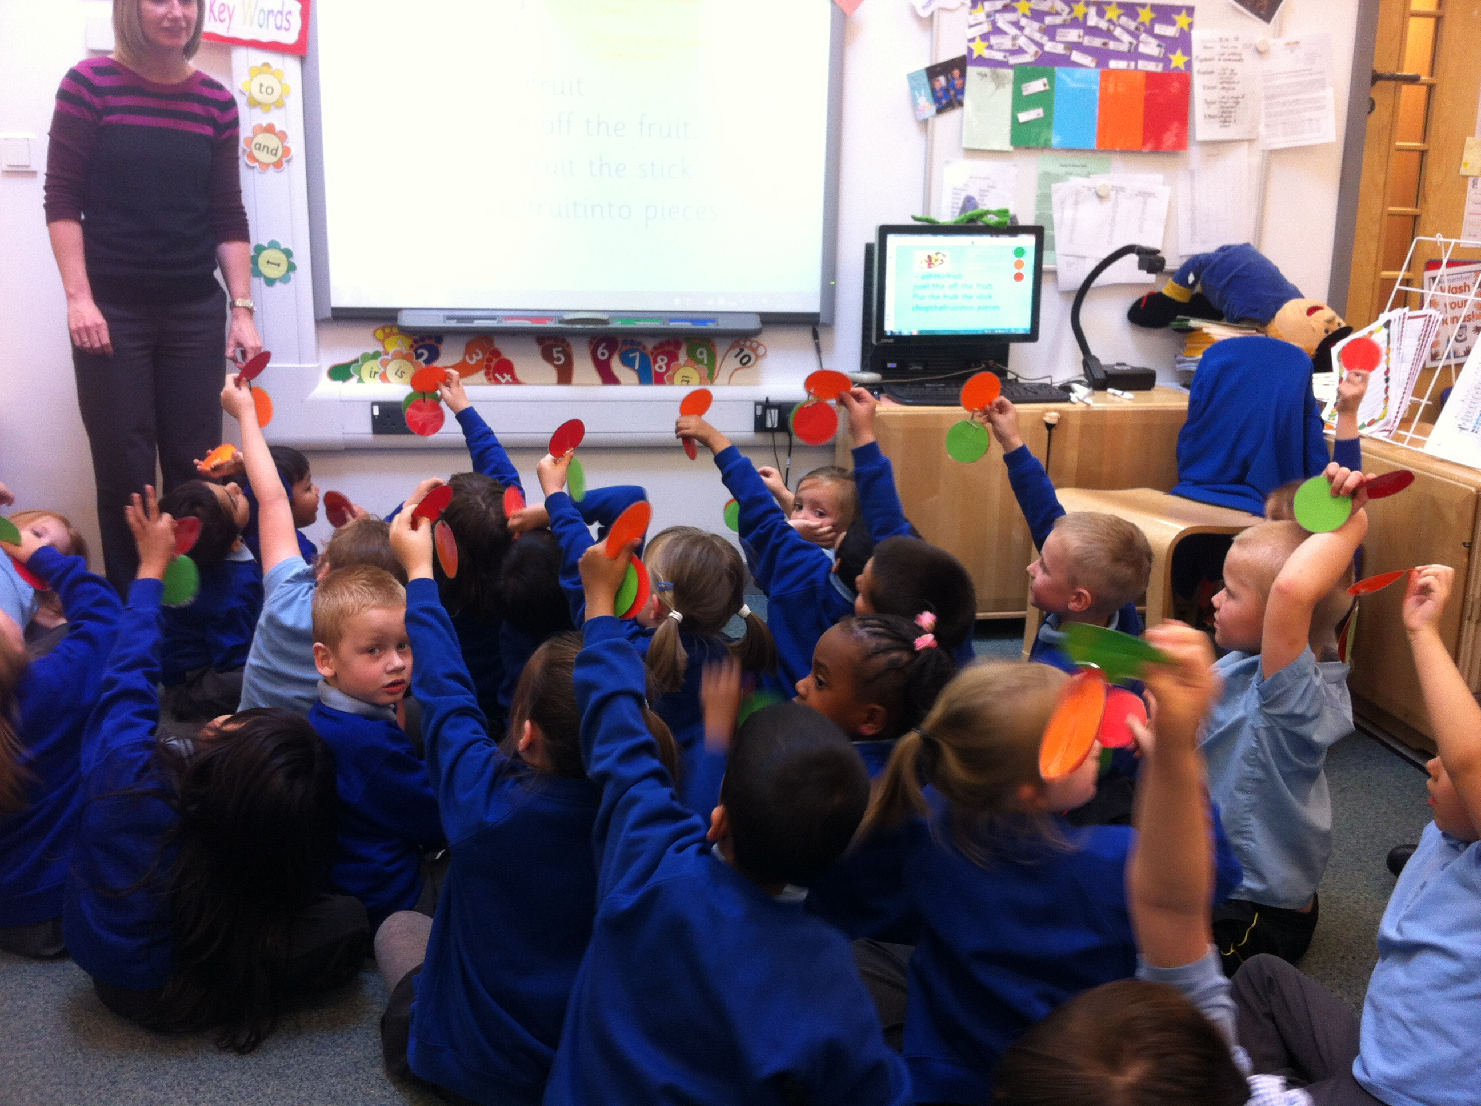

Slide 36
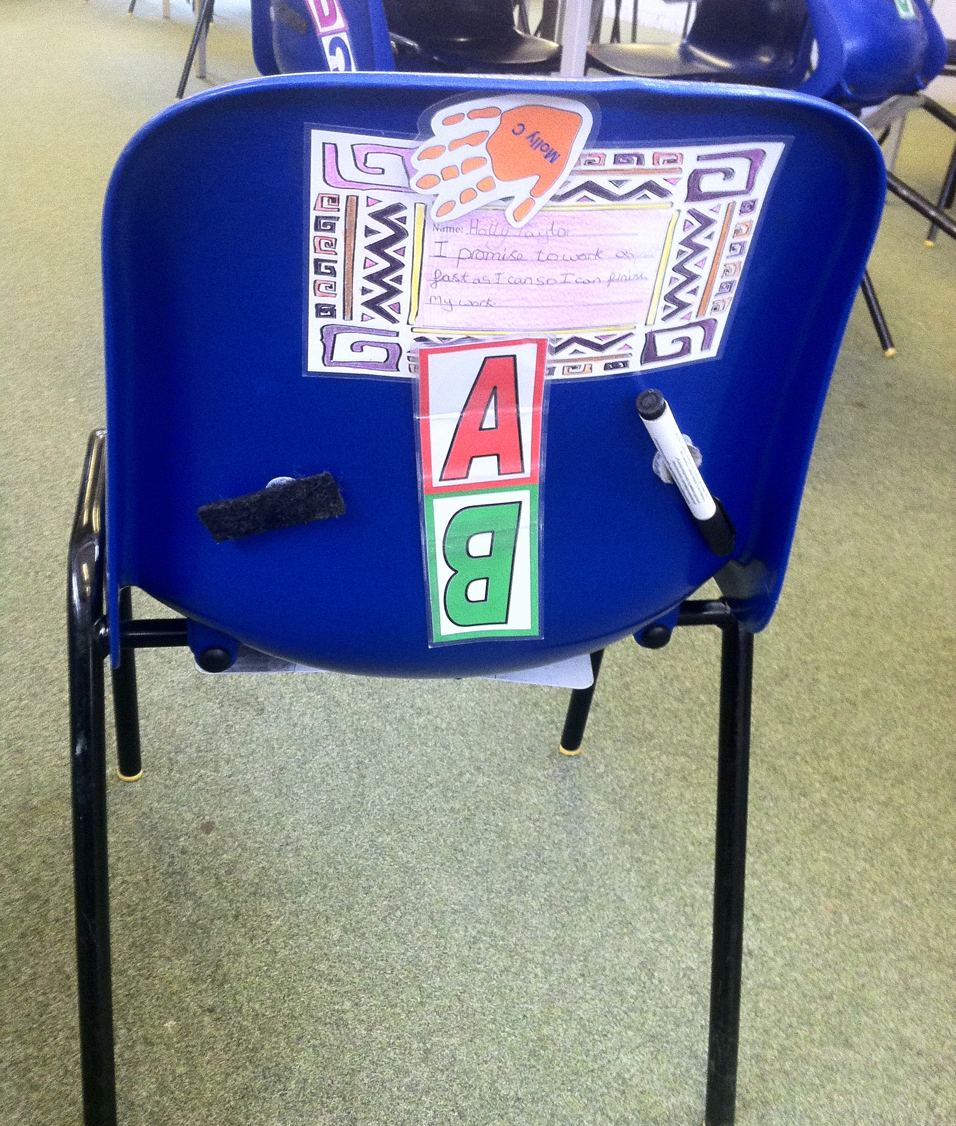
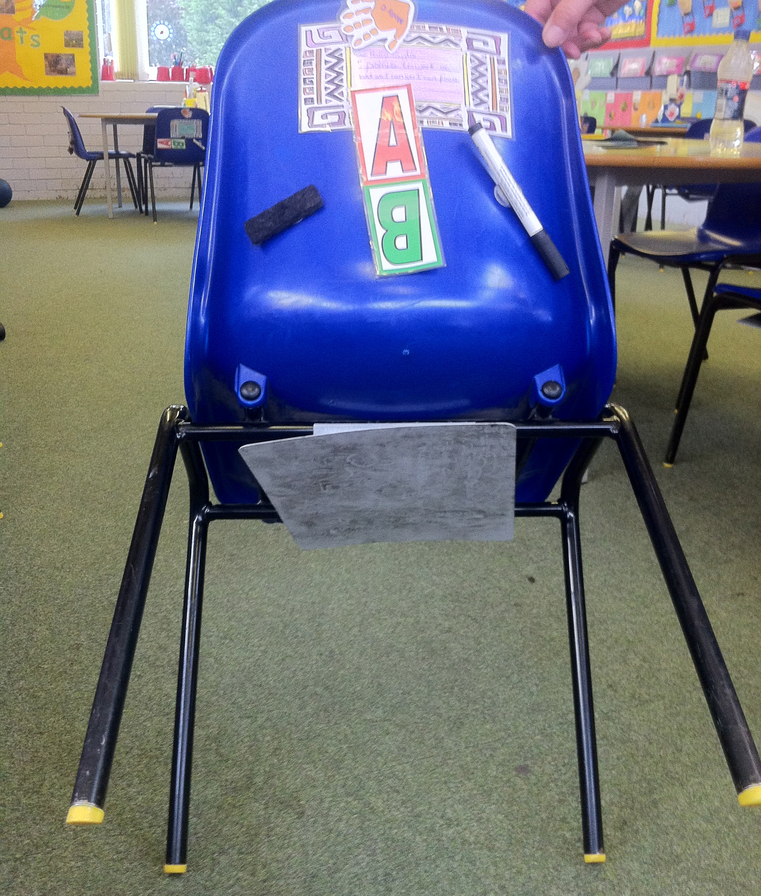
All ready for action…

Slide 37
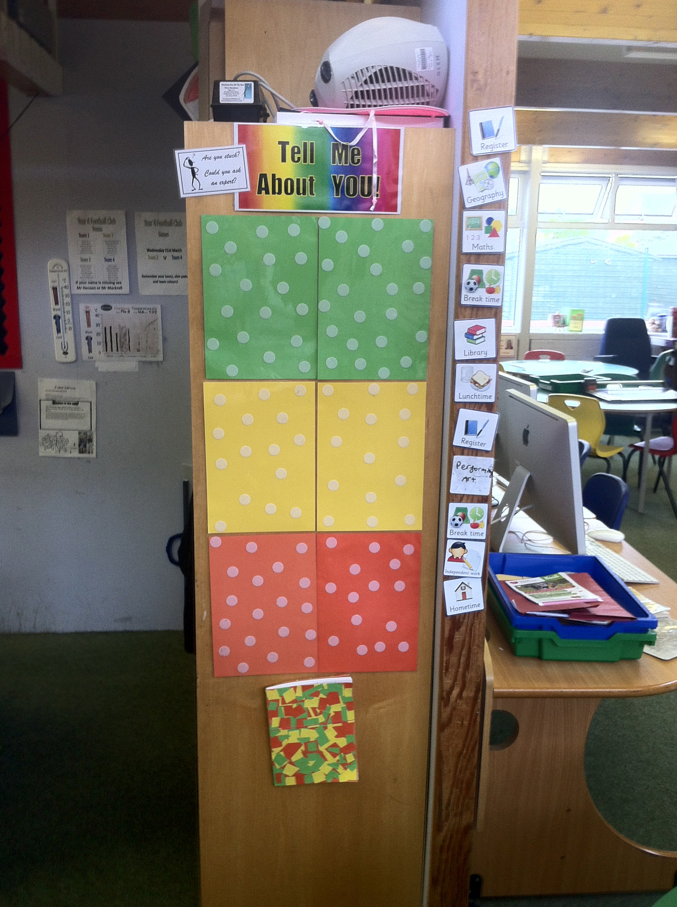
Tell me about you…

Slide 38
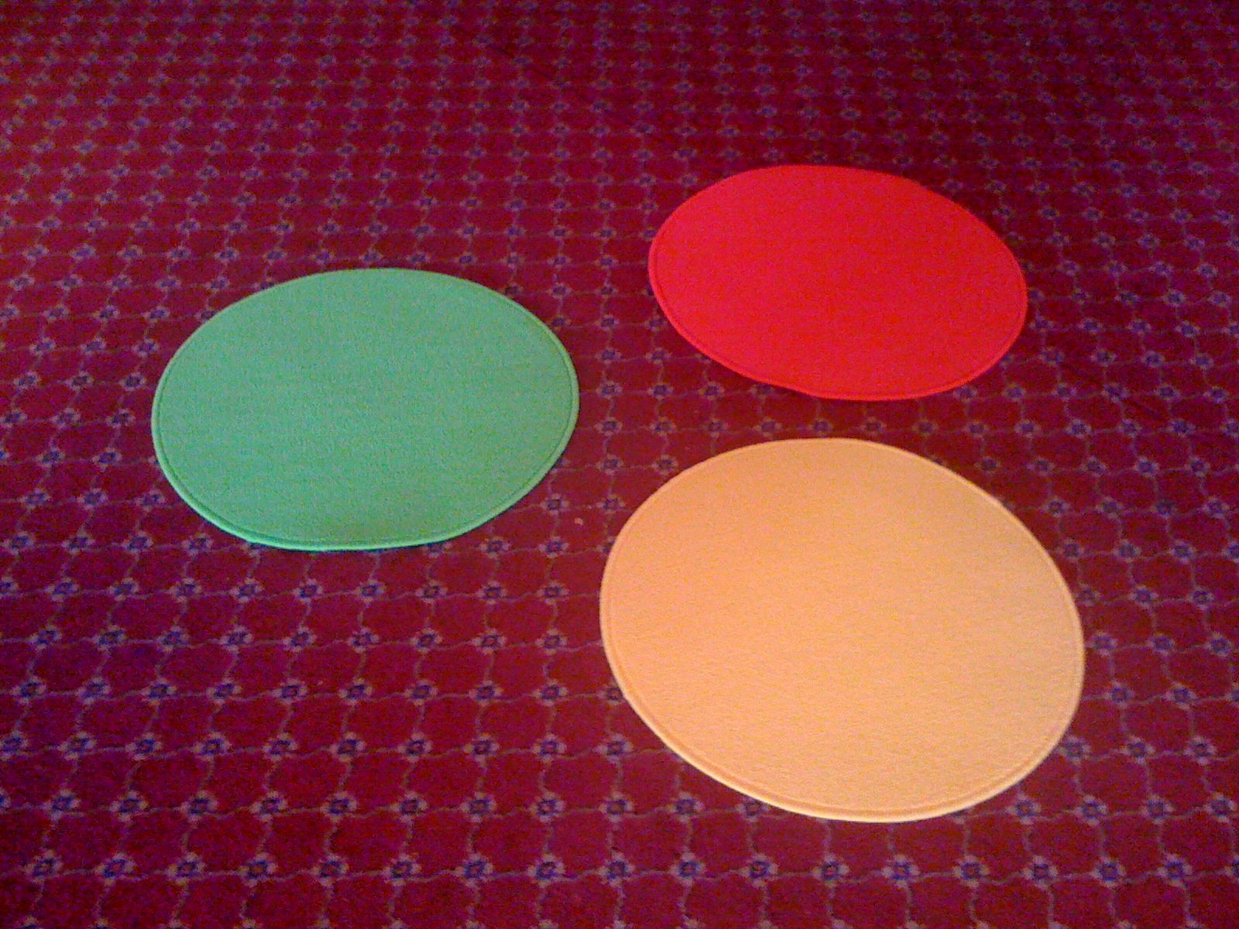
IKEA mats…

Slide 39
So much for the easy bit

Slide 40
A model for teacher learning
Content, then process
Content (what we want teachers to change):
  Evidence
  Ideas (strategies and techniques)
Process (how to go about change):
  Choice
  Flexibility
  Small steps
  Accountability
  Support
Science
Design

Slide 41
Teacher learning communities

Slide 42
We need to create time and space for teachers to reflect on their practice in a structured way, and to learn from mistakes.
Bransford, Brown & Cocking (1999)
“Always make new mistakes.”
Esther Dyson
“Ever tried. Ever failed. No matter. Try again. Fail again. Fail better.”
Beckett (1984)

Slide 43
Teacher learning communities
Plan that the TLC will run for two years
Identify 10 to 12 interested colleagues:
  Conscripts vs. volunteers
  Composition:
    Similar assignments (e.g., early years, math/science)
    Mixed subject/mixed phase
    Hybrid
Secure institutional support for:
  Monthly workshops (75–120 minutes each, inside or outside school time)
  Time between workshops (two hours per month in school time) for collaborative planning and peer observation
  Any necessary waivers from school policies

Slide 44
A “signature pedagogy” for teacher learning
Every monthly TLC workshop should follow the same structure and sequence of activities:
  Activity 1: Introduction (5 minutes)
  Activity 2: Starter activity (5 minutes)
  Activity 3: Feedback (25–50 minutes)
  Activity 4: New learning about formative assessment (20–40 minutes)
  Activity 5: Personal action planning (15 minutes)
  Activity 6: Review of learning (5 minutes)

Slide 45
Every TLC needs a leader
The job of the TLC leader(s):
  To ensure that all necessary resources (including refreshments!) are available at workshops
  To ensure that the agenda is followed
  To maintain a collegial and supportive environment
But most important of all:
  It is not to be the formative assessment “expert”

Slide 46
Peer observation
Run to the agenda of the observed, not the observer:
  Observed teacher specifies focus of observation:
    e.g., teacher wants to increase wait time
  Observed teacher specifies what counts as evidence:
    Provides observer with a stopwatch to log wait times
  Observed teacher owns any notes made during the observation

Slide 47
Summary
Raising achievement is important
Raising achievement requires improving teacher quality
Improving teacher quality requires teacher professional development
To be effective, teacher professional development must address:
  What teachers do in the classroom
  How teachers change what they do in the classroom
Formative assessment + teacher learning communities:
  A point of (uniquely?) high leverage

Slide 48
Force-field analysis (Lewin, 1954)
What are the forces that will support or drive the adoption of formative assessment practices in your school/authority?
What are the forces that will constrain or prevent the adoption of formative assessment practices in your school/authority?
+
—

Slide 49
Thank You
www.dylanwiliam.net

