Slide 1
Dylan Wiliam (@dylanwiliam)
Leadership for teacher learning: Transforming mathematics instruction with embedded formative assessment
www.dylanwiliamcenter.com www.dylanwiliam.org

Slide 2
The basic argument
We need to improve student achievement in math
This requires improving instructional quality
Instructional quality depends on many things
the quality of the curriculum
the time teachers have to plan instruction
the resources and supports teachers have
this size of classes
the skills of the individual teacher
All of these are important, but the quality of the teacher seems to be especially important

Slide 3
Teacher quality and student achievement
 |  | Correlation with progress in
Study | Location | Reading | Math
Rockoff (2004) | New Jersey | 0.10 | 0.11
Nye, Konstantopoulos, Hedges (2004) | Tennessee | 0.26 | 0.36
Rivkin, Hanushek, and Kain (2005) | Texas | 0.15 | 0.11
Aaronson, Barrow, and Sander (2007) | Chicago |  | 0.13
Kane, Rockoff, and Staiger (2008) | New York City | 0.08 | 0.11
Jacob and Lefgren (2008) |  | 0.12 | 0.26
Kane and Staiger (2008) |  | 0.18 | 0.22
Koedel and Betts (2009) | San Diego |  | 0.23
Rothstein (2010) | North Carolina | 0.11 | 0.15
Hanushek and Rivkin (2010) |  |  | 0.11
Chetty et al. (2014) |  | 0.12 | 0.16
Hanushek and Rivkin (2010)
Notes:
Obviously Chetty et al. was not included in Hanushek and Rivkin (2010)

Slide 4
What does this mean for student progress?
Take a group of 50 teachers:
Students taught by the most effective teacher in that group of 50 teachers learn in six months what those taught by the average teacher learn in a year
Students taught by the least effective teacher in that group of 50 teachers will take two years to achieve the same learning
And furthermore:
In the classrooms of the most effective teachers, students from disadvantaged backgrounds learn at the same rate as those from advantaged backgrounds (Hamre & Pianta, 2005)

Slide 5
The “dark matter” of teacher quality
Recall that the in the classrooms of the most effective teachers, students make 12 months more progress per year than those taught by average teachers
If you are taught math, in 4th grade, by a teacher who has outstanding subject knowledge (i.e., within the top 5% of all teachers), how many more months’ progress will you make per year, compared with an average teacher?
Hill, Rowan, and Ball (2005)

Slide 6
Evaluation vs. improvement
Evaluation frameworks:
of necessity, have to be comprehensive
include all aspects of teachers work
at best, incentivize improvement on all aspects of practice
at worst, incentivize improvement on aspects of practice that are easy to improve
Improvement frameworks:
are selective
focus on those aspects of practice with the biggest payoff for students
To maximize improvement, evaluation frameworks have to be used selectively

Slide 7
Things that don’t work
Getting smarter people into teaching
Paying good teachers more
Brain Gym®
Learning styles
Copying other countries

Slide 8
Things that might work
Lesson study/Learning study
Social and emotional aspects of learning
Educational neuroscience
Growth mindset
Differentiated instruction
Grit

Slide 9
Things that do work—a bit
Firing bad teachers
Charter schools
Vouchers
Class size reduction

Slide 10
Things that do work—a lot
Curriculum improvement
Formative assessment

Slide 11
Why formative assessment needs to be a priority

Slide 12
Limitations of educational research
You can’t deduce an “ought” from an “is” (Hume, 1739)
Educational research can only tell you what was, not what might be
Ability grouping
Homework
Class-size reduction
Teachers’ aides
Educational leaders need to be critical consumers of educational research

Slide 13
Best-evidence synthesis

Slide 14
Bottom up: Research on formative assessment
Fuchs & Fuchs (1986)
Natriello (1987)
Crooks (1988)
Bangert-Drowns, et al. (1991)
Dempster (1991)
Dempster (1992)
Kluger & DeNisi (1996)
Black & Wiliam (1998)
Nyquist (2003)
Elshout-Mohr (1994)
Brookhart (2004)
Allal & Lopez (2005)
Köller (2005)
Brookhart (2007)
Wiliam (2007)
Hattie & Timperley (2007)
Shute (2008)
Kingston & Nash (2011)

Slide 15
Formative Assessment: A contested term
Long-cycle
Medium-cycle
Short-cycle
Across terms, teaching units
Within and between teaching units
Within and between lessons
Span
Four weeks to
one year
One to four weeks
Minute-by-minute and day-by-day
Length
Monitoring, curriculum alignment
Student-involved assessment
Engagement, responsiveness
Impact

Slide 16
Unpacking Formative Assessment
 | Where the learner is going | Where the learner is now | How to get the learner there
Teacher
Peer
Student
Clarifying, sharing, and understanding learning intentions
Eliciting evidence of learning
Providing feedback that moves learners forward
Activating students as learning
resources for one another
Activating students as
owners of their own learning

Slide 17
Unpacking Formative Assessment
 | Where the learner is going | Where the learner is now | How to get the learner there
Teacher
Peer
Student
Using evidence of achievement to adapt what happens in classrooms to meet learner needs

Slide 18
Educational Endowment Foundation toolkit
Intervention | Cost | Quality of evidence | Extra months of learning
Feedback | $$ | ★★★ | +8
Metacognition and self-regulation | $$ | ★★★★ | +8
Peer tutoring | $$ | ★★★★ | +6
Early years intervention | $$$$$ | ★★★★ | +6
One to one tuition | $$$$ | ★★★★ | +5
Homework (secondary) | $ | ★★★ | +5
Collaborative learning | $ | ★★★★ | +5
Phonics | $ | ★★★★ | +4
Small group tuition | $$$ | ★★★★ | +4
Behaviour interventions | $$$ | ★★ | +4
Digital technology | $$$$ | ★★★★ | +4
Social and emotional learning | $ | ★★★★ | +4

Slide 19
Educational Endowment Foundation toolkit
Intervention | Cost | Quality of evidence | Extra months of learning
Parental involvement | $$$ | ★★★ | +3
Reducing class size | $$$$$ | ★★★ | +3
Summer schools | $$$ | ★★ | +3
Sports participation | $$$ | ★★ | +2
Arts participation | $$ | ★★★ | +2
Extended school time | $$$ | ★★ | +2
Individualized instruction | $ | ★★★ | +2
After school programmes | $$$$ | ★★ | +2
Learning styles | $ | ★★★ | +2
Mentoring | $$$ | ★★★ | +1
Homework (primary) | $ | ★★★ | +1

Slide 20
Educational Endowment Foundation toolkit
Intervention | Cost | Quality of evidence | Extra months of learning
Teaching assistants | $$$$ | ★★ | 0
Performance pay | $$ | ★ | 0
Aspiration interventions | $$$ | ★ | 0
Block scheduling | $ | ★★ | 0
School uniform | $ | ★ | 0
Physical environment | $$ | ★ | 0
Ability grouping | $ | ★★★ | -1

Slide 21
Unpacking Formative Assessment
 | Where the learner is going | Where the learner is now | How to get the learner there
Teacher
Peer
Student
Clarifying, sharing, and understanding learning intentions
Eliciting evidence of learning
Providing feedback that moves learners forward
Activating students as
resources for one another
Activating students as
owners of their own learning

Slide 22
What makes effective teacher learning?

Slide 23
Looking at the wrong knowledge
The most powerful teacher knowledge is not explicit:
That’s why telling teachers what to do doesn’t work.
What we know is more than we can say.
And that is why most professional development has been ineffective.
Improving practice involves changing habits, not adding knowledge:
That’s why it’s hard:
And the hardest bit is not getting new ideas into people’s heads.
It’s getting the old ones out.
That’s why it takes time.
But it doesn’t happen naturally:
If it did, the most experienced teachers would be the most productive, and that’s not true (Hanushek & Rivkin, 2006).

Slide 24
Strategies for change (Heath & Heath, 2010)
Direct the rider (rational)
Follow the bright spots (volunteers vs. conscripts)
Script the critical moves (structured meetings)
Point to the destination (NCLB)
Motivate the elephant (emotional)
Find the feeling (the moral imperative)
Shrink the change (small steps)
Grow your people (all teachers can improve)
Shape the path (enviromental/cultural)
Tweak the environment (time for teacher learning)
Build habits (create routines and structures)
Rally the herd (make new mistakes)

Slide 25
Teacher learning communities

Slide 26
Supportive accountability
What is needed from teachers:
A commitment to:
The continual improvement of practice
Focus on those things that make a difference to students
What is needed from leaders:
A commitment to engineer effective learning environments for teachers by:
Creating expectations for continually improving practice
Keeping the focus on the things that make a difference to students
Providing the time, space, dispensation, and support for innovation
Supporting risk-taking

Slide 27
Teacher learning communities
Plan that the TLC will run for two years.
Identify 10 to 12 interested colleagues:
Composition:
Similar assignments (e.g., early years, math/science)
Mixed subject/mixed phase
Hybrid
Secure institutional support for:
Monthly meetings (75–120 minutes each, inside or outside school time)
Time between meetings (two hours per month in school time):
Collaborative planning
Peer observation
Any necessary waivers from school policies

Slide 28
A “signature pedagogy” for teacher learning
Every monthly TLC meeting should follow the same structure and sequence of activities:
Activity 1: Introduction (5 minutes)
Activity 2: Starter activity (5 minutes)
Activity 3: Feedback (25–50 minutes)
Activity 4: New learning about formative assessment (20–40 minutes)
Activity 5: Personal action planning (15 minutes)
Activity 6: Review of learning (5 minutes)

Slide 29
Activities 1, 2, 3, 5, 6: “Bookends”
For each of these five activities, the process is exactly the same at each TLC meeting
This provides a familiar structure for teachers to get better together
As the structure fades into the background,
The learning comes into the foreground
Teachers come to the meeting knowing what is expected of them

Slide 30
Activity 1: Introduction
Sharing learning intentions for the meeting

Slide 31
Activity 2: Starter
A variety of warm-up activities to get participants’ minds to the meeting:
Think of something you are looking forward to this year
30 seconds to tell the group about something that happened within the last month and made you feel good
Think of something that happened in a lesson this year that made you smile
Think of something that one of your colleagues did last term that supported you
30-seconds to get “things off your chest” about what infuriates you about your job
Go back to the TLC ‘ground rules’

Slide 32
Activity 3: Feedback
Routines need to be established, expectations shared, and structure maintained.
Similar expectations regarding preparation and engagement.
Coming to the meeting knowing they will be sharing their own formative assessment experiences.
Being prepared to offer constructive, thoughtfully conceived feedback to colleagues.
Being prepared to challenge ideas that may be good classroom practice but are not necessarily tightly related to formative assessment.

Slide 33
Activity 4: New learning
Drip-feed’ of new ideas, to increase knowledge, and to produce variety
Watch videos of classroom practice
Book study (one chapter each month)
New formative assessment techniques

Slide 34
Activity 5: Personal action planning
Each teacher updates his or her personal action plan
Makes a specific commitment about what they will do over the coming month
Arranges any support needed from colleagues
Specific date and time for peer observation

Slide 35
Activity 6: Wrap
Did the meeting meet its intended objectives
If yes, great
If no, time to plan what to do about it

Slide 36
Every TLC needs a leader
The job of the TLC leader(s):
To ensure that all necessary resources (including refreshments!) are available at meetings
To ensure that the agenda is followed
To maintain a collegial and supportive environment
But most important of all:
It is not to be the formative assessment “expert.”

Slide 37
Peer observation
Run to the agenda of the observed, not the observer:
Observed teacher specifies focus of observation:
E.g., teacher wants to increase wait time.
Observed teacher specifies what counts as evidence:
Provides observer with a stopwatch to log wait times.
Observed teacher owns any notes made during the observation.

Slide 38
How will we know if it’s working?

Slide 39
We’ll know when it’s working when…
Leading indicators of success
Teachers are given time to meet, and do so
Teachers increasingly act as “critical friends” to others
The prevalence of classroom formative assessment practices is increasing
Students are more engaged in classrooms
Teachers modify the techniques in appropriate ways, indicating an understanding of the underlying theory
There is a shift in the ownership of the reform
Lagging indicators of success
Increased student achievement

Slide 40
Possible foci for “Learning walks”
Clear, valuable learning intentions for lesson
Success criteria understood by students
Students chosen at random
Questions that make students think
Students, not teacher, dominate discussions
At least 80% students involved in answering questions
All-student response system used
Teacher waits three seconds after question
Students support each others’ learning
Students take responsibility for own learning
Teacher gives oral formative feedback
Evidence of comments that advance learning
Teacher finds out what students learned
Teaching adjusted after evidence collection

Slide 41
Key stakeholders’ reactions
Departmental sub-cultures
Unions
Professional associations
Teaching assistants
Parents
School Board members
Community leaders

Slide 42
Managing disappointments
Failure: opportunity for learning or blame
Falling down: failing or learning?
High-reliability organizations embrace failure
$1m dollar club
“A complaint is a gift”
Group-work is hard for teachers, … and for teachers of teachers…

Slide 43
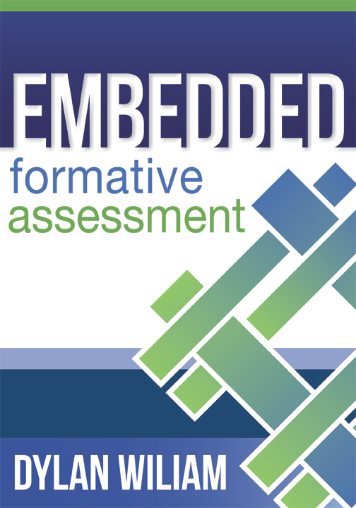
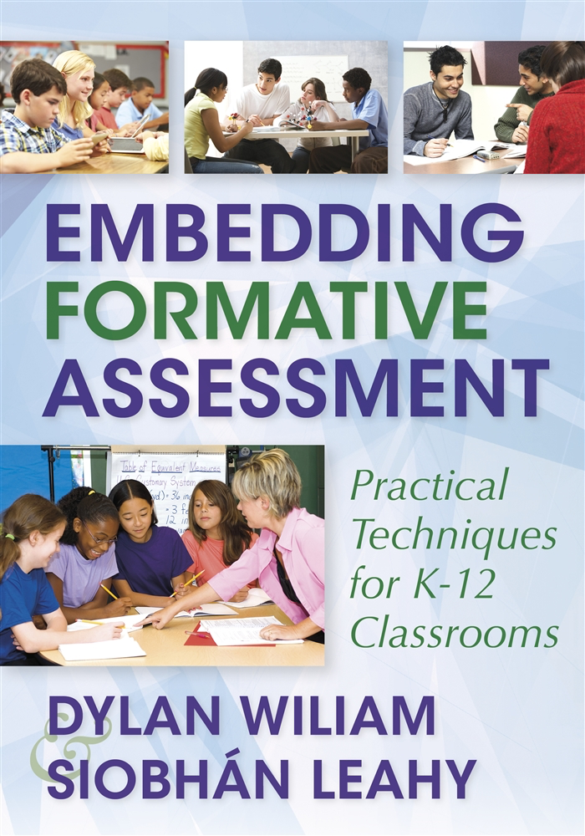
To find out more…
www.dylanwiliamcenter.com
www.dylanwiliam.net
Notes:
These are a few books you might consider. We would recommend you start with Embedding Formative Assessment. Maybe consider a book study.

Slide 44
Thank You
www.dylanwiliam.net

