Slide 1
Dylan Wiliam (@dylanwiliam)
Providing feedback that moves
learning forward
www.dylanwiliamcenter.com www.dylanwiliam.org

Slide 2
Unpacking Formative Assessment
 | Where the learner is going | Where the learner is now | How to get the learner there
Teacher
Peer
Student
Clarifying, sharing, and understanding learning intentions
Eliciting evidence of learning
Providing feedback that moves learners forward
Activating students as learning
resources for one another
Activating students as
owners of their own learning

Slide 3
Kinds of feedback: Israel
264 low and high ability grade 6 students in 12 classes in 4 schools; analysis of 132 students at top and bottom of each class
Same teaching, same aims, same teachers, same classwork
Three kinds of feedback: grades, comments, grades+comments
 | Achievement | Attitude
Grades | no gain | High scorers: positive Low scorers: negative
Comments | 30% gain | High scorers: positive Low scorers: positive
Butler (1988)

Slide 4
Responses
 | Achievement | Attitude
Grades | no gain | High scorers: positive Low scorers: negative
Comments | 30% gain | High scorers: positive Low scorers: positive
What happened for students given both grades and comments?
  Gain: 30%; Attitude: all positive
  Gain: 30%; Attitude: high scorers positive, low scorers negative
  Gain: 0%; Attitude: all positive
  Gain: 0%; Attitude: high scorers positive, low scorers negative
  Something else

Slide 5
Effects of feedback
Kluger & DeNisi (1996) review of 3000 research reports
Excluding those:
  without adequate controls
  with poor design
  with fewer than 10 participants
  where performance was not measured
  without details of effect sizes
left 131 reports, 607 effect sizes, involving 12652 individuals
On average, feedback increases achievement
  Effect sizes highly variable
  38% (231 out of 607) of effect sizes were negative

Slide 7
Discussion question
How can feedback lower student achievement?

Slide 8
Kinds of feedback (Nyquist, 2003)
Weaker feedback only
  Knowledge or results (KoR)
Feedback only
  KoR + clear goals or knowledge of correct results (KCR)
Weak formative assessment
  KCR+ explanation (KCR+e)
Moderate formative assessment
  (KCR+e) + specific actions for gap reduction
Strong formative assessment
  (KCR+e) + activity

Slide 9
Effects of formative assessment (HE)
Kind of feedback | Count | Effect
Weaker feedback only | 31 | 0.14
Feedback only | 48 | 0.36
Weaker formative assessment | 49 | 0.26
Moderate formative assessment | 41 | 0.39
Strong formative assessment | 16 | 0.56

Slide 10
Getting feedback right is hard
Response type | Feedback indicates performance…
 | falls short of goal | exceeds goal
Change behavior | Increase effort | Exert less effort
Change goal | Reduce aspiration | Increase aspiration
Abandon goal | Decide goal is too hard | Decide goal is too easy
Reject feedback | Feedback is ignored | Feedback is ignored

Slide 11
Provide feedback that moves learning on
Key idea: feedback should:
  Cause thinking
  Provide guidance on how to improve
Comment-only marking
Focused marking
Explicit reference to mark-schemes/rubrics
Suggestions on how to improve:
  Not giving complete solutions
Re-timing assessment:
  E.g., three-fourths-of-the-way-through-a-unit test

Slide 12
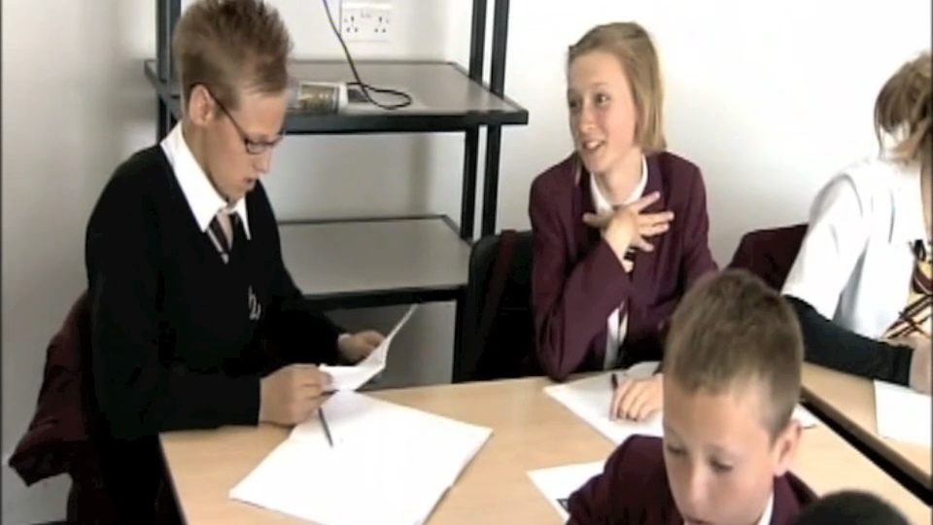
Students and grades

Slide 13
What determines a student’s response to feedback?

Slide 14
“Flow” (Csikszentmihalyi, 1990, pp. 53–54)
A dancer describes how it feels when a performance is going well: “Your concentration is very complete. Your mind isn’t wandering, you are not thinking of something else; you are totally involved in what you are doing. […] Your energy is flowing very smoothly. You feel relaxed, comfortable and energetic.”
A rock climber describes how it feels when he is scaling a mountain: “You are so involved in what you are doing [that] you aren’t thinking of yourself as separate from the immediate activity. … You don’t see yourself as separate from what you are doing.”
A chess player tells of playing in a tournament: “… the concentration is like breathing—you never think of it. The roof could fall in and, if it missed you, you would be unaware of it.”

Slide 15
Motivation: cause or effect?
high
arousal
Flow
anxiety
challenge
worry
control
apathy
relaxation
low
boredom
low
high
competence
Csikszentmihalyi (1990)

Slide 16
“Ability”: Fixed or malleable?
‘Mindset’ (Dweck, 2000)
  Implicit theory of intelligence
    “Some believe that intelligence is more of an unchangeable, fixed ‘‘entity’’ (an entity theory). Others think of intelligence as a malleable quality that can be developed (an incremental theory).” (Blackwell, Dweck, & Trzesniewski, 2007 p. 247)
  Issues
    Impact on student achievement not significant (0.05 < p < 0.10)
    Results have never been replicated (despite at least 3 attempts)
    No examples of schools changing their own students’ mindsets
  But,
    None of this matters if we ignore Dweck and just focus on getting our students to believe that “Smart is not something you just are, smart is something you can get” (Howard, 1991 p. 7)

Slide 17
Dual-pathway theory (Boekaerts, 2006)
Long-term learning goals are translated into short-term learning intentions
Dynamic comparisons of task and situational demands with personal resources, taking into account:
  Current perceptions of the task
  Beliefs about the subject or task
  Beliefs about “ability” and the role of effort in the subject
  Interest in the subject (personal vs. situational)
  Previous experiences on similar tasks
  Costs and benefits

Slide 18
Dual-pathway theory
Resulting activation of energy along one of two pathways:
  Well-being
  Growth

Slide 19
Discussion question
How can feedback be designed so that feedback leads to a focus on growth, rather than well-being?

Slide 20
Provide feedback that moves learning on
Focus on the reaction of the students, not the feedback
Develop a growth mindset in your students
Design feedback as part of a system
Concentrate on “personal bests”
Make feedback into detective work

Slide 21
Discussion question
What are the obstacles to introducing more effective forms of feedback?

