Slide 1
Dylan Wiliam (@dylanwiliam)
Assessment: The Bridge Between
Teaching and Learning
www.dylanwiliamcenter.com www.dylanwiliam.org

Slide 2
Overview: Science and Design
We need to improve student achievement
This requires improving teacher quality
Improving the quality of entrants takes too long
So we have to make the teachers we have better
We can change teachers in a range of ways
Some will benefit students, and some will not
Those that do involve changes in teacher practice
Changing practice requires new kinds of teacher learning
And new models of professional development
Science
Design

Slide 3
Raising achievement matters
For individuals:
Increased lifetime salary (Hanushek, 2005)
Improved health (OECD, 2010)
Longer life (Lleras-Muney, 2005)
For society:
Lower criminal justice costs (Levin et al., 2007)
Lower healthcare costs (Levin et al., 2007)
Increased economic growth (Hanushek & Woessman, 2015)
Net present value to the U.S. of a 25-point increase on PISA: $62 trillion (3 times the National Debt)
Net present value to the U.S. of getting all students to 420 on PISA: $29 trillion

Slide 4
What is the purpose of education?
Four main philosophies of education/development
Personal empowerment
Cultural transmission
Preparation for citizenship
Preparation for work
All are important
Any education system is a (sometimes uneasy) compromise between these four forces

Slide 5
Why we need to raise achievement
In advanced economies, over the next 20 to 30 years
Between a quarter and a third of jobs could be offshored (Blinder, 2011)
About half of all jobs could be done by machines (Frey & Osborne, 2013)

Slide 6
The world of work is changing
Which kinds of skill are disappearing fastest from the workplace?
 | Skill category
A | Complex communication
B | Expert thinking/problem solving
C | Non-routine manual
D | Routine cognitive
E | Routine manual
Change 1969-1999
+14%
+8%
–5%
–8%
–3%
Autor, Levy and Murnane (2003)

Slide 7
There is only one 21st century skill
So the model that says learn while you’re at school, while you’re young, the skills that you will apply during your lifetime is no longer tenable. The skills that you can learn when you’re at school will not be applicable. They will be obsolete by the time you get into the workplace and need them, except for one skill. The one really competitive skill is the skill of being able to learn. It is the skill of being able not to give the right answer to questions about what you were taught in school, but to make the right response to situations that are outside the scope of what you were taught in school.
We need to produce people who know how to act when they’re faced with situations for which they were not specifically prepared. (Papert, 1998)

Slide 8
Pause for reflection
What’s the most interesting, surprising, or challenging thing you have heard so far?
See if you can get consensus with your neighbors.

Slide 9
What determines how quickly children learn?
Student characteristics
School organization
Instructional quality
The quality of the curriculum
The time teachers have to plan teaching
The size of classes
The resources available
The skills of the teacher
All of these are important, but the quality of the teacher is especially important

Slide 10
Evaluation vs. improvement
Evaluation frameworks:
of necessity, have to be comprehensive
include all aspects of teachers’ work
at best, incentivize improvement on all aspects of practice
at worst, incentivize improvement on aspects of practice that are easy to improve
Improvement frameworks:
are selective
focus on those aspects of practice with the biggest payoff for students
To maximize improvement, evaluation frameworks have to be used selectively

Slide 11
Recap
We need higher student achievement
Higher student achievement requires improving teacher quality
Improving teacher quality requires investing in the teachers we already have
To be effective, that investment needs to be focused on the things that make most difference for students

Slide 12
Why Strategic Formative Assessment?
A principle and an uncomfortable fact about the world
The principle:
"If I had to reduce all of educational psychology to just one principle, I would say this: The most important single factor influencing learning is what the learner already knows. Ascertain this and teach him [or her] accordingly” (Ausubel, 1968 p. vi)
The uncomfortable fact:
Students do not learn what we teach.
What is learning?
Learning is a change in long-term memory (Kirschner et al., 2006)
The fact that someone can do something now does not mean they will be able to do it in six weeks, but
If they cannot do something now, it is highly unlikely they will be able to do it in six weeks

Slide 13
Building Plan “B” into Plan “A”

Slide 14
Relevant studies
Fuchs & Fuchs (1986)
Natriello (1987)
Crooks (1988)
Bangert-Drowns et al. (1991)
Dempster (1991, 1992)
Elshout-Mohr (1994)
Kluger & DeNisi (1996)
Black & Wiliam (1998)
Nyquist (2003)
Allal & Lopez (2005)
Köller (2005)
Brookhart (2007)
Wiliam (2007)
Hattie & Timperley (2007)
Shute (2008)
Kingston & Nash (2011, 2015)

Slide 15
Which of these are formative?
A district science supervisor uses test results to plan professional development workshops for teachers
Teachers doing item-by-item analysis of 5th grade math tests to review their 5th grade curriculum
A school tests students every 10 weeks to predict which students are “on course” to pass the end-of-year exam
“Three-quarters of the way through a unit” test
Students who fail a test on Friday have to come back on Saturday
Exit pass question: “What is the difference between mass and weight?”
“Sketch the graph of y equals one over one plus x squared on your mini-white boards.”

Slide 16
Formative Assessment: A contested term
Long-cycle
Medium-cycle
Short-cycle
Across terms, teaching units
Within and between teaching units
Within and between lessons
Span
Four weeks to
one year
One to four weeks
Minute-by-minute and day-by-day
Length
Monitoring, curriculum alignment
Student-involved assessment
Engagement, responsiveness
Impact

Slide 17
Complementary Processes
Instructional Data Teams
Teacher Learning Communities
Quality control
Common assessments
Improvement through better team work and systems
Focus on individual outcomes for students
Regular meetings focused on data
16 points on PISA (in two to three years)
Quality assurance
Highly structured meetings
Improvement through increased teacher capacity
Focus on teachers’ individual accountability for change
Regular meetings focused on teacher change
30 points on PISA (in two to three years)

Slide 18
Unpacking Formative Assessment
 | Where the learner is going | Where the learner is now | How to get the learner there
Teacher
Peer
Student
Clarifying, sharing, and understanding learning intentions
Eliciting evidence of learning
Providing feedback that moves learners forward
Activating students as learning
resources for one another
Activating students as
owners of their own learning

Slide 19
Unpacking Formative Assessment
 | Where the learner is going | Where the learner is now | How to get the learner there
Teacher
Peer
Student
Using evidence of achievement to adapt what happens in classrooms to meet learner needs

Slide 20
An educational positioning system
A good teacher:
Establishes where the students are in their learning
Identifies the learning destination
Carefully plans a route
Begins the learning journey
Makes regular checks on progress on the way
Makes adjustments to the course as conditions dictate

Slide 21
The relationship of formative assessment to other policy priorities

Slide 22
Educational Endowment Foundation toolkit
Intervention | Cost | Quality of evidence | Extra months of learning
Feedback | $$ | ★★★ | +8
Metacognition and self-regulation | $$ | ★★★★ | +8
Peer tutoring | $$ | ★★★★ | +6
Early years intervention | $$$$$ | ★★★★ | +6
One to one tuition | $$$$ | ★★★★ | +5
Homework (secondary) | $ | ★★★ | +5
Collaborative learning | $ | ★★★★ | +5
Phonics | $ | ★★★★ | +4
Small group tuition | $$$ | ★★★★ | +4
Behaviour interventions | $$$ | ★★ | +4
Digital technology | $$$$ | ★★★★ | +4
Social and emotional learning | $ | ★★★★ | +4

Slide 23
Educational Endowment Foundation toolkit
Intervention | Cost | Quality of evidence | Extra months of learning
Parental involvement | $$$ | ★★★ | +3
Reducing class size | $$$$$ | ★★★ | +3
Summer schools | $$$ | ★★ | +3
Sports participation | $$$ | ★★ | +2
Arts participation | $$ | ★★★ | +2
Extended school time | $$$ | ★★ | +2
Individualized instruction | $ | ★★★ | +2
After school programmes | $$$$ | ★★ | +2
Learning styles | $ | ★★★ | +2
Mentoring | $$$ | ★★★ | +1
Homework (primary) | $ | ★★★ | +1

Slide 24
Educational Endowment Foundation toolkit
Intervention | Cost | Quality of evidence | Extra months of learning
Teaching assistants | $$$$ | ★★ | 0
Performance pay | $$ | ★ | 0
Aspiration interventions | $$$ | ★ | 0
Block scheduling | $ | ★★ | 0
School uniform | $ | ★ | 0
Physical environment | $$ | ★ | 0
Ability grouping | $ | ★★★ | -1

Slide 25
Unpacking Formative Assessment
 | Where the learner is going | Where the learner is now | How to get the learner there
Teacher
Peer
Student
Clarifying, sharing, and understanding learning intentions
Eliciting evidence of learning
Providing feedback that moves learners forward
Activating students as
resources for one another
Activating students as
owners of their own learning

Slide 26
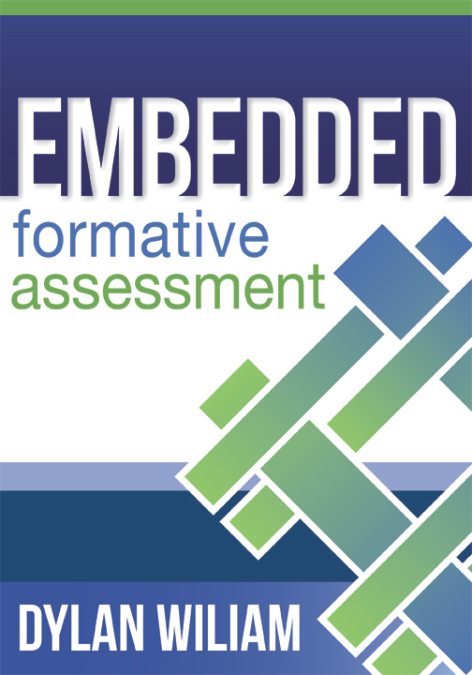
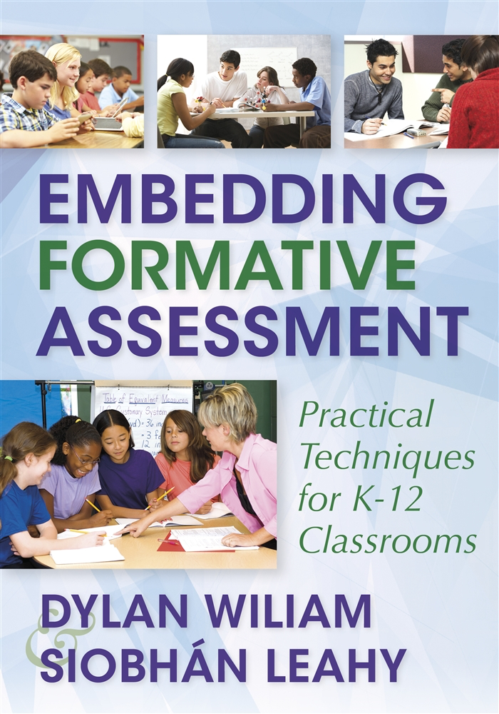
To find out more…
www.dylanwiliam.net
www.dylanwiliamcenter.com

Slide 27
…and even more...

