Slide 1
Dylan Wiliam (@dylanwiliam)
Assessment: The bridge between teaching and learning
www.dylanwiliamcenter.com www.dylanwiliam.org

Slide 2
Why Strategic Formative Assessment?
A principle and an uncomfortable fact about the world
  The principle:
    "If I had to reduce all of educational psychology to just one principle, I would say this: The most important single factor influencing learning is what the learner already knows. Ascertain this and teach him [or her] accordingly” (Ausubel, 1968 p. vi)
  The uncomfortable fact:
    Students do not learn what we teach.
  What is learning?
    Learning is a change in long-term memory (Kirschner et al., 2006)
    The fact that someone can do something now does not mean they will be able to do it in six weeks, but
    If they cannot do something now, it is highly unlikely they will be able to do it in six weeks

Slide 3
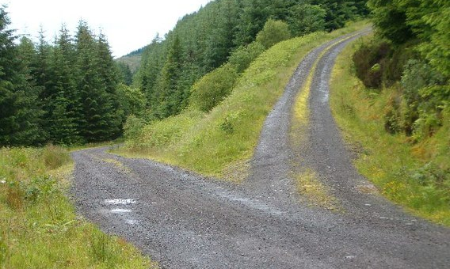
Building Plan “B” into Plan “A”

Slide 4
Relevant studies
Fuchs & Fuchs (1986)
Natriello (1987)
Crooks (1988)
Bangert-Drowns et al. (1991)
Dempster (1991, 1992)
Elshout-Mohr (1994)
Kluger & DeNisi (1996)
Black & Wiliam (1998)
Nyquist (2003)
Allal & Lopez (2005)
Köller (2005)
Brookhart (2007)
Wiliam (2007)
Hattie & Timperley (2007)
Shute (2008)
Kingston & Nash (2011, 2015)

Slide 5
Formative Assessment: A contested term
Long-cycle
Medium-cycle
Short-cycle
Across terms, teaching units
Within and between teaching units
Within and between lessons
Span
Four weeks to
one year
One to four weeks
Minute-by-minute and day-by-day
Length
Monitoring, curriculum alignment
Student-involved assessment
Engagement, responsiveness
Impact

Slide 6
Unpacking Formative Assessment
 | Where the learner is going | Where the learner is now | How to get the learner there
Teacher
Peer
Student
Clarifying, sharing, and understanding learning intentions
Eliciting evidence of learning
Providing feedback that moves learners forward
Activating students as learning
resources for one another
Activating students as
owners of their own learning

Slide 7
Unpacking Formative Assessment
 | Where the learner is going | Where the learner is now | How to get the learner there
Teacher
Peer
Student
Using evidence of achievement to adapt what happens in classrooms to meet learner needs

Slide 8
Strategies and practical techniques for classroom formative assessment

Slide 9
Clarifying, sharing and understanding learning intentions

Slide 10
Learning intentions and success criteria
In general, it is a good idea that students know where they are going
But,
  It is not always possible
  It is not always advisable
  It is hard to do well

Slide 11
A standard middle school math problem…
Two farmers have adjoining fields with a common boundary that is not straight, which is inconvenient for plowing.
How can they divide the two
fields so that the boundary
is straight, but the two
fields have the same
area as they had before?

Slide 13
How many rectangles?

Slide 14
Share learning intentions
Explain learning intentions at start of lesson/unit:
  Learning intentions
  Success criteria
Consider providing learning intentions and success criteria in students’ language
Use posters of key words to talk about learning:
  E.g., describe, explain, evaluate
Use planning and writing frames judiciously
Use annotated examples of different standards to “flesh out” assessment rubrics (e.g., lab reports).
Provide opportunities for students to design their own tests.

Slide 15
Engineering effective discussions, activities, and classroom tasks that elicit evidence of learning

Slide 16
Kinds of questions: Israel
Which fraction is the smallest?
Success rate 88%
Which fraction is the largest?
Success rate 46%; 39% chose (b)
Vinner (1997)

Slide 17
Eliciting evidence
Key idea: questioning should
  cause thinking
  provide data that informs teaching
Improving teacher questioning
  generating questions with colleagues
  low-order vs. high-order not closed vs. open
  appropriate wait-time
Getting away from I-R-E (initiation-response-evaluation)
  basketball rather than serial table-tennis
  ‘No hands up’ (except to ask a question)
  ‘Hot Seat’ questioning
All-student response systems
  ABCD cards, “show-me” boards, exit passes

Slide 18
Eliciting evidence:
Kinds of questions

Slide 19
Principles of diagnostic questioning
A response from every student
  ABCD cards, mini-white boards, exit passes
Quick checks on understanding, not extended discussions
Decision-driven data-collection
The right response means the right thinking
  Distractor-driven multiple-choice questions
  Multiple correct responses

Slide 20
Distractor-driven multiple-choice questions (1)
What can you say about the means of the following two data sets?
Set 1: {10, 12, 13, 15}
Set 2: {10, 12, 13, 15, 0}
  The two sets have the same mean.
  The two sets have different means.
  It depends on whether you choose to count the zero.

Slide 21
Distractor-driven multiple-choice questions (2)
What is the median of the following numbers?
38 74 22 44 96 22 19 53
  22
  38 and 44
  41
  46
  77
  This data set has no median

Slide 22
Multiple correct responses (1)
In which of these right triangles is a² + b² = c² ?
A
b
B
c
a
a
c
b
C
a
D
c
b
b
c
a
E
a
F
b
c
c
b
a

Slide 23
Multiple correct responses (2)
20 cm
What is the area of the semi-circle?
A. B. C. D. E.

Slide 24
Developing good questions
Start by identifying a “hinge-point” in a lesson plan—a point where you need to collect evidence from students in order to decide what to do next
Identify any relevant misconceptions
  by discussion with colleagues
  by asking the question as an “exit-pass”
Develop the question
Ask colleagues to look for possible false-positives
Trial the question with students, asking them to explain their choices

Slide 25
Cognitive rules
Responses
A
Correct
B
Incorrect
C
D
E

Slide 26
What makes a good hinge question?
Essential:
  In no case do incorrect and correct cognitive rules lead to the same response
Desirable (in order of priority):
  Different incorrect cognitive rules lead to different responses
  Different correct cognitive rules lead to different responses

Slide 27
Multiple correct responses (3)
Which of these are trapezoids?
A
B
C
E
D
F

Slide 28
Real-time test: equations
Solve the following equations
  9x + 3 = 12
  5x – 1 = 19
  12 – 3x = 6
  4 = 27 – 3x
  4x – 5 = 2x + 5
  3 – 2x = 17 – 4x

Slide 29
Providing feedback that moves learners forward

Slide 30
Effects of feedback
Kluger & DeNisi (1996) review of 3000 research reports
Excluding those:
  without adequate controls
  with poor design
  with fewer than 10 participants
  where performance was not measured
  without details of effect sizes
left 131 reports, 607 effect sizes, involving 12652 individuals
On average, feedback increases achievement
  Effect sizes highly variable
  38% (231 of 607) of effect sizes were negative

Slide 31
Getting feedback right is hard
Response type | Feedback indicates performance…
 | falls short of goal | exceeds goal
Change behavior | Increase effort | Exert less effort
Change goal | Reduce aspiration | Increase aspiration
Abandon goal | Decide goal is too hard | Decide goal is too easy
Reject feedback | Feedback is ignored | Feedback is ignored

Slide 32
Provide feedback that moves learning on
Key idea: feedback should:
  Cause thinking
  Provide guidance on how to improve
Comment-only marking
Focused marking
Explicit reference to mark-schemes/rubrics
Suggestions on how to improve:
  Not giving complete solutions
Re-timing assessment:
  E.g., three-fourths-of-the-way-through-a-unit test

Slide 33
Activating students as learning resources for one another

Slide 34
Cooperative learning: a research success story
Two essential components
  Group goals:
    so students are working as a group, not just in a group
  Individual accountability:
    the best learning efforts of every member of the group must be necessary for the group to succeed, and
    the performance of each group member must be clearly visible and quantifiable to the other group members
Slavin, Hurley and Chamberlain (2003)

Slide 35
Help students be learning resources
Students assessing their peers’ work:
  “Pre-flight checklist”
  “Two stars and a wish”
  Choose-swap-choose
  Daily sign-in
Training students to pose questions/identifying group weaknesses
End-of-lesson students’ review
Best composite test paper

Slide 36
Activating students as owners of their own learning

Slide 37
Help students own their own learning
Students assessing their own work:
  With rubrics
  With exemplars
Self-assessment of understanding:
  Learning portfolio
  Traffic lights
  Red/green discs
  Coloured cups
  Plus/minus/interesting

Slide 38
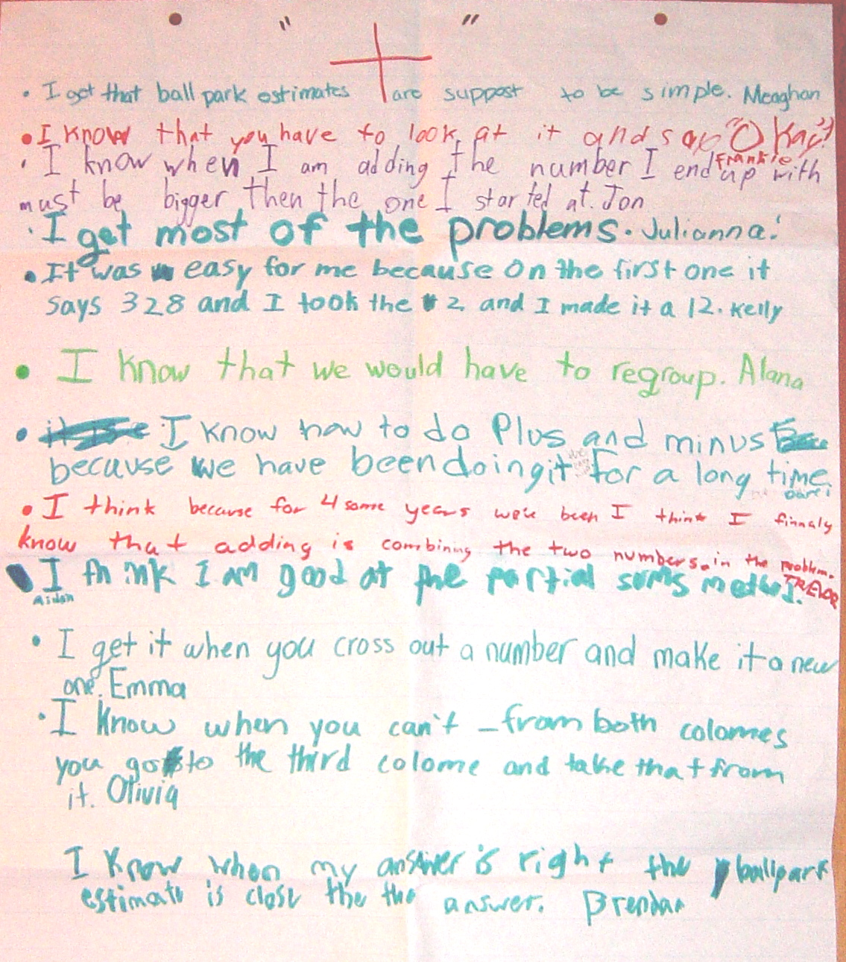

Slide 39
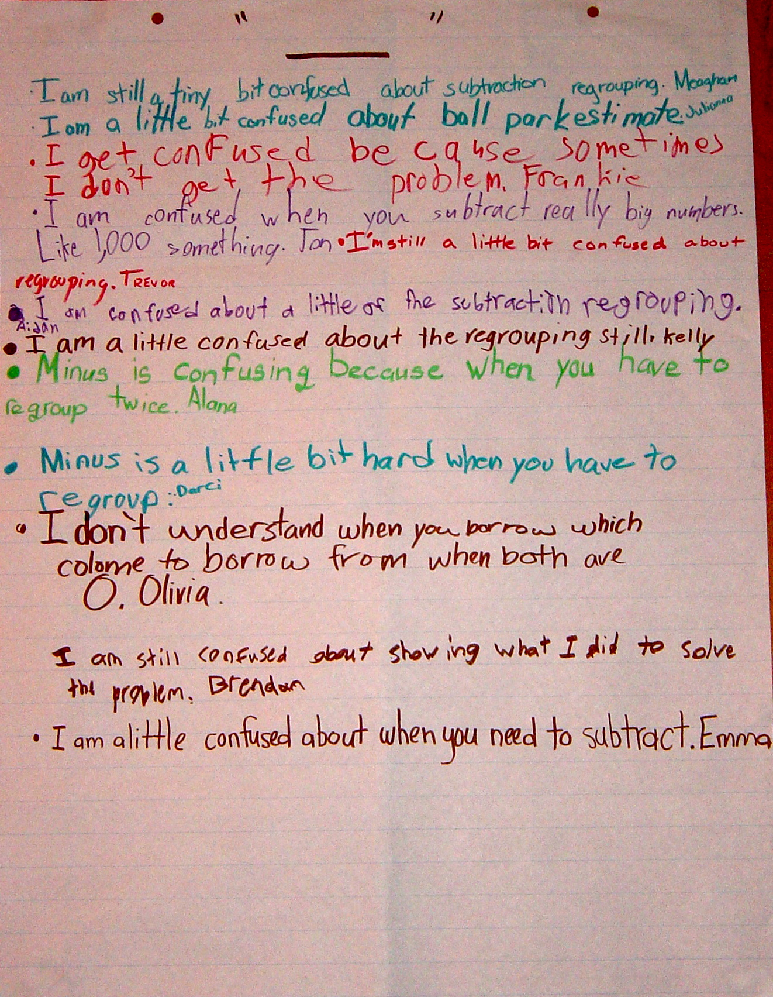

Slide 40
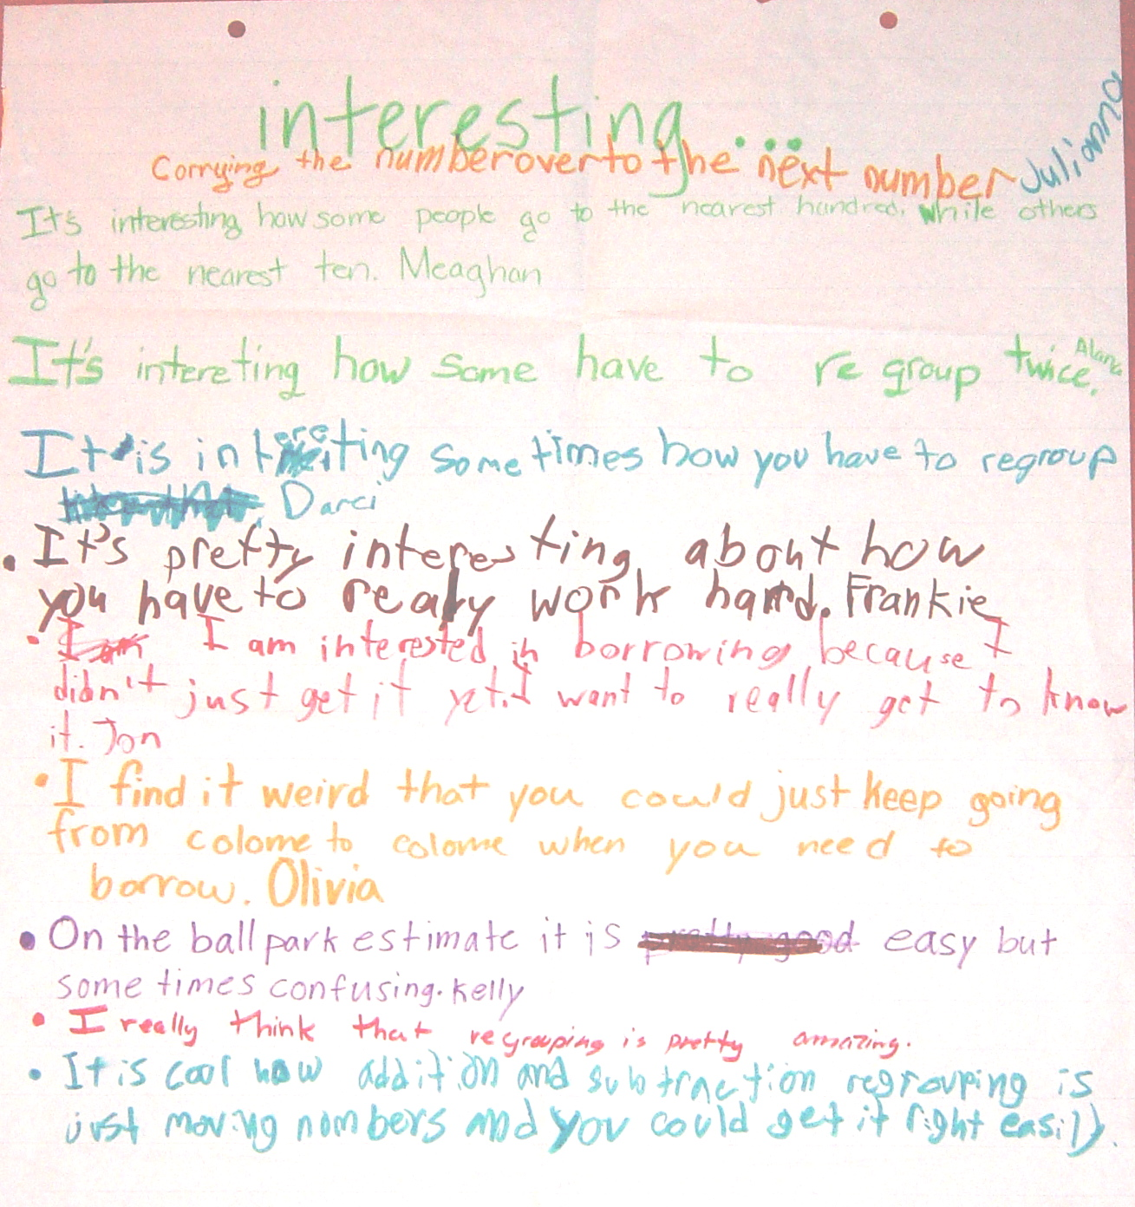

Slide 41
+/–/interesting: responses for “+”
I got that ball-park estimates are supposed to be simple
I know that you have to look at it and say “OK”
I know that when I am adding the number I end up with must be bigger than the one I started at
I get most of the problems
It was easy for me because on the first one it says 328 so I took the 2 and made it a 12
I know that we would have to regroup
I know how to do plus and minus because we have been doing it for a long time
I get it when you cross out a number and make it a new one
I know that when you can’t – from both colomes you go to the third colome and take that from it
I know that when my answer is right the ball park estimate is close to it

Slide 42
+/–/interesting: responses for “–”
I am still a tiny bit confused about subtraction regrouping
I am a little bit confused about ball park estimates
I get confused because sometimes I don’t get the problem
I am confused when you subtract really big numbers like 1,000 something
I’m still a little bit confused about regrouping
Minus is confusing when you have to regroup twice
Minus is a little bit hard when you have to regroup
I don’t understand when you borrow which colome you borrow from when both are 0
I am a little confused about when you need to subtract
I am still confused about showing what I did to solve the problem

Slide 43
+/–/interesting: responses for “interesting”
Carrying the number over to the next number
It’s interesting how some people go to the nearest hundred while some go to the nearest ten
It’s interesting how some have to regroup twice
It’s pretty interesting about how you have to work really hard
I am interested in borrowing because I didn’t just get it yet. I want to really get to know it
I find it weird that you could just keep going from colome to colome when you need to borrow
On the ball park estimate it is easy but sometimes hard
I really think that regrouping is pretty amazing
It is cool how addition and subtraction regrouping is just moving numbers and you could get it right easily

Slide 44
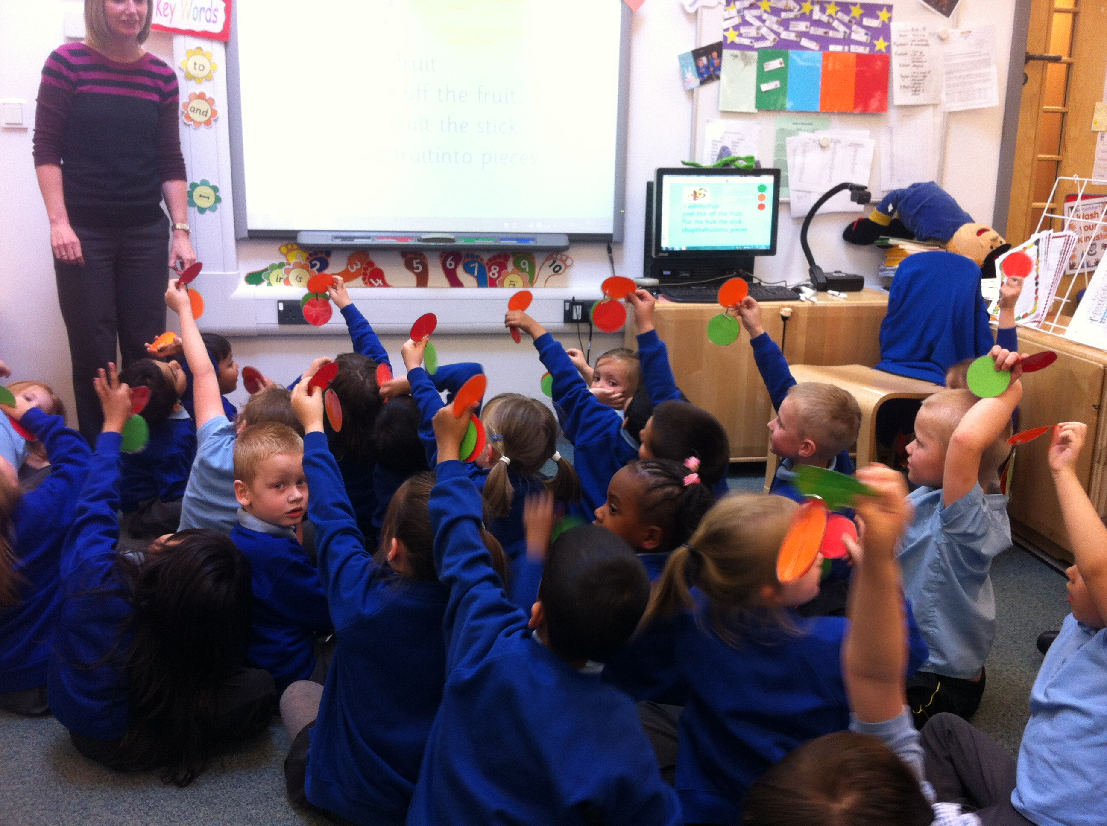

Slide 45
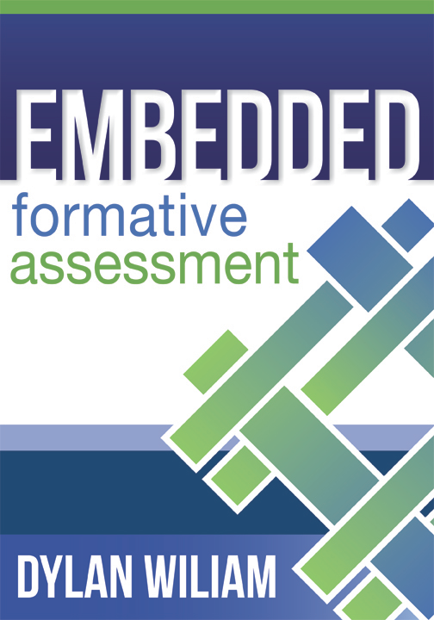
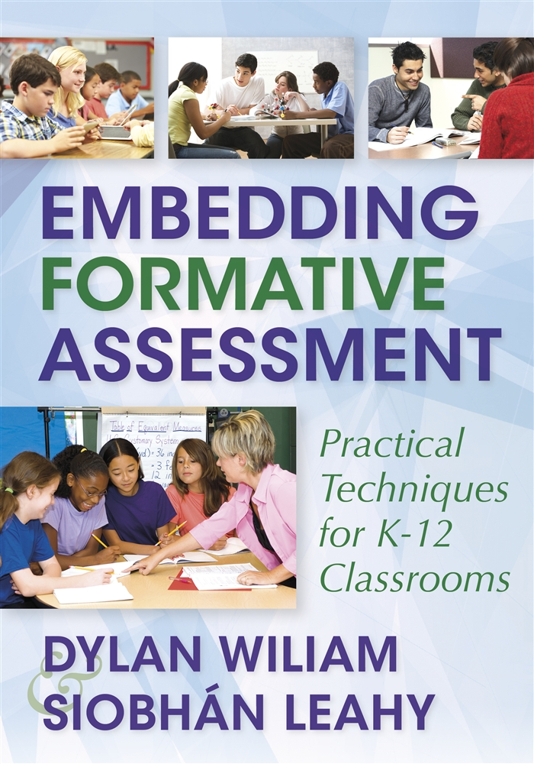


To find out more…
www.dylanwiliamcenter.com
www.dylanwiliam.net
Notes:
These are a few books you might consider. We would recommend you start with Embedding Formative Assessment. Maybe consider a book study.

