Slide 1
Formative assessment: Confusions, clarifications, & prospects for consensus

Slide 2
Outline
Formative assessment: A critical review
The definitional issue
The domain-dependency issue
The effectiveness issue
The measurement issue
The professional development issue
The system issue
Bennett (2011)

Slide 3
Formative and summative
A shift in focus
Teaching as linear
Teaching as a contingent activity
New labels for old ideas
In programme evaluation
In student assessment

Slide 4
Google Ngram of key terms

Slide 5
Reviewing the research
Philosophy
Idealist Realist
Relation to theory
Generate Explore Test
Approach to synthesis
Configurating Aggregating
Methods
Iterative A priori
Theoretical search
Exhaustive search
Quality assessment
Value contribution
Avoid bias
Product
Emergent concepts
Magnitude/precision
Use
Enlightenment
Instrumental
Gough (2012)

Slide 6
The definitional issue
Need for clear definitions
So that research outcomes are commensurable
To communicate effectively
Theorization and definition
Theorizing what?
Prescriptive: formative assessment as we would like it to be
in terms of what students should learn
in terms of what happens when learning takes place
in terms of how instruction should be organized
in terms of how teachers should teach
Descriptive: formative assessment as it is

Slide 7
Which of these are formative?
A district science supervisor uses test results to plan professional development workshops for teachers
Teachers doing item-by-item analysis of 5th grade math tests to review their 5th grade curriculum
A school tests students every 10 weeks to predict which students are “on course” to pass the end-of-year exam
“Three-quarters of the way through a unit” test
Students who fail a test on Friday have to come back on Saturday
Exit pass question: “What is the difference between mass and weight?”
“Sketch the graph of y equals one over one plus x squared on your mini-white boards.”

Slide 8
Formative Assessment: A contested term
Long-cycle
Medium-cycle
Short-cycle
Across terms, teaching units
Within and between teaching units
Within and between lessons
Span
Four weeks to
one year
One to four weeks
Minute-by-minute and day-by-day
Length
Monitoring, curriculum alignment
Student-involved assessment
Engagement, responsiveness
Impact

Slide 9
Theorization and definition
Possible variables
Category (instruments, outcomes, functions)
Beneficiaries (teachers, learners)
Timescale (months, weeks, days, hours, minutes)
Consequences (outcomes, instruction, decisions)
Theory of action (what gets formed?)

Slide 11
Ten principles for assessment
Assessment
is part of effective learning
focuses on how students learn
is central to classroom practice
is a key professional skill
is sensitive and constructive
fosters motivation
promotes understanding of goals and criteria
helps learners know how to improve
develops the capacity for self-assessment
recognises all educational achievement
Assessment Reform Group (2002)

Slide 12
Assessment for learning
“Assessment for learning is any assessment for which the first priority in its design and practice is to serve the purpose of promoting pupils’ learning. It thus differs from assessment designed primarily to serve the purposes of accountability, or of ranking, or of certifying competence.
An assessment activity can help learning if it provides information to be used as feedback, by teachers, and by their pupils, in assessing themselves and each other, to modify the teaching and learning activities in which they are engaged. Such assessment becomes ‘formative assessment’ when the evidence is actually used to adapt the teaching work to meet learning needs.” (Black, Harrison, Lee, Marshall & Wiliam, 2004 p. 2)

Slide 13
Assessment for learning (Mittler, 1973)
Assessment for learning is a broader concept than formative assessment
Assessment for motivation
Assessment for retrieval practice
“New theory of disuse”
Practice testing
Effective even when tests are not marked
Hypercorrection effect

Slide 14
An inclusive definition…
An assessment functions formatively to the extent that evidence about student achievement is elicited, interpreted, and used by teachers, learners, or their peers, to make decisions about future instruction that are likely to be better, or better founded, than the decisions that would have been taken in the absence of that evidence.

Slide 15
The domain dependency issue
Domain dependency
A theoretical stance or an empirical question?
Trade-offs
Domain dependent
Questions, feedback
Domain independent
Strategies, techniques
Formative assessment is, trivially, both domain dependent and domain-independent
Key question: How far can we take formative assessment as a domain-independent process?

Slide 16
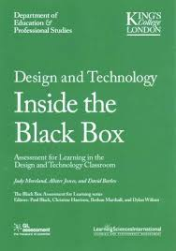

Slide 17
The effectiveness issue
Understanding meta-analysis
A technique for aggregating results from different studies by converting empirical results to a common measure (usually effect size)
Standardized effect size is defined as:
Problems with meta-analysis
The “file drawer” problem
Variations in intervention quality
Variation in population variability
Selection of studies
Sensitivity of outcome measures

Slide 18
Annual growth in achievement, by age
Bloom, Hill, Black, and Lipsey (2008)

Slide 19
Recent meta-analytic findings
Content area | N | 95% confidence interval for effect size
 |  | Lower | Mean | Upper
Mathematics | 19 | 0.14 | 0.17 | 0.20
English Language Arts | 4 | 0.30 | 0.32 | 0.34
Science | 17 | 0.06 | 0.19 | 0.31
Total | 40
Mean effect size ≈ 0.20
A big effect size
Equivalent to a 50% to 70% increase in the rate of learning
Kingston and Nash (2011, 2015)

Slide 20
The measurement issue
Formative assessment as assessment
An assessment is a procedure for making inferences (Cronbach, 1971 p. 447)
We give students things to do
We observe their responses
We collect evidence
We make inferences
The terms “formative” and “summative” are best thought of as descriptions of inferences

Slide 21
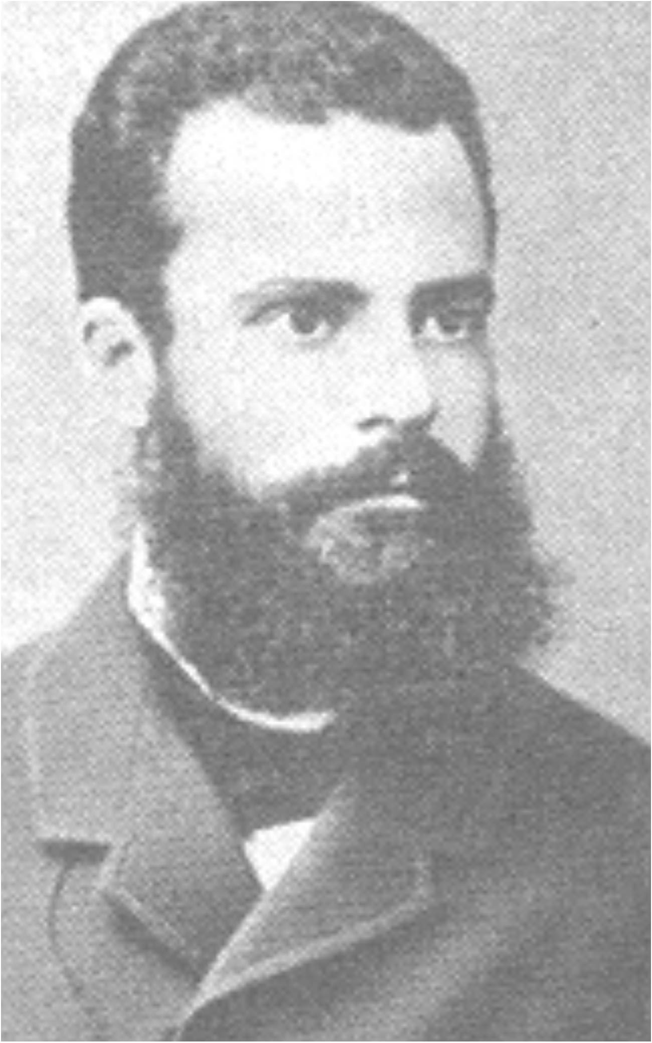
The professional development issue
Vilfredo Pareto (1848-1923)
Economist, philosopher, and sociologist, associated with the 80:20 rule
Pareto improvement
A change that can make at least one person (e.g., a student) better off without making anyone else (e.g., a teacher) worse off.
Pareto efficiency/Pareto optimality
An allocation (e.g., of resources) is Pareto efficient or Pareto optimal when there are no more Pareto improvements
The essence of effective leadership is to stop people doing good things to give them time to do better things

Slide 22
The professional development issue
 | If we treat formative assessment as:
 | Domain specific | Domain general
Benefits of professional development are: | mostly limited to those domains studied | mostly applicable to all aspects of practice
Professional development improves student achievement: | a little | a lot
Professional development is mostly a matter of: | knowledge acquisition | habit change
And doing it is: | easy | hard

Slide 23
The system issue
Evaluation versus improvement
Evaluation frameworks:
of necessity, have to be comprehensive
include all aspects of teachers work
at best, incentivize improvement on all aspects of practice
at worst, incentivize improvement on aspects of practice that are easy to improve
Improvement frameworks:
are selective
focus on those aspects of practice with the biggest payoff for students
To maximize improvement, evaluation frameworks have to be used selectively

Slide 24
The relationship of formative assessment to other policy priorities

Slide 25
Unpacking formative assessment
Where the learner is going
Where the learner is
How to get there
Engineering effective discussions, tasks, and activities that elicit evidence of learning
Providing feedback that moves learners forward
Teacher
Clarifying, sharing and understanding learning intentions
Peer
Activating students as learning
resources for one another
Learner
Activating students as owners of their own learning

Slide 26
Educational Endowment Foundation toolkit
Intervention | Cost | Quality of evidence | Extra months of learning
Feedback | ££ | ★★★ | +8
Metacognition and self-regulation | ££ | ★★★★ | +8
Peer tutoring | ££ | ★★★★ | +6
Early years intervention | £££££ | ★★★★ | +6
One to one tuition | ££££ | ★★★★ | +5
Homework (secondary) | £ | ★★★ | +5
Collaborative learning | £ | ★★★★ | +5
Phonics | £ | ★★★★ | +4
Small group tuition | £££ | ★★★★ | +4
Behaviour interventions | £££ | ★★ | +4
Digital technology | ££££ | ★★★★ | +4
Social and emotional learning | £ | ★★★★ | +4

Slide 27
Educational Endowment Foundation toolkit
Intervention | Cost | Quality of evidence | Extra months of learning
Parental involvement | £££ | ★★★ | +3
Reducing class size | £££££ | ★★★ | +3
Summer schools | £££ | ★★ | +3
Sports participation | £££ | ★★ | +2
Arts participation | ££ | ★★★ | +2
Extended school time | £££ | ★★ | +2
Individualized instruction | £ | ★★★ | +2
After school programmes | ££££ | ★★ | +2
Learning styles | £ | ★★★ | +2
Mentoring | £££ | ★★★ | +1
Homework (primary) | £ | ★★★ | +1

Slide 28
Educational Endowment Foundation toolkit
Intervention | Cost | Quality of evidence | Extra months of learning
Teaching assistants | ££££ | ★★ | 0
Performance pay | ££ | ★ | 0
Aspiration interventions | £££ | ★ | 0
Block scheduling | £ | ★★ | 0
School uniform | £ | ★ | 0
Physical environment | ££ | ★ | 0
Ability grouping | £ | ★★★ | -1

Slide 29
Unpacking formative assessment
Where the learner is going
Where the learner is
How to get there
Engineering effective discussions, tasks, and activities that elicit evidence of learning
Providing feedback that moves learners forward
Teacher
Clarifying, sharing and understanding learning intentions
Peer
Activating students as learning
resources for one another
Learner
Activating students as owners of their own learning

Slide 30
“More research is (always) needed…”
“Furthermore, despite the existence of some marginal and even negative results, the range of conditions and contexts under which studies have shown that gains can be achieved must indicate that the principles that underlie achievement of substantial improvements in learning are robust. Significant gains can be achieved by many different routes, and initiatives here are not likely to fail through neglect of delicate and subtle features.” (Black & Wiliam, 1998 pp. 61-62)

Slide 31
Implementation issues
Articulation with other policy priorities
Teacher evaluation frameworks (Marzano, Danielson)
Differentiated instruction
Response to (instruction and) intervention
Policy environment
Teacher pre-service education
Commitment to continuous improvement
District-level policies that require all teachers to improve
Improvement focused on evidence-based practices
Focus

Slide 32
A simplified logic model
Better evidence of student achievement
Increased student engagement
Increased peer support
Improved instructional decision making
Improved student achievement

Slide 33
A (suspiciously neat) retrospective
Five phases
1992-1997: Reviewing the evidence
1998-2003: Working with teachers on implementation
2004-2009: Work on scalability
2010-2015: Working with leaders
2016-2021: Creating conditions for system transformation

Slide 34
Unfinished business
Links with
Pedagogy
Instructional design
Learning versus performance
Cognitive load theory

