Slide 1
Dylan Wiliam (@dylanwiliam)
Creating the schools our children need:
Why what we’re doing now won’t help much and what we can do instead
www.dylanwiliamcenter.com www.dylanwiliam.org

Slide 2
Outline
Why we need to improve American education
What we’re doing right now
  Getting smarter people into teaching
  Firing bad teachers
  Paying good teachers more
  Reducing class size
  Copying other countries
  Expanding school choice
What we can do instead
  Developing a knowledge-rich curriculum
  Improving the teachers we have

Slide 3
Why we need to raise achievement
US students leaving school without basic levels of achievement in:
  Reading: 20%
  Mathematics: 30%
  Science: 20%
  In any of these: 15%
In advanced economies, over the next 20 to 30 years
  25% to 35% of jobs could be offshored
  About half the work being done right now could be done by machines with existing technology
OECD (2017); Blinder (2011); Frey & Osborne, 2013; McKinsey (2015)

Slide 4
What we’re doing right now (and why it won’t help much)

Slide 5
Getting smarter people into teaching

Slide 6
Teacher preparation, student progress
 | Mathematics |  |  | Reading
 | Primary | Middle | High | Primary | Middle | High
General theory of education courses
Teaching practice courses
Pedagogical content courses
Advanced university courses
Aptitude test scores
 | Mathematics |  |  | Reading
 | Primary | Middle | High | Primary | Middle | High
General theory of education courses |  |  |  |  | —
Teaching practice courses |  |  |  | — | +
Pedagogical content courses | + | +
Advanced university courses |  |  | — |  |  | +
Aptitude test scores |  |  | —
Harris and Sass (2007)

Slide 7
Firing bad teachers

Slide 8
Effects of removing low-performing teachers
Data: reading scores for 4th and 5th grade students in Florida’s public schools from 2004-05 to 2008-09
A total of 227,014 students (96%) are matched to 15,152 teachers responsible for teaching reading
A value-added score is estimated for each teacher each year
Two policy options explored for teacher removal:
  Value-added score below threshold for two consecutive years
  Two-year average value-added score below threshold
Winters and Cowen (2013)

Slide 9
System-wide impact
Policy | Remove all teachers in the bottom | Extra days of learning per student per year
Consecutive years | 5% | 0.0
 | 10% | 0.5
 | 25% | 1.5
Two-year average | 5% | 1.5
 | 10% | 2.0
 | 25% | 3.5

Slide 10
Paying good teachers more

Slide 11
Differentiated compensation
Paying all teachers more does seem to increase student achievement
Paying good teachers more
  No link between teacher qualifications and student progress
  Many failures (Nashville, NYC)
  Some successes
    Washington DC Impact scheme
    Teacher Incentive Fund
      One off “bump” (3 to 4 weeks extra learning in the second year)
      No improvement after that
      Not sustainable because of cost
Dolton & Marcenaro-Gutierrez (2011); Chiang et al. (2017)

Slide 12
Can we identify good teachers by observation?

Slide 13
Do we know a good teacher when we see one?
Experiment 1
  Seven teachers (3 high-performing, 4 not)
    Group 1: at least 0.5 sd above mean value-added for 3 years
    Group 2: never 0.5 sd above average value-added in 3 years
  7 video clips shown to 100 raters
  Average number of correct ratings: 2.8
Distribution of total correct ratings
0 | 1 | 2 | 3 | 4 | 5 | 6 | 7
1% | 11% | 29% | 36% | 13% | 9% | 1% | 0%
Strong, Gargani, and Hacifazlioğlu (2011)

Slide 14
Ratings by rater type
Rater | Number | Accuracy (%)
Teachers | 10 | 37
Parents | 7 | 37
Mentors | 10 | 47
University professors | 9 | 41
Administrators | 10 | 31
Teacher educators | 10 | 31
College students | 11 | 36
Math educators | 10 | 34
Other adults | 11 | 43
Elementary students | 12 | 50

Slide 15
Bias in lesson observations
A study of 834 teachers from six large US school districts found that teachers were more likely to be given a higher observation rating if they were teaching students with higher achievement.
Compared with teachers teaching the lowest achieving students (bottom 20%), those teaching the highest achieving students (top 20%) were:
  2.5 times as likely to be top-rated in English
  6 times as likely to be top-rated in mathematics

Slide 16
Can we identify good teachers from test scores?

Slide 17
Value-added: Different models, different answers
Analysis of teacher value-added estimates from ACT scores
  Subject Number of teachers
  Algebra I teachers 22
  Algebra II teachers 36
  Biology teachers 31
  Chemistry teachers 26
  10th-grade English teachers 25
  11th-grade English teachers 34
  Geometry teachers 38
  Total 212

Slide 18
Teachers allocated to quintiles of quality
Cross-classification of the percentage of teachers classified in quintiles of teacher quality using two different value-added models
 | Student fixed-effects model
Traditional model |  | 1 | 2 | 3 | 4 | 5
 | 1 | 38 | 22 | 24 | 16 | 0
 | 2 | 26 | 28 | 15 | 20 | 11
 | 3 | 20 | 20 | 20 | 24 | 16
 | 4 | 13 | 24 | 26 | 13 | 24
 | 5 | 9 | 5 | 12 | 28 | 47
Goldhaber, Goldschmidt, and Tseng (2013)

Slide 19
Can we identify good teachers by combining evidence from different sources?

Slide 20
Measures of Effective Teaching project
Three sources of evidence on teacher effectiveness
  Value-added estimates
  Classroom observation
  Student perception surveys
Bill and Melinda Gates Foundation (2012)

Slide 21
Prediction and reality
Teacher rating
To get a reliable estimate of a teacher’s quality, you would need to collect data on that teacher for 11 years
How good the teacher actually is

Slide 22
Reducing class size

Slide 23
Class-size reduction programs
In general, students taught by the same teacher in a smaller class will make more progress, depending on
  Age of the students
  Support for the teacher
  Supply of additional teachers
However, meaningful reductions in class size are costly
Reducing class size from 30 to 20 requires increasing education expenditure by 40%
There are better things to do with the money

Slide 24
Copying other countries

Slide 25
Issues with international comparisons
Test translation
Student motivation
Unrepresentative samples
Figuring out the causes
Implementation

Slide 26
Expanding school choice

Slide 27
Charter schools
In the US, between-school differences are small
Charter schools
  Some charter schools are highly effective
  (KIPP, Uncommon schools)
  Most are similar to traditional public schools
  System-wide impacts will be small
    even if all charter schools are as good as KIPP schools,
    and charter schools places expand at their current rate (250,000/year),
    we will have students making 3 week more progress each year
    by 2058

Slide 28
Educational vouchers
US student performance on PISA 2012
  Public Private
  Reading 498 527
  Math 481 496
  Science 497 518
But, taking into account differences in students, in mathematics,
  Public schools outscore private schools by 7 points
And, taking into account peer effects:
  Public schools outscore private schools by 27 points

Slide 29
Pause for reflection
What’s the most interesting, surprising, or challenging thing you have heard so far?
See if you can get consensus with your neighbors.

Slide 30
What we can do instead

Slide 31
Learning from research
Three questions we should be asking
  How much will this improve learning?
  How much will it cost?
  Will it work here?

Slide 32
A knowledge-rich curriculum

Slide 33
Copy this
ЖӘШІК

Slide 34
Countdown game
Target number: 127
25
3
1
9
4

Slide 35
Memorization of spoken digits
World record for the memorization of single digits, spoken at the rate of one per second
World Memory Statistics (2015)

Slide 36
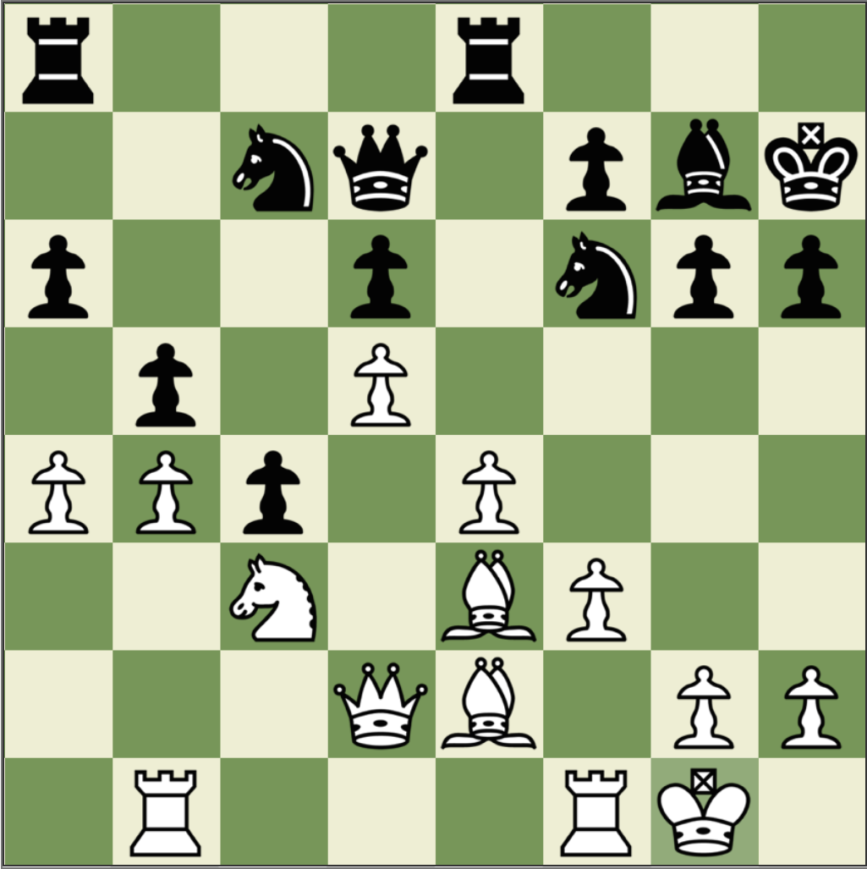
Memory in chess
Studies of memory in chess
  Djakow, Petrovskij, and Rudik (1927)
  Adriaan De Groot (1946)
  Chase and Simon (1973)

Slide 37
Perception in chess
Three chess players were shown a chess board for five seconds, and then asked to reproduce what they had seen.
Two scenarios
  Middle game (30 to 40 moves in, 25 pieces on board)
  End game (80 moves in, 12 to 15 pieces on board)

Slide 38
Memory in chess (1)
Mid-game | Player level | Number of pieces correctly placed
 | Novice | 5
 | Club player | 9
 | Expert | 16
Random | Player level | Number of pieces correctly placed
 | Novice | 2
 | Club player | 3
 | Expert | 3

Slide 39
Memory in chess (2)
End game | Player level | Number of pieces correctly placed
 | Novice | 4
 | Club player | 7
 | Expert | 8
Attempts to simulate the performance of the expert chess player with computers suggest that the expert can recognize at least 10,000—but probably fewer than 100,000—different arrangements of chess pieces or “chunks,” with a most likely value around 13,500 (Simon & Gilmartin, 1973)

Slide 40
A model of human memory
Long-term memory
Short-term memory
Environment
Limited
Limitless
The purpose of education is to build domain-specific knowledge—i.e., long-term memory

Slide 41
Reading ability and soccer knowledge
17.0
16.4
11.1
11.0
Schneider, Körkel, and Wiener (1989)

Slide 42
What is learning?
Learning is “a change in long-term memory”
(Kirschner, Sweller, & Clark, 2016 p. 77)
“The aim of all instruction is to alter long-term memory. If nothing has changed in long-term memory, nothing has been learned.” (ibid p. 77)
“Novices need to use thinking skills. Experts use knowledge” (Sweller et al., 2011 p. 21)

Slide 43
Why curriculum matters
Myths about curriculum
  Standards tell us what to teach
  Curriculum means textbooks
  Knowledge isn’t important (“You can always Google it”)
  Students should be involved in authentic tasks
  We should be teaching skills, not content
  Responding to students’ interests closes achievement gaps
What is the purpose of curriculum?
  The real purpose of the curriculum is to increase the contents of long-term memory

Slide 44
Investing in the teachers we already have

Slide 45
Where should our efforts be focused?
Which of these is most strongly associated with high student achievement?
  Student speaks the language of teaching at home
  Student behavior in the school is good
  The amount of inquiry-based teaching
  The amount of teacher-directed teaching
  The school’s socio-economic profile
Top 3 factors
  Student’s socio-economic profile
  Index of adaptive instruction
  The amount of teacher-directed instruction
OECD (2016, Fig II.7.2)

Slide 46
General conclusions about expertise
Elite performance is the result of at least a decade of maximal efforts to improve performance through an optimal distribution of deliberate practice
What distinguishes experts from others is the commitment to deliberate practice
Deliberate practice is
  an effortful activity that can be sustained only for a limited time each day
  neither motivating nor enjoyable—it is instrumental in achieving further improvement in performance

Slide 47
Expertise in teaching
Research shows expertise in teaching shares the hallmarks of expertise in other domains
More importantly, for the general expertise research not to apply to teaching:
  All the other areas would have to be similar, and
  Teaching would have to be different
This seems unlikely, so
As far as we can tell, what is true for expertise in other areas is likely to be true for teaching
In other words, we can make almost all teachers as good as the very best if we support them in the right way

Slide 48
Supportive accountability
What is needed from teachers:
  A commitment to:
    The continual improvement of practice
    Focus on those things that make a difference to students
What is needed from leaders:
  A commitment to engineer effective learning environments for teachers by:
    Creating expectations for continually improving practice
    Keeping the focus on the things that make a difference to students
    Providing the time, space, dispensation, and support for innovation
    Supporting risk-taking

Slide 49
Thank You
www.dylanwiliam.net

