Slide 1
The central role of constructs in the pursuit of equity in educational assessment
Dylan Wiliam (@dylanwiliam)
www.dylanwiliam.org

Slide 2
Outline
No need to “reconceptualize” assessment
No such thing as a biased assessment
Focus on constructs, not assessments
A case study in selection for medical education

Slide 3
A brief history of the idea of validity
Validity as a property of
tests
test scores
inferences
The “consensus view” of validity
“an integrative evaluative judgment of the degree to which empirical evidence and theoretical rationales support the adequacy and appropriateness of inferences and actions based on test scores or other modes of assessment.” (Messick, 1989 p. 13)
Current work focuses on respective responsibilities of test producers and users

Slide 4
Consequences of the consensus view
“One validates not a test but an interpretation of data arising from a specified procedure”(Cronbach, 1971 p. 447)
Consequences
Category mistakes (Ryle, 1949)
No such thing as a valid (or indeed invalid) assessment
No such thing as a biased assessment
Formative and summative are descriptions of inferences

Slide 5
Quality in assessment
Threats to validity
Construct-irrelevant variance
Systematic: good performance on the assessment requires abilities not related to the construct of interest
Random: good performance is related to chance factors, such as luck (effectively poor reliability)
Construct under-representation
Good performance on the assessment can be achieved without demonstrating performance on all aspects of the construct of interest

Slide 6
Some practical applications
Mental rotation (Voyer et al. 1995)
Males outperform females
Selection in higher education
Some minorities perform less well than whites
But the same minorities perform less well at college
SAT overpredicts college grades for African-Americans
Assessing history (Breland 1991)
Multiple choice: males outperform females
Constructed response: females outperform males

Slide 7
Focus on constructs, not assessments
Validity debates
often appear to be about the technical adequacy of the assessment
but more often are debates about the construct to be assessed
Without clear construct definition
construct debates manifest as assessment debates
With clear construct definition
construct selection is necessarily value-laden
assessment design is primarily a technical task

Slide 8
An illustrative case study: Access to Medicine

Slide 9
Access to Medicine: the context
King’s College London
5th largest university in the United Kingdom
Largest medical school in Europe
Located in SE London: ethnically diverse population
Highly selective admissions, based on achievement on high-stakes examinations
Result:
Private school students over-represented
White and Asian students over-represented
Students of African heritage under-represented
Socio-economically disadvantaged students under-represented

Slide 10
Access to Medicine
The goal:
Widen participation to, and success in, medical education
Produce more culturally competent medical services
The challenge
Do so without “lowering the bar”
Do not provide a “second chance” for already advantaged students

Slide 11
Correlation or pre-requisite?
Pearson product-moment
correlation = 0.71

Slide 12
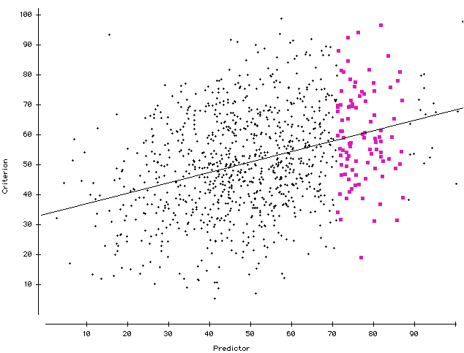
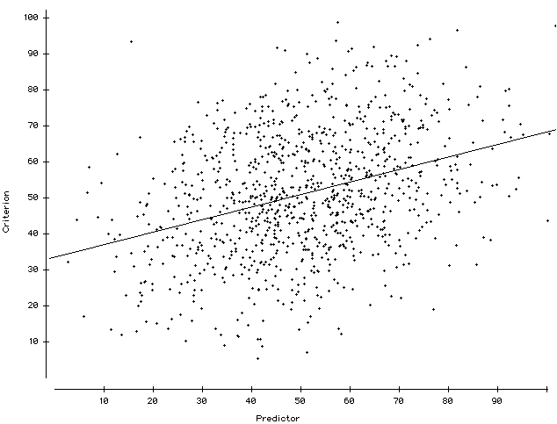
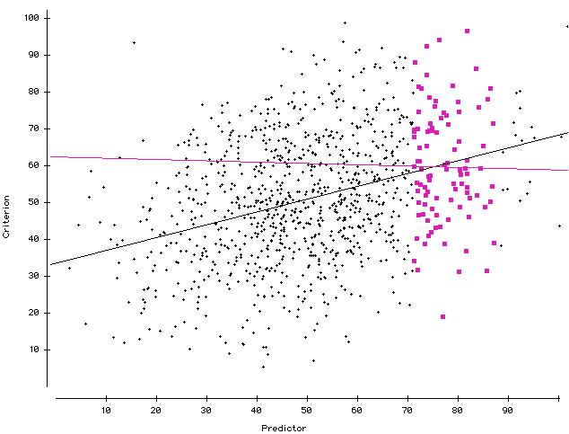
Correlation: 0.35

Slide 15
A solution in three parts…
Recruitment
Program to raise aspirations in middle school
Selection
Only public-school students in local area eligible
Target: 10, 20, 30, 40, 50 in 2000, 2001, 2002, 2004, 2005
Assessment via
achievement at school
personal characteristics
science reasoning tasks
Retention
Additional foundation year
Two years to cover traditional first year curriculum
Dedicated support
living expenses and tuition provided for first year only
dedicated tutorial support

Slide 16
Science Reasoning Tasks (SRTs)
Based on work of Shayer & Adey (1981)
Suite of group-administered tasks
Assess not science knowledge but ability to incorporate new facts into existing schema
Benchmarked on existing medical students
So provide alternative ways of showing talent

Slide 17
The story so far
Program now in its 16th year
now called the Extended Medical Degree Programme
Steady state: 300 students enrolled (50 in each year)
Still substantial challenges
High maintenance cost
Selection methods modified over time
But
Non-traditional students essentially indistinguishable from traditional route students
Is not seen as a ‘soft option’

Slide 18
Conclusions
Differential impact is not (necessarily) bias
When assessments show differential impact
Consider alternative constructs
If no suitable alternative constructs exist
Check for consistent, strong predictor-criterion relationships in the area where selections are made
Where no such relationships exist, set a cut score, and select at random from those who exceed that score

