Slide 1
Dylan Wiliam (@dylanwiliam)
Activating students as owners of their own learning: Metacognition in the classroom
www.dylanwiliamcenter.com

Slide 2
The most important idea in education?
Learning is a change in long-term memory
“The aim of all instruction is to alter long-term memory. If nothing has changed in long-term memory, nothing has been learned.” (Kirschner, Sweller, & Clarke, 2006 p. 77)

Slide 3
Learning and performance
Alley maze experiments
Hungry rats put in mazes
Removed when they reach the food box
Learning measured by number of entrances into blind alleys

Slide 4
Learning and performance
Tolman and Honzik (1930) adapted by Sodestrom and Bjork (2015)

Slide 5
What is learning?
Learning is “a change in long-term memory” (Kirschner, Sweller, & Clark, 2016 p. 77)
“The aim of all instruction is to alter long-term memory. If nothing has changed in long-term memory, nothing has been learned.” (ibid p. 77)

Slide 6
Metacognition (Flavell, 1976)
“Metacognition” refers to one’s knowledge concerning one’s own cognitive processes and products or anything related to them, e.g., the learning-relevant properties of information and data. For example I am engaging in metacognition (metamemory, metalearning, metaattention, metalanguage, or whatever)
if I notice that I am having more trouble learning A than B;
if it strikes me that I should double-check C before accepting it as a fact;
if it occurs to me that I had better scrutinise each and every alternative in any multiple-choice type task situation before deciding which is the best one;
if I sense that I had better make a note of D because I may forget it;
if I think to ask someone about E to see if I have it right.

Slide 7
“In any kind of cognitive transaction with the human or nonhuman environment, a variety of information processing activities may go on. Metacognition refers, among other things, to the active monitoring and consequent regulation and orchestration of these processes in relation to the cognitive objects or data on which they bear, usually in the service of some concrete goal or objective.” (Flavell, 1976 p. 232)

Slide 8
Self-regulated learning
Three components
Motivation
Cognition
Metacognition
Metacognitive knowledge
generalizing and inferring rules
labeling strategies
when and how to use strategies
Metacognitive strategies
Planning strategies
Monitoring strategies
Evaluation strategies

Slide 9
“Unskilled and unaware of it”
45 Cornell University undergraduates completed a 20-item logical reasoning test derived from the LSAT preparation guide
After the test, students were asked to estimate
general logical reasoning ability
how their score would compare with classmates
how many questions they had answered correctly

Slide 10
Logical reasoning
Kruger and Dunning (1999)

Slide 11
Flawed self-assessment
Only 2% of high school seniors believe their leadership skills are below average (College Board, 1976/1977)
…and 25% of them believe they are in the top 1% in their ability to get along with others (College Board, 1976/1977)
93% of Americans and 69% of Swedes think they are above average drivers (Svenson, 1981)
94% of college professors report doing above average work (Cross, 1997)
People think they are at lower risk than their peers for heart attacks, cancer, food poisoning, etc. (Weinstein, 1980)
Strangers predict your IQ better than you do (Borkenau & Liebler, 1993)
People believe they are more accurate than their peers at self-assessment (Pronin, Lin, & Ross, 2002)

Slide 12
Do students know when they are learning?
Data: 10,534 students attending USAFA (2000-2007)
Students randomly allocated to calculus instructors
Less-qualified, less experienced instructors
Higher end-of-course scores
Lower scores on follow-on courses
Higher student evaluations
More-qualified, more experienced instructors
Lower end-of-course scores
Higher scores on follow-on courses
Lower student evaluations
Carrell and West (2010)

Slide 13
Can learners self-regulate?
Orient
Test
Plan
Monitor
When applied by experts
Many relevant schema available
Many automated skills/processes available
Works forward
When applied by novices
Few relevant schema available
Individual skills/processes have to be consciously processed
Works backward (means-end)
“Novices need to use thinking skills. Experts use knowledge”
(Sweller et al., 2011 p. 21)
Kirschner (2018)

Slide 14
Where should our efforts be focused?
Which of these is most strongly associated with high student achievement?
Student speaks the language of instruction at home
Student behavior in the school is good
The amount of inquiry-based instruction
The amount of teacher-directed instruction
The school’s socio-economic profile
Top 3 factors
Student’s socio-economic profile
Index of adaptive instruction
The amount of teacher-directed instruction
OECD (2016, Fig II.7.2)

Slide 15
Why formative assessment needs to be a priority

Slide 16
Why Formative Assessment?
A principle and an uncomfortable fact about the world
The principle:
"If I had to reduce all of educational psychology to just one principle, I would say this: The most important single factor influencing learning is what the learner already knows. Ascertain this and teach him [or her] accordingly” (Ausubel, 1968 p. vi)
The uncomfortable fact:
Students do not learn what we teach.
What is learning?
Learning is a change in long-term memory (Kirschner et al., 2006)
The fact that someone can do something now does not mean they will be able to do it in six weeks, but
If they cannot do something now, it is highly unlikely they will be able to do it in six weeks

Slide 17
Building Plan “B” into Plan “A”

Slide 18
Relevant studies
Fuchs & Fuchs (1986)
Natriello (1987)
Crooks (1988)
Bangert-Drowns et al. (1991)
Dempster (1991, 1992)
Elshout-Mohr (1994)
Kluger & DeNisi (1996)
Black & Wiliam (1998)
Nyquist (2003)
Allal & Lopez (2005)
Köller (2005)
Brookhart (2007)
Wiliam (2007)
Hattie & Timperley (2007)
Shute (2008)
Kingston & Nash (2011, 2015)

Slide 19
Formative assessment: A contested term
Long-cycle
Medium-cycle
Short-cycle
Across terms, teaching units
Within and between teaching units
Within and between lessons
Span
Four weeks to
one year
One to four weeks
Minute-by-minute and day-by-day
Length
Monitoring, curriculum alignment
Student-involved assessment
Engagement, responsiveness
Impact

Slide 20
Unpacking formative assessment
 | Where the learner is going | Where the learner is now | How to get the learner there
Teacher
Peer
Student
Clarifying, sharing, and understanding learning intentions
Eliciting evidence of learning
Providing feedback that moves learners forward
Activating students as learning
resources for one another
Activating students as
owners of their own learning

Slide 21
Unpacking formative assessment
 | Where the learner is going | Where the learner is now | How to get the learner there
Teacher
Peer
Student
Using evidence of achievement to adapt what happens in classrooms to meet learner needs

Slide 22
Strategies and practical techniques for classroom formative assessment

Slide 23
Clarifying, sharing and understanding learning intentions

Slide 24
“The indispensable conditions for improvement are that the student comes to hold a concept of quality roughly similar to that held by the teacher, is able to monitor continuously the quality of what is being produced during the act of production itself, and has a repertoire of alternative moves or strategies from which to draw at any given point. In other words, students have to be able to judge the quality of what they are producing and be able to regulate what they are doing during the doing of it.” (Sadler, 1989 p. 121)

Slide 25
Sharing success criteria (English)

Slide 26
Sharing success criteria (German)

Slide 27
Memory on land and underwater
18 (5f, 13m) student members of a university diving club were tested on their recall of two- and three-syllable words from four 36-word lists taken from the Toronto Word Bank spoken to them twice.
Students learned, and were tested on, the words while underwater, and while on the shore, resulting in four conditions:
DD (learn dry, recall dry)
DW (learn dry, recall wet)
WD (learn wet, recall dry)
WW (learn wet, recall wet)

Slide 28
Memory and context
 |  | Recall environment
 |  | Dry | Wet
Learning environment | Dry | 13.5 | 8.6
 | Wet | 8.4
11.4
No significant main effects; interaction effect: F=22.0; df = 1, 12; p= <0.001
Godden and Baddeley (1975)

Slide 29
Alcohol and memory
32 adults (aged 22 to 43) asked to memorize a map and a 19-item set of instructions for a journey
Half did so sober and half at the legal limit for intoxication
The following day, half of them were tested sober and half at the legal limit for intoxication.
 | Number of items correct
 | Day 1 | Day 2
Day 1: sober; day 2: sober | 17 | 17
Day 1: sober; day 2: intoxicated | 17 | 11
Day 1: intoxicated; day 2: sober | 18 | 13
Day 1: intoxicated; day 2: intoxicated | 16
16
Lowe (1981)

Slide 30
Share learning intentions
Keep the context out of the learning intention
Differentiate success criteria, not learning intentions
Process versus product success criteria
Generic, not specific criteria
Start with samples of work, rather than rubrics, to communicate quality
Quality cannot always be reduced to words
Ensure deep and surface features are not aligned
Don’t abdicate responsibility for quality

Slide 31
Engineering effective discussions, activities, and classroom tasks that elicit evidence of learning

Slide 32
Eliciting evidence
No hands up (except to ask a question)
Choose students at random
No opting out
Avoiding questions altogether
All-student response systems
Decision-driven data collection
Hinge-questions

Slide 33
Diagnostic questions in Psychology
Which of the following is the most important difference between the theories of Piaget and Vygotsky?
Piaget places greater importance on the role of conservation in cognitive development
Vygotsky places greater importance on the role of cultural artifacts in cognitive development.
Vygotsky did not believe in distinct stages of cognitive development.
Piaget was a social constructivist while Vygotsky placed greater emphasis on cultural-historical activity theory

Slide 34
Diagnostic questions in graduate school
An experimental study of a new method of teaching reading reports that a result was significant (p<0.05). This means that:
The experimental group out-performed the control group by 5%
There is a 5% chance that the experimental group did not out-perform the control group
There is a 5% chance that there is no difference between the experimental group and the treatment group
There is only a 5% chance that the observed result would have happened if the experimental and control groups had the same achievement

Slide 35
Providing feedback that moves learners forward

Slide 36
Effects of feedback
Kluger & DeNisi (1996) review of 3000 research reports
Excluding those:
without adequate controls
with poor design
with fewer than 10 participants
where performance was not measured
without details of effect sizes
left 131 reports, 607 effect sizes, involving 12652 individuals
On average, feedback increases achievement
Effect sizes highly variable
38% (231 out of 607) of effect sizes were negative

Slide 37
Getting feedback right is hard
Response type | Feedback indicates performance…
 | falls short of goal | exceeds goal
Change behavior | Increase effort | Exert less effort
Change goal | Reduce aspiration | Increase aspiration
Abandon goal | Decide goal is too hard | Decide goal is too easy
Reject feedback | Feedback is ignored | Feedback is ignored

Slide 38
Provide feedback that moves learning on
Focus on the reaction of the students, not the feedback
Develop a growth mindset in your students
Design feedback as part of a system
Concentrate on “personal bests”
Make feedback into detective work

Slide 39
Dual-pathway theory (Boekaerts, 2006)
Long-term learning goals are translated into short-term learning intentions
Dynamic comparisons of task and situational demands with personal resources, taking into account:
Current perceptions of the task
Beliefs about the subject or task
Beliefs about “ability” and the role of effort in the subject
Interest in the subject (personal vs. situational)
Previous experiences on similar tasks
Costs and benefits

Slide 40
Dual-pathway theory
Resulting activation of energy along one of two pathways:
Well-being
Growth

Slide 41
Students as learning resources for one another

Slide 42
Cooperative learning: a research success story
Two essential components
Group goals:
so students are working as a group, not just in a group
Individual accountability:
the best learning efforts of every member of the group must be necessary for the group to succeed, and
the performance of each group member must be clearly visible and quantifiable to the other group members
Slavin, Hurley and Chamberlain (2003)

Slide 43
How does cooperative learning work?
Four mechanisms
Motivation: students help their peers to learn because, in well-structured cooperative learning settings, it is in their own interests to do so, and so effort is increased;
Social cohesion: students help their peers because they care about the group, again leading to increased effort;
Personalization: students learn more because more able peers can engage with the particular difficulties a student is having;
Cognitive elaboration: those who provide help in group settings are forced to think through the ideas more clearly.
Slavin, Hurley and Chamberlain (2003)

Slide 44
Peer-tutoring in science

Slide 45
Peer-tutoring in English Literature

Slide 46
Help students be learning resources
Students assessing their peers’ work:
“Pre-flight checklist”
“Two stars and a wish”
Choose-swap-choose
Daily sign-in
Training students to pose questions/identifying group weaknesses
End-of-lesson students’ review
Best composite response

Slide 47
Pros and cons of self/peer assessment
 | + | —
Teachers
Students

Slide 48
Activating students as owners of their own learning

Slide 49
Why people shouldn’t work on their own
Only 2% of high school seniors believe their leadership skills are below average (College Board, 1976/1977)
…and 25% of them believe they are in the top 1% in their ability to get along with others (College Board, 1976/1977)
93% of Americans and 69% of Swedes think they are above average drivers (Svenson, 1981)
94% of college professors report doing above average work (Cross, 1997)
People think they are at lower risk than their peers for heart attacks, cancer, food poisoning, etc. (Weinstein, 1980)
Strangers predict your IQ better than you do (Borkenau & Liebler, 1993)
People believe they are more accurate than their peers at self-assessment (Pronin, Lin, & Ross, 2002)

Slide 50
Benefits of critical listening
15-yr-olds studying World History were tested on their understanding of material delivered in lectures
Students divided into two groups
Unstructured: review the material as they chose
Structured: posing questions as they listened to the lectures
At the end of the lectures, students were given time to review their understanding of the material
 | Individual | Group
Unstructured | Independent review | Group discussion
Structured | Structured self-questioning | Structured peer-questioning

Slide 51
Impact on achievement
Unstructured
Structured
King (1991)

Slide 52
Long-term benefits for spaced learning
169 undergraduate students attended a 45-minute lecture on meteorology with 4 sections:
clouds (formation and classification)
wind (pressure streams and the Coriolis effect)
rain (classification)
thunderstorms (development; thunder and lightning)
Students tested on the material
20 lower-order questions
20 higher-order questions
Students then reviewed half of the material online:
76 did so after 1 day
93 did so after 8 days
Students tested on all material after 35 days
Kapler, Weston, and Wiseheart (2015)

Slide 53
Results after 35 days

Slide 54
Results after 35 days, by review interval
Effect sizes
0.33
0.37
0.35
0.42
Lower-order
Higher-order
Kapler, Weston, and Wiseheart (2015)

Slide 55
Help students own their own learning
Practice testing
Students assessing their own work:
With rubrics
With exemplars
Self-assessment of understanding:
Learning portfolio
Traffic lights
Red/green discs
Coloured cups
Plus/minus/interesting

Slide 56
Technique review

Slide 57
So much for the easy bit

Slide 58
A model for teacher learning
Content, then process
Content (what we want teachers to change):
Evidence
Ideas (strategies and techniques)
Process (how to go about change):
Choice
Flexibility
Small steps
Accountability
Support

Slide 59
Supportive accountability
What is needed from teachers:
A commitment to:
The continual improvement of practice
Focus on those things that make a difference to students
What is needed from leaders:
A commitment to engineer effective learning environments for teachers by:
Creating expectations for continually improving practice
Keeping the focus on the things that make a difference to students
Providing the time, space, dispensation, and support for innovation
Supporting risk-taking

Slide 60
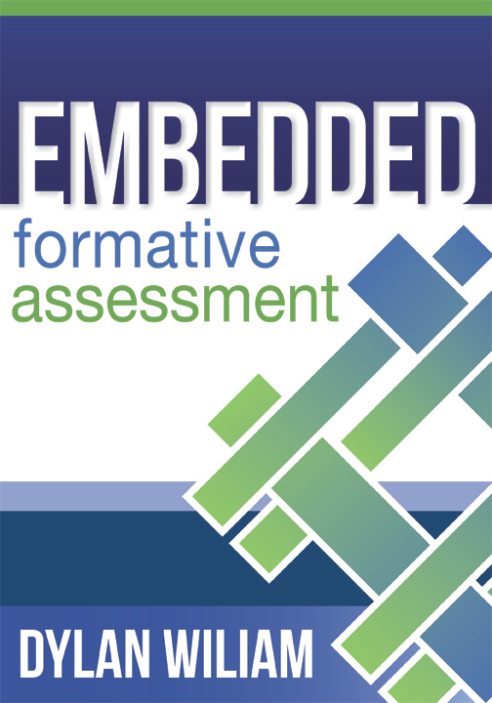
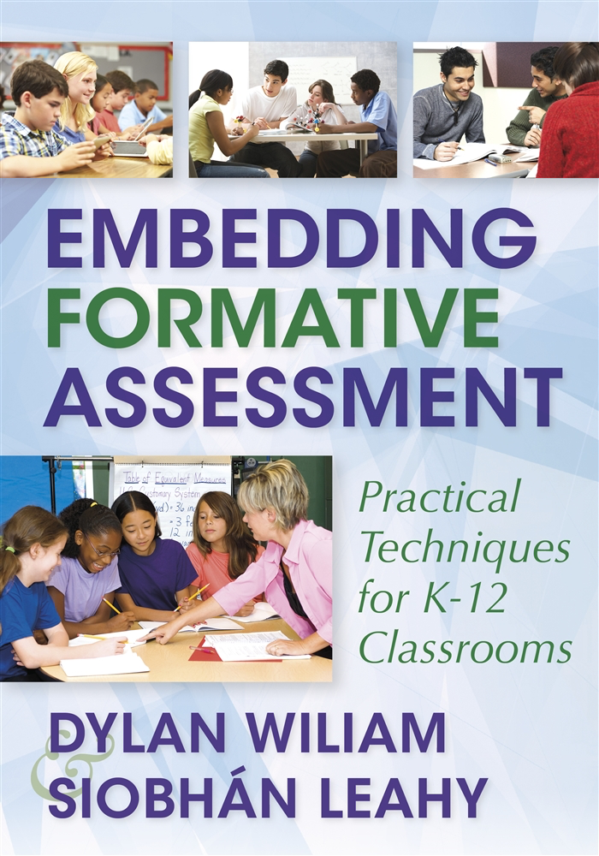
To find out more…
www.dylanwiliamcenter.com
www.dylanwiliam.net

