Slide 1
Why formative assessment is always both domain-general and domain-specific and what matters is the balance between the two
Dylan Wiliam, NCME 2019
April: Toronto, Canada
@dylanwiliam

Slide 2
Some preliminary assumptions
Learning is a change in long-term memory
Definitions of formative assessment should be descriptive, not prescriptive
Formative assessment is assessment
“Formative” and “summative” as classifications of
instruments
outcomes
purposes
inferences
8
8
8
4

Slide 3
An inclusive definition…
An assessment functions formatively to the extent that evidence about student achievement is elicited, interpreted, and used by teachers, learners, or their peers, to make decisions about future instruction that are likely to be better, or better founded, than the decisions that would have been taken in the absence of that evidence.
Black and Wiliam (2009)

Slide 4
Formative Assessment: A contested term
Long-cycle
Medium-cycle
Short-cycle
Across units, semesters
Within and between teaching units
Within and between lessons
Span
Four weeks to
one year
One to four weeks
Minute-by-minute and day-by-day
Length
Monitoring, curriculum alignment
Student-involved assessment
Engagement, responsiveness
Impact

Slide 5
Unpacking Formative Assessment
 | Where the learner is going | Where the learner is now | How to get the learner there
Teacher
Peer
Student
Clarifying, sharing, and understanding learning intentions
Eliciting evidence of learning
Providing feedback that moves learners forward
Activating students as learning
resources for one another
Activating students as
owners of their own learning

Slide 6
Unpacking Formative Assessment
 | Where the learner is going | Where the learner is now | How to get the learner there
Teacher
Peer
Student
Before you can
even begin
Responsive teaching
Clarifying, sharing, and understanding learning intentions
Eliciting evidence of learning
Providing feedback that moves learners forward
The learner’s role
Activating students as learning
resources for one another
Activating students as
owners of their own learning

Slide 7
Defining formative assessment descriptively…
A commitment to formative assessment entails no commitment of any kind about:
What students should learn (Curriculum philosophy)
What it means to know (Epistemology)
What happens when learning takes place (Psychology)
How to get students to know (Pedagogy)
Formative assessment requires accepting only that teaching is a contingent process

Slide 8
Teaching as an intentional activity
Learning intentions are descriptions of the learning (i.e., changes in long term memory) that is intended as a result of completing tasks specified by the teacher.
Success criteria are descriptions of the desired performance on those tasks.
Success criteria
As limitations on what is expected
As practice in applying in different contexts
As explanations to students of what is meant
As scaffolding for students’ responses

Slide 9
Where do learning intentions come from?
From domain theories
From standards
From curriculum objectives
From expectations about assessments
syllabuses
specimen/past papers
From shared constructs of quality

Slide 10
The roles of assessors, teachers, and learners
Effective summative assessment requires assessors to share a construct of quality
Effective formative assessment requires that
learners are enculturated into the community of practice of which the assessors are already members
teachers possess an anatomy of quality
Communities of practice can be:
stable (Lave & Wenger, 1991; Holland et al., 1998)
dynamic (Engeström, 1987)

Slide 11
Empirical evidence
 | Domain-
 | specific | mixed | general
Kingston and Nash (2011, 2015) | 0.20
Wiliam et al. (2004) |  | 0.32
Andrade et al. (2019) | 0.26
Burkhardt and Schoenfeld (2019) | 0.13

Slide 12
Embedding Formative Assessment
Whole-school 2-year PD program
Focus on
the five formative assessment strategies
teacher development as a process of habit change
Choice
Flexibility
Small steps
Accountability
Support
Detailed resource packs for groups of 8 - 14 teachers
18 monthly 75-minute meetings (1% of teacher contract time)
Peer observations between meetings
Additional cost: $2 per student per year

Slide 13
Evaluation
“Intention to treat” design
Participants
Design: detect an effect size of 0.2 with 80% power
140 schools recruited (70 treatment, 70 control)
Excluding those with previous involvement in similar work
58 treatment schools, 66 control schools
22,709 students in year 10 (9th grade) in Sep 2015
Outcome measure
“Attainment 8”
Average score on exams in 8 subjects taken in May 2017

Slide 14
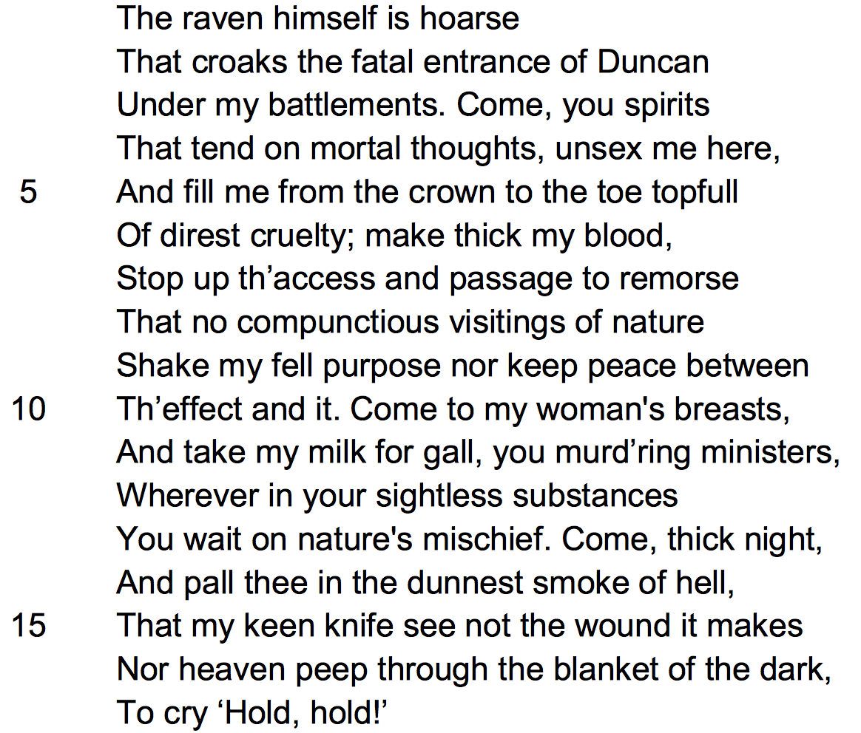
English literature (Macbeth)
Read the following extract from Act 1 Scene 5 of Macbeth and then answer the question that follows.
At this point in the play Lady Macbeth is speaking. She has just received the news that King Duncan will be spending the night at her castle.

Slide 15
Question (45 minutes)
Starting with this speech, explain how far you think Shakespeare presents Lady Macbeth as a powerful woman.
Write about:
how Shakespeare presents Lady Macbeth in this speech
how Shakespeare presents Lady Macbeth in the play as a whole
Assessment and Qualifications Alliance (2014)

Slide 16
History
Pearson (2015)

Slide 17
Empirical evidence
 | Domain-
 | specific | mixed | general
Kingston and Nash (2011, 2015) | 0.20
Wiliam et al. (2004) |  | 0.32
Andrade et al. (2019) | 0.26
Burkhardt and Schoenfeld (2019) | 0.13
Speckesseser et al. (2018) |  |  | 0.13

Slide 18
Two (complementary?) approaches
Top-down
Begin with generic approaches and see how these can best be implemented in subject domains
Bottom-up
Begin with detailed conceptualizations of domains, and then identify formative assessment practices that are particularly relevant/appropriate
Suggestions for further work
Clarify the differences between the two approaches
Explore implications for practice
Investigate strengths/weaknesses of the approaches empirically

