Slide 1
Curriculum, pedagogy, and assessment, in that order
Dylan Wiliam (@dylanwiliam)
www.dylanwiliam.org

Slide 2
Outline
Evaluation versus improvement
Teaching as an unkind learning environment
What educational research can, and cannot, do
Focuses for improvement
Curriculum
Pedagogy
Assessment
Creating the culture that makes it happen

Slide 3
What changes do we wish to effect?

Slide 4
The Early Career Framework standards
Set high expectations
Promote good progress
Demonstrate good subject and curriculum knowledge
Plan and teach well structured lessons
Adapt teaching
Make accurate and productive use of assessment
Manage behaviour effectively
Fulfil wider professional responsibilities
Department for Education (2019)

Slide 5
Evaluation vs. improvement
Professional frameworks:
of necessity, are comprehensive
at best, incentivize improvement on all aspects of practice
at worst, incentivize improvement on aspects of practice that are easy to improve
Improvement frameworks:
are selective
focus on those aspects of practice with the biggest payoff for students
To maximize improvement, professional frameworks have to be used selectively

Slide 6
So where should we focus our efforts?
Inference involves two settings
Information is acquired in one setting (learning)
Information is applied in others (predictions, choices)
What kind of learning environment is teaching?
Kind learning environments
close match of informational elements in the two settings
Wicked learning environments
poor match of informational elements in the two settings
Hogarth, Lejarraga, and Soyer (2015)

Slide 7
Teaching is a wicked learning environment…
Weak signal; lots of noise (Steinberg & Garrett, 2016)
Performance is not learning (Bjork, 1991)
Things that work in the short term can be ineffective, or even counter-productive, later (Carrell & West, 2010)
When things work—or don’t work—without good theories, we may well learn the wrong lessons (setting)
Things that work in one setting may not work in a different, but similar, setting (Tennessee STAR study)

Slide 8
…made worse by inconsistent terminology…
What capabilities do we want in our students?
standards, curriculum philosophy
The experiences we provide to get students to learn
curriculum, instruction
How we organize learning experiences
curriculum, instruction, teaching, pedagogy
How we determine what has been learned
assessment, evaluation
Tyler (1949)

Slide 9
Curriculum and pedagogy
Curriculum
Intended
Implemented
Achieved
Two common uses of ‘pedagogy’
‘how to teach something’ (so pedagogy is part of curriculum)
“the act of teaching together with its attendant discourse of educational theories, values, evidence and justifications”* (so curriculum is part of pedagogy)
*Alexander (2008)

Slide 10
The role of research
“Evidence-based” is a continuum, not a category
Research can
Indicate areas where improvement efforts are unlikely to improve education
Provide information about moderators of effect
Provide information about how much improvement is possible or likely
Provide information about the costs of the innovation

Slide 11
Why meta-analysis is especially hard to do well in education

Slide 12
Problems with meta-analysis
Inappropriate comparisons
Aptitude x treatment interaction
The “file drawer” problem
Variations in intervention quality
Variation in population variability
Selection of studies
Sensitivity of outcome measures

Slide 13
The alternative? Best evidence synthesis

Slide 14
Four questions to ask of research
If we implement this, will it make things better?
Does it solve a problem we have?
Can we implement it here?
How much does it cost:
in additional cost?
in teacher time?
How much additional achievement will we get?
Leaders need to be critical consumers of educational research

Slide 15
What are the ‘best bets’ to improve achievement?
Not at all | Maybe | A bit | A lot
Brain Gym | Differentiation | Growth mindset | Knowledge-rich curricula
Learning styles | SEAL | Smaller classes | Responsive pedagogy
Merit pay | Grit | Removing weak teachers
Policy tourism | Educational neuroscience
 | Free schools and academies
Not at all | Maybe | A bit
Brain Gym | Differentiation | Growth mindset
Learning styles | SEAL | Smaller classes
Merit pay | Grit | Removing weak teachers
Policy tourism | Educational neuroscience
 | Free schools and academies
Not at all | Maybe
Brain Gym | Differentiation
Learning styles | SEAL
Merit pay | Grit
Policy tourism | Educational neuroscience
 | Free schools and academies
Not at all
Brain Gym
Learning styles
Merit pay
Policy tourism

Slide 16
Why curriculum matters

Slide 17
Two main drivers of curriculum
An understanding of the capabilities we seek
An understanding of the way we learn

Slide 18
What is it that we want?

Slide 19
Copy this
ЖӘШІК

Slide 20
Countdown game
Target number: 127
25
3
1
9
4

Slide 21
A model of human memory
Long-term memory
Short-term memory
Environment
Limited
Limitless
We don’t need to give our students more practice in thinking
We need to give our students more to think with

Slide 22
How do we learn?

Slide 23
‘The new theory of disuse’
An item in memory is characterized by
Storage strength
how well learned an item is
can only increase
Retrieval strength
how easy an item is to retrieve at a particular time
goes up and down
Bjork (1992)

Slide 24
Two important experiments

Slide 25
Studying and testing
180 students read one of two TOEFL passages:
“The Sun” (256 words) or “Sea Otters” (275 words)
Each passage contained 30 idea units
Phase 1: four 7-minute periods, interspersed with 2 minute multiplications problems
Students randomly allocated to one of three patterns of study (S) and testing (T)
SSSS
SSST
STTT
Students then tested on their recall of the passages immediately (i.e., after 5 minutes) and after 1 week

Slide 26
Studying and testing
Roediger and Karpicke (2006)

Slide 27
Effects of frequent classroom testing
Bangert-Drowns, Kulik, and Kulik (1991)

Slide 28
How memory really works (part 1)
Storage strength (and retrieval strength) is increased by
Re-studying an item
Retrieving it from memory
Retrieval has a greater impact than re-study
Bjork (1992)

Slide 29
Interleaved mathematics practice
54 7th grade classes taught by 15 teachers in 5 middle schools in a large school district in Florida
Classes described as “advanced honors mathematics”
All recruited teachers taught at least two sections
Students completed a total of 9 worksheets over a four month period, followed by a test one month later
Each worksheet covered two sides of a sheet of paper and contained 8 problems
Rohrer, Dedrick, Hartwig, and Cheung (2019)

Slide 30
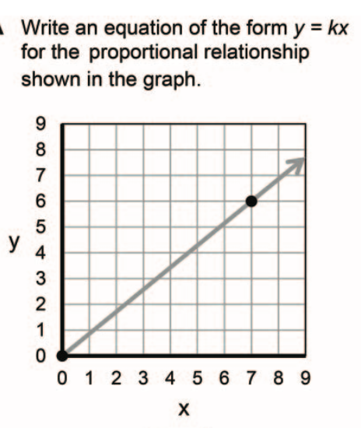
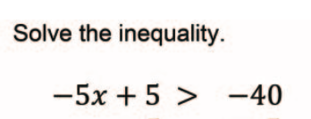
Four kinds of problem
A. Graphs
B. Inequalities
C. Expressions
D. Circles

Slide 31
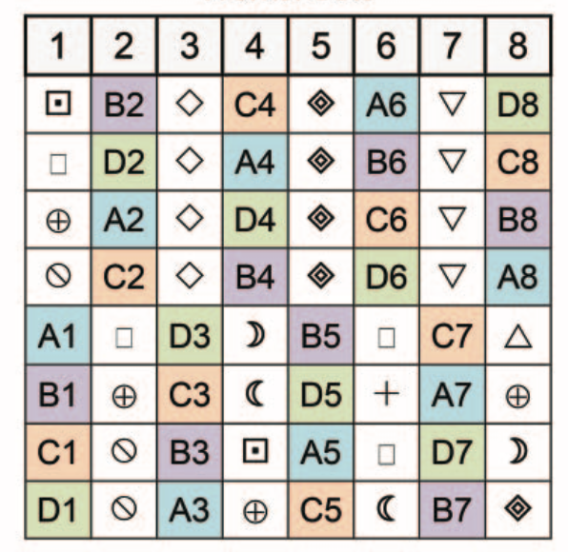
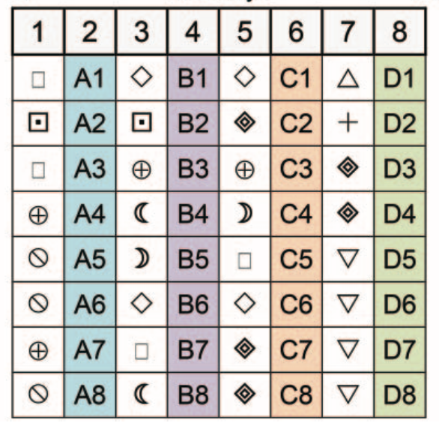
Experimental design
Worksheet
Review
Test
Interleaved practice
10 days
35 days
Blocked practice
103 days

Slide 32
Test results
 | Blocked | Interleaved
Mean | 38 | 61
Standard deviation | 27 | 29
Effect size (Cohen’s d) | 0.83
Percentile increase | 30
 | Blocked | Interleaved
Mean | 38 | 61
Standard deviation | 27 | 29
 | Blocked
Mean | 38
Standard deviation | 27
Rohrer, Dedrick, Hartwig, and Cheung (2019)

Slide 33
How memory really works (part 2)
Storage strength (and retrieval strength) is increased by
Re-studying an item
Retrieving it from memory
Retrieval has a greater impact than re-study
Retrieval and re-study increase storage strength more when retrieval strength is low
Key takeaways: Frequent testing and distributed practice
Bjork (1992)

Slide 34
Pedagogy

Slide 35
The origins of mastery learning
Two views of aptitude
The proportion of taught material retained
The time taken to learn that material
“In fact, we may even insist that our educational efforts have been unsuccessful to the extent to which our distribution of achievement approximates the normal distribution.” (Bloom, 1968 p. 3)
Teaching should be a contingent process

Slide 36
Formative assessment
Long-cycle
Medium-cycle
Short-cycle
Across terms, teaching units
Within and between teaching units
Within and between lessons
Span
Four weeks to
one year
One to four weeks
Minute-by-minute and day-by-day
Length
Monitoring, curriculum alignment
Student-involved assessment
Engagement, responsiveness
Impact

Slide 37
The professional development issue
 | If we treat formative assessment as:
 | Content-specific | Discipline-specific | Generic
Benefits are: | specific to those domains studied |  | applicable to all aspects of practice
Improves achievement: | a little |  | a lot
Is mostly a matter of: | knowledge acquisition |  | habit change
And doing it is: | hard |  | very hard
 | If we treat formative assessment as:
 | Content-specific | Discipline-specific | Generic
Benefits are: | specific to those domains studied |  | applicable to all aspects of practice
Improves achievement: | a little |  | a lot
Is mostly a matter of: | knowledge acquisition |  | habit change
 | If we treat formative assessment as:
 | Content-specific | Discipline-specific | Generic
Benefits are: | specific to those domains studied |  | applicable to all aspects of practice
Improves achievement: | a little |  | a lot
 | If we treat formative assessment as:
 | Content-specific | Discipline-specific | Generic
Benefits are: | specific to those domains studied |  | applicable to all aspects of practice
 | If we treat formative assessment as:
 | Content-specific | Discipline-specific | Generic

Slide 38
The challenge
A single model for the whole school/college
Scalable
Supports a ‘single conversation’ with students
A model that honours the specificities of
discipline
age range
A model that acknowledges the realities
Affordable
Feasible

Slide 39
Embedding formative assessment
Programme
Teachers meet monthly in groups of 8 to 12
Make commitments about what to try out
Hold each other accountable
Evaluation
Pre-registered cluster randomized trial
Outcome measure: Attainment 8
Impact: 25% increase in rate of progress over KS4
Speckesser, Runge, Foliano, Bursnall, Hudson-Sharpe, Rolfe, and Anders (2018)

Slide 40
Assessment

Slide 41
Data and evidence
“Evidence is data related to a claim” (Wainer, 2011 p. 148)
Some radical shifts
From | To
Data | Information
From | To
Data-driven decision-making | Decision-driven data collection

Slide 42
Mapping out the terrain
Timescale
Annually
Academic promotion
High-stakes accountability
End-of-course exams
Quarterly
Growth measures
Benchmarks
Monthly
Common assessments
Weekly
Before the end- of-unit tests
End-of-unit tests
Graded work
Daily
Exit pass
Hourly
Hinge-point questions
Instructional Guidance (“formative”)
Describing Individuals
(“summative”)
Institutional Accountability (“evaluative”)
Function

Slide 43
Assessment literacy
Do you know what this assessment result means?
Does it have utility for its intended use?
What message does this assessment send to students (and other stakeholders) about the achievement outcomes we value?
What is likely to be the effect of this assessment on students?
Stiggins (1991)

Slide 44
Errors of measurement and growth
Reading scores: 2015 norms (6th grade)
Northwest Evaluation Association (2015)

Slide 45
Responses to unreliability
Reliability can be increased
By narrowing the focus of the assessment
By increasing the length of the assessment
We have better things to do with our time
The unreliability of our assessments may be optimal
Provided we don’t place too much emphasis on them…

Slide 46
What makes effective teacher learning?

Slide 47
A model for teacher learning
Content, then process
Content (what we want teachers to change):
Evidence
Ideas (strategies and techniques)
Process (how to go about change):
Choice
Flexibility
Small steps
Accountability
Support

Slide 48
What is needed from teachers
A commitment to:
The continual improvement of practice
Focus on those things that make a difference to students

Slide 49
What is needed from leaders
A commitment to create effective learning environments for teachers by:
Creating expectations for continually improving practice

Slide 51
What is needed from leaders
A commitment to create effective learning environments for teachers by:
Creating expectations for continually improving practice
Keeping the focus on the things that make a difference to students
Providing the time, space, dispensation, and support for innovation
Supporting risk-taking

Slide 52
Conclusion
Teaching is a wicked learning environment
Research must inform—but cannot dictate—action
Focus
Curriculum: distributed practice and practice testing
Pedagogy: contingent and responsive
Assessment: decision-driven data collection
Culture
All teachers improving
On the things that make the biggest difference to students

Slide 53
Thank You
www.dylanwiliam.net

