Slide 1
Dylan Wiliam (@dylanwiliam)
Creating the schools our children need:
Why what we’re doing now won’t help much and what we can do instead
www.dylanwiliamcenter.com www.dylanwiliam.org

Slide 2
Outline
Why we need to improve education
What we’re doing right now
What we can do instead

Slide 3
UK scores on PISA 2000 to 2018

Slide 4
Why we need to raise achievement
UK students leaving school without basic levels of achievement in:
Reading: 17%
Mathematics: 19%
Science: 17%
In advanced economies, over the next 20 to 30 years
25% to 35% of jobs could be offshored
About half the work being done right now could be done by machines with existing technology
OECD (2017); Blinder (2011); Frey & Osborne, 2013; McKinsey (2015)

Slide 5
What we’re doing right now (and why it won’t help much)

Slide 6
What we’re doing right now
Getting smarter people into teaching
Firing bad teachers
Paying good teachers more
Reducing class size
Expanding school choice
Copying other countries

Slide 7
What we can do instead

Slide 8
Learning from research
Four questions we should be asking
Does this solve a problem we have?
How much will this improve learning?
How much will it cost (in money and time)?
Will it work here?

Slide 9
A knowledge-rich curriculum

Slide 10
Copy this
ЖӘШІК

Slide 11
Countdown game
Target number: 127
25
3
1
9
4

Slide 12
Memorization of spoken digits
World record for the memorization of single digits, spoken at the rate of one per second
World Memory Statistics (2015)

Slide 13
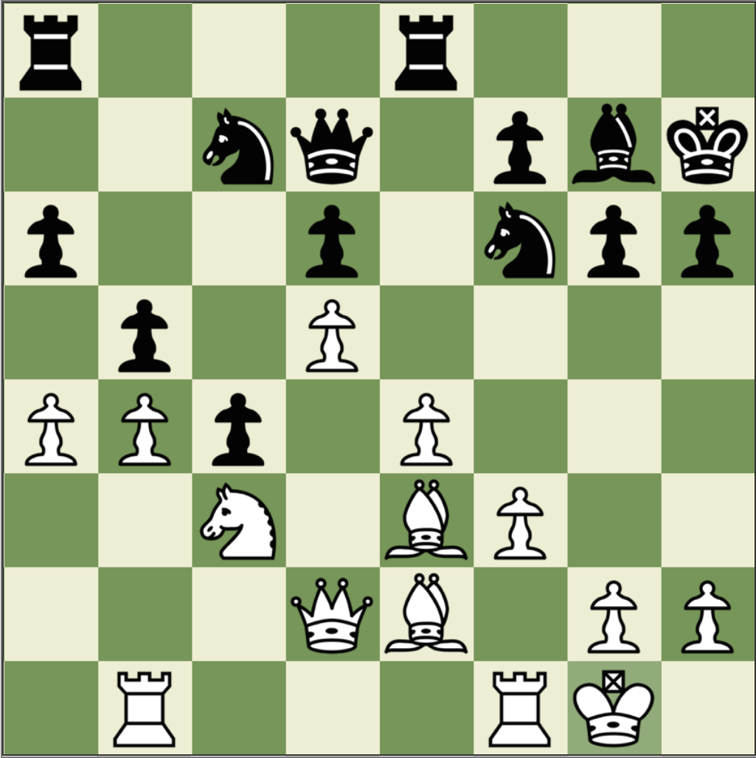
Memory in chess
Studies of memory in chess
Djakow, Petrovskij, and Rudik (1927)
Adriaan De Groot (1946)
Chase and Simon (1973)

Slide 14
Perception in chess
Three chess players were shown a chess board for five seconds, and then asked to reproduce what they had seen.
Two scenarios
Middle game (30 to 40 moves in, 25 pieces on board)
End game (80 moves in, 12 to 15 pieces on board)

Slide 15
Memory in chess (1)
Mid-game | Player level | Number of pieces correctly placed
 | Novice | 5
 | Club player | 9
 | Expert | 16
Random | Player level | Number of pieces correctly placed
 | Novice | 2
 | Club player | 3
 | Expert | 3

Slide 16
Memory in chess (2)
End game | Player level | Number of pieces correctly placed
 | Novice | 4
 | Club player | 7
 | Expert | 8
Attempts to simulate the performance of the expert chess player with computers suggest that the expert can recognize at least 10,000—but probably fewer than 100,000—different arrangements of chess pieces or “chunks,” with a most likely value around 13,500 (Simon & Gilmartin, 1973)

Slide 17
A model of human memory
Long-term memory
Short-term memory
Environment
Limited
Limitless

Slide 18
Domain knowledge and memory
3rd (N=64), 5th (N=67) and 7th (N=54) grade students from Heidelberg, Germany, tested on reading expertise and football knowledge
13-item questionnaire on football knowledge
standardized reading comprehension test
Students heard (twice) and read a well-structured readable story on a young player’s experiences in a football game
Tested 15 minutes later with a cloze version of the test with 20 blanks

Slide 19
17.0
17.0
16.4
16.4
11.1
11.1
11.0
11.0
Schneider, Körkel, and Wiener (1989)

Slide 20
What is learning?
Learning is “a change in long-term memory” (Kirschner, Sweller, & Clark, 2016 p. 77)
“The aim of all instruction is to alter long-term memory. If nothing has changed in long-term memory, nothing has been learned.” (ibid p. 77)
“Novices need to use thinking skills. Experts use knowledge” (Sweller et al., 2011 p. 21)

Slide 21
Why curriculum matters
Myths about curriculum
Knowledge isn’t important (“You can always Google it”)
Students should be involved in authentic tasks
We should be teaching skills, not content
Responding to students’ interests closes achievement gaps
What is the purpose of curriculum?
The main purpose of the curriculum is to increase the contents of long-term memory

Slide 22
Investing in the teachers we already have

Slide 23
General conclusions about expertise
Elite performance is the result of at least a decade of maximal efforts to improve performance through an optimal distribution of deliberate practice
What distinguishes experts from others is the commitment to deliberate practice
Deliberate practice is
an effortful activity that can be sustained only for a limited time each day
neither motivating nor enjoyable—it is instrumental in achieving further improvement in performance

Slide 24
Expertise in teaching
Research shows expertise in teaching shares the hallmarks of expertise in other domains
More importantly, for the general expertise research not to apply to teaching:
All the other areas would have to be similar, and
Teaching would have to be different
This seems unlikely, so
As far as we can tell, what is true for expertise in other areas is likely to be true for teaching
In other words, we can make almost all teachers as good as the very best if we support them in the right way

Slide 25
Evaluation vs. improvement
Evaluation frameworks:
of necessity, have to be comprehensive
include all aspects of teachers work
at best, incentivize improvement on all aspects of practice
at worst, incentivize improvement on aspects of practice that are easy to improve
Improvement frameworks:
are selective
focus on those aspects of practice with the biggest payoff for students
To maximize improvement, evaluation frameworks have to be used selectively

Slide 26
What should teachers get better at?
Behaviour management
Subject knowledge
Academic subject knowledge
Pedagogical content knowledge
Instructional design
Pedagogical skills

Slide 27
Five perspectives on formative assessment
The empirical perspective
The intuitive perspective
The cross-cultural perspective
The functional perspective
The equity perspective

Slide 28
The empirical perspective

Slide 29
Relevant studies
Fuchs & Fuchs (1986)
Natriello (1987)
Crooks (1988)
Bangert-Drowns et al. (1991)
Dempster (1991, 1992)
Elshout-Mohr (1994)
Kluger & DeNisi (1996)
Black & Wiliam (1998)
Nyquist (2003)
Allal & Lopez (2005)
Köller (2005)
Brookhart (2007)
Wiliam (2007)
Hattie & Timperley (2007)
Shute (2008)
Kingston & Nash (2011, 2015)

Slide 30
The intuitive perspective

Slide 31
Why Strategic Formative Assessment?
A principle and an uncomfortable fact about the world
The principle:
"If I had to reduce all of educational psychology to just one principle, I would say this: The most important single factor influencing learning is what the learner already knows. Ascertain this and teach him [or her] accordingly” (Ausubel, 1968 p. vi)
The uncomfortable fact:
Students do not learn what we teach.
What is learning?
Learning is a change in long-term memory (Kirschner et al., 2006)
The fact that someone can do something now does not mean they will be able to do it in six weeks, but
If they cannot do something now, it is highly unlikely they will be able to do it in six weeks

Slide 32
The cross-cultural perspective

Slide 33
So, where should our efforts be focused?
Factors most strongly associated with high student achievement in science classrooms
The student’s socio-economic profile
Index of adaptive instruction
Index of teacher-directed instruction
The student’s socio-economic profile
The school’s socio-economic profile
OECD (2016, Fig II.7.2)

Slide 34
The functional perspective (1)

Slide 35
Formative Assessment: A contested term
Long-cycle
Medium-cycle
Short-cycle
Across terms, teaching units
Within and between teaching units
Within and between lessons
Span
Four weeks to
one year
One to four weeks
Minute-by-minute and day-by-day
Length
Monitoring, curriculum alignment
Student-involved assessment
Engagement, responsiveness
Impact

Slide 36
The functional perspective (2)

Slide 37
Unpacking Formative Assessment
 | Where the learner is going | Where the learner is now | How to get the learner there
Teacher
Peer
Student
Clarifying, sharing, and understanding learning intentions
Eliciting evidence of learning
Providing feedback that moves learners forward
Activating students as learning
resources for one another
Activating students as
owners of their own learning

Slide 38
Unpacking Formative Assessment
 | Where the learner is going | Where the learner is now | How to get the learner there
Teacher
Peer
Student
Before you can begin
Responsive teaching
Clarifying, sharing, and understanding learning intentions
Eliciting evidence of learning
Providing feedback that moves learners forward
The learner’s role
Activating students as learning
resources for one another
Activating students as
owners of their own learning

Slide 39
The equity perspective

Slide 40
Educational Endowment Foundation toolkit
Intervention | Cost | Quality of evidence | Extra months of learning
Feedback | ££ | ★★★ | +8
Metacognition and self-regulation | ££ | ★★★★ | +8
Peer tutoring | ££ | ★★★★ | +6
Early years intervention | £££££ | ★★★★ | +6
One to one tuition | ££££ | ★★★★ | +5
Homework (secondary) | £ | ★★★ | +5
Collaborative learning | £ | ★★★★ | +5
Phonics | £ | ★★★★ | +4
Small group tuition | £££ | ★★★★ | +4
Behaviour interventions | £££ | ★★ | +4
Digital technology | ££££ | ★★★★ | +4
Social and emotional learning | £ | ★★★★ | +4

Slide 41
Educational Endowment Foundation toolkit
Intervention | Cost | Quality of evidence | Extra months of learning
Parental involvement | £££ | ★★★ | +3
Reducing class size | £££££ | ★★★ | +3
Summer schools | £££ | ★★ | +3
Sports participation | £££ | ★★ | +2
Arts participation | ££ | ★★★ | +2
Extended school time | £££ | ★★ | +2
Individualized instruction | £ | ★★★ | +2
After school programmes | ££££ | ★★ | +2
Learning styles | £ | ★★★ | +2
Mentoring | £££ | ★★★ | +1
Homework (primary) | £ | ★★★ | +1

Slide 42
Educational Endowment Foundation toolkit
Intervention | Cost | Quality of evidence | Extra months of learning
Teaching assistants | ££££ | ★★ | 0
Performance pay | ££ | ★ | 0
Aspiration interventions | £££ | ★ | 0
Block scheduling | £ | ★★ | 0
School uniform | £ | ★ | 0
Physical environment | ££ | ★ | 0
Ability grouping | £ | ★★★ | -1

Slide 43
Unpacking Formative Assessment
 | Where the learner is going | Where the learner is now | How to get the learner there
Teacher
Peer
Student
Clarifying, sharing, and understanding learning intentions
Eliciting evidence of learning
Providing feedback that moves learners forward
Activating students as
resources for one another
Activating students as
owners of their own learning

Slide 44
Supportive accountability
What is needed from teachers:
A commitment to:
The continual improvement of practice
Focus on those things that make a difference to students
What is needed from leaders:
A commitment to engineer effective learning environments for teachers by:
Creating expectations for continually improving practice
Keeping the focus on the things that make a difference to students
Providing the time, space, dispensation, and support for innovation
Supporting risk-taking

Slide 45
A model for teacher learning
Content, then process
Content (what we want teachers to change):
Evidence (classroom formative assessment)
Ideas (strategies and techniques)
Process (how to go about change):
Choice
Flexibility
Small steps
Accountability
Support

Slide 46
Embedding Formative Assessment
Whole-school 2-year PD programme
Focus on five strategies of formative assessment
clarifying, sharing and understanding learning intentions
eliciting evidence of achievement
feedback that moves learning forward
activating students as learning resources for one another
activating students as owners of their own learning
Detailed resource packs for groups of 8 - 14 teachers
18 monthly 75-minute meetings
Peer observations between meetings

Slide 47
Summary
There are lots of things we can change
Many will have an impact on student achievement
But any reform has an opportunity cost
Four questions we need to ask
Does this solve a problem we have?
How much will it cost?
How much extra achievement will we get?
Can it be implemented here?
Most promising ideas right now
A knowledge-rich curriculum
Improved teacher pedagogical skill

Slide 48
Thank You
www.dylanwiliam.net

