Slide 1
How should we use what we know about learning to read?
7th International Reading Recovery Institute
July, 2010
Dylan Wiliam www.dylanwiliam.net

Slide 2
Improving education: science and design
We need to improve student achievement
This requires improving teacher quality
Improving the quality of entrants takes too long
So we have to help the teachers we have improve
Teachers can change in a range of ways
Some will benefit students, and some will not.
Those that do tend to involve changes in teacher practice
Changing practice requires new kinds of teacher learning
And new models of professional development.
Science
Design

Slide 3
Raising achievement matters…
For individuals
  Increased lifetime salary (13% for a degree)
  Improved health (half the number of disabled years)
  Longer life (1.7 years of life per extra year of schooling
For society
  Lower criminal justice costs
  Lower health-care costs
  Increased economic growth (Hanushek & Wößman, 2010)
    Present value to UK of raising PISA scores by 25 points: £4trillion
    Present value of ensuring all students score 400 on PISA: £5trillion

Slide 4
…because the world of work is changing…
Which of the following categories of skill is disappearing from the work-place most rapidly?
  Routine manual
  Non-routine manual
  Routine cognitive
  Complex communication
  Expert thinking/problem-solving

Slide 5
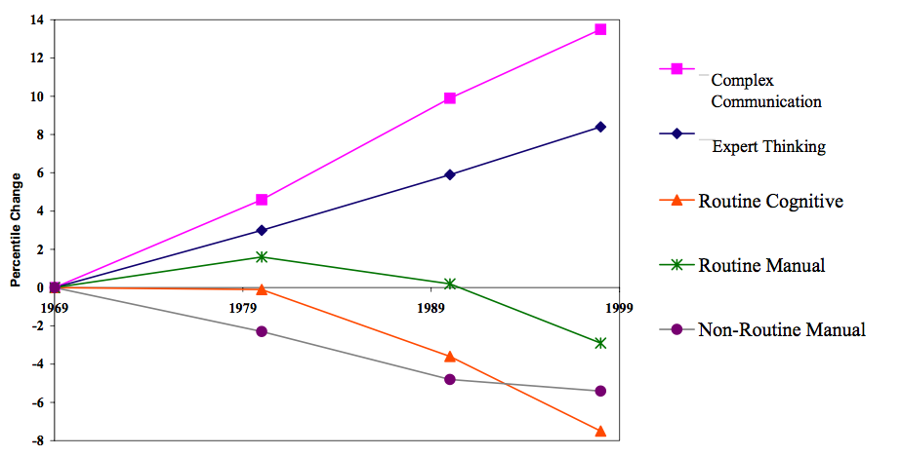
…in surprising ways.
Autor, Levy & Murnane, 2003

Slide 6
There is only one 21st century skill
So the model that says learn while you’re at school, while you’re young, the skills that you will apply during your lifetime is no longer tenable. The skills that you can learn when you’re at school will not be applicable. They will be obsolete by the time you get into the workplace and need them, except for one skill. The one really competitive skill is the skill of being able to learn. It is the skill of being able not to give the right answer to questions about what you were taught in school, but to make the right response to situations that are outside the scope of what you were taught in school. We need to produce people who know how to act when they’re faced with situations for which they were not specifically prepared. (Papert, 1998)

Slide 7
Successful education
The test of successful education is not the amount of knowledge that a pupil takes away from school, but his appetite to know and his capacity to learn. If the school sends out children with the desire for knowledge and some idea how to acquire it, it will have done its work. Too many leave school with the appetite killed and the mind loaded with undigested lumps of information. The good schoolmaster is known by the number of valuable subjects which he declines to teach.
The Future of Education (Livingstone, 1941 p. 28)

Slide 8
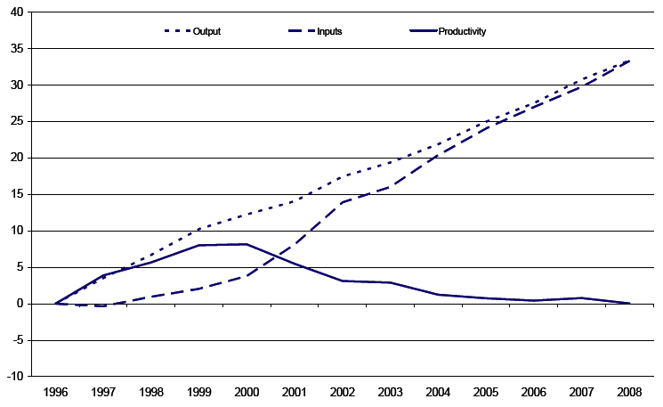
Educational productivity 1996-2008
Source: Office for National Statistics

Slide 9
Where’s the solution?
Structure
  Smaller/larger high schools
  K-8 schools/”All-through” schools
Alignment
  Curriculum reform/National strategies
  Textbook replacement
Governance
  Specialist schools & Academies
  Charter schools and vouchers
Technology
  Computers
  Interactive white-boards
Workforce reforms
  Classroom assistants

Slide 10
School effectiveness
Three generations of school effectiveness research
  Raw results approaches
    Different schools get different results
    Conclusion: Schools make a difference
  Demographic-based approaches
    Demographic factors account for most of the variation
    Conclusion: Schools don’t make a difference
  Value-added approaches
    School-level differences in value-added are relatively small
    Classroom-level differences in value-added are large
    Conclusion: An effective school is a school full of effective classrooms

Slide 11
Within-school variation
Why do students get different results?
  Within class variation
    Main cause: differences in students’ abilities
  Between-class, within-school variation
    Main cause: differences in teacher quality
  Between-school
    Main cause: selection practices
As long as you go to school…
  It doesn’t matter very much which school you go to
  But it matters very much which classrooms you are in…

Slide 12
Between-school effects are small
Proportion of students reaching proficiency
  7% of the variability in the proportion achieving this is nothing to do with the school, so
  93% of the variability in the proportion achieving this is nothing to do with the school
So, if 15 students in a class reach proficiency in the average school:
  17 students will do so at a “good” school (1sd above mean)
  13 students will do so at a “bad” school (1sd below mean)

Slide 13
Within schools
Between schools
OECD PISA data from McGaw, 2008

Slide 14
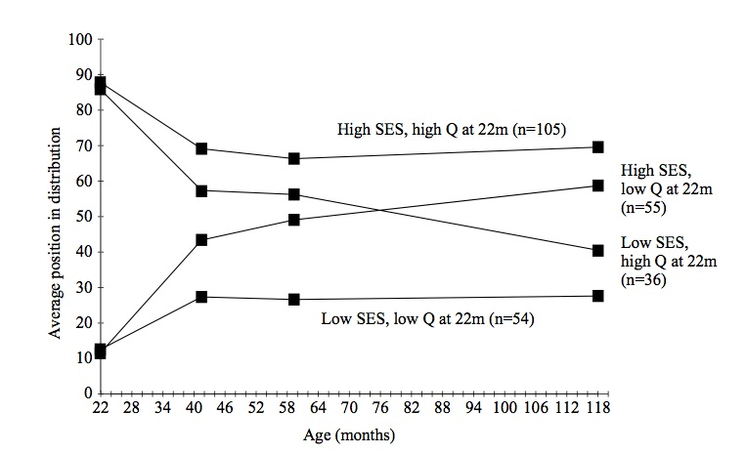
Impact of background on development
(Feinstein, 2003)

Slide 15
Meaningful differences
Hour-long samples of family talk in 42 American families
Number of words spoken to children by adults by the age of 36 months
  In professional families: 35 million
  In other working-class families: 20 million
  In families on welfare: 10 million
Kinds of reinforcements:
  positive negative
  professional 500,000 50,000
  working-class 200,000 100,000
  welfare 100,000 200,000
(Hart & Risley, 1995)
Notes:
Analysis of transcripts of hour-long samples of family talk in 42 American families suggests that by the age of 36 months, approximately 10 million words were uttered to children in families on welfare, 20 million to children in other working-class families, and 35 million to children in professional families. By the same age, children in professional, working-class and welfare families will have received 500,000, 200,000 and 100,000 encouraging remarks or positive reinforcements respectively, while the number of negative reinforcements and discouragements were 50,000, 100,000 and 200,000 respectively.

Slide 16
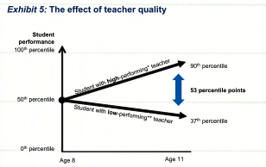
What matters is the teacher
Barber & Mourshed, 2007

Slide 17
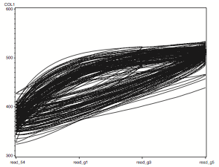
Trajectories of learning to read
‘Fast’ readers
‘Normal’ readers
Pianta et al. (2008)

Slide 18
Teacher quality and student learning
 | Subject | Correlation
Woodhead | All | 0*
Hanushek, Rivkin & Kain (2005) | Reading | >0.10
Hanushek, Rivkin & Kain (2005) | Mathematics | >0.11
Rockoff (2003) | Reading | 0.20
Rockoff (2003) | Mathematics | 0.25

Slide 19
Teacher quality matters…
The consequence:
  Take a group of 50 teachers
  Students taught by the most effective teacher in that group of 50 teachers learn in six months what those taught by the average teacher learn in a year
  Students taught by the least effective teacher in that group of 50 teachers will take two years to achieve the same learning (Hanushek, 2006)
And furthermore:
  In the classrooms of the most effective teachers, students from disadvantaged backgrounds learn at the same rate as those from advantaged backgrounds (Hamre & Pianta, 2005)

Slide 20
… but is often ignored
Because it is politically difficult
  For teacher unions (who understandably resist performance-related pay)
  For politicians (who often prefer to focus on teacher supply, rather than teacher quality)
And because it is hard to pin down
Teachers make a difference, but what makes the difference in teachers?
  Advanced content matter knowledge 5%
  Pedagogical content knowledge 15%
  Further professional qualifications (MA, NBPTS) 5%
  Total “explained” 25%

Slide 21
Reading skills: what are they really?
A manifold, contained in an intuition which I call mine, is represented, by means of the synthesis of the understanding, as belonging to the necessary unity of self-consciousness; and this is effected by means of the category.
What is the main idea of this passage? 1. Without a manifold, one cannot call an intuition ‘mine.’ 2. Intuition must precede understanding. 3. Intuition must occur through a category. 4. Self-consciousness is necessary to understanding
(Hirsch, 2006)

Slide 22
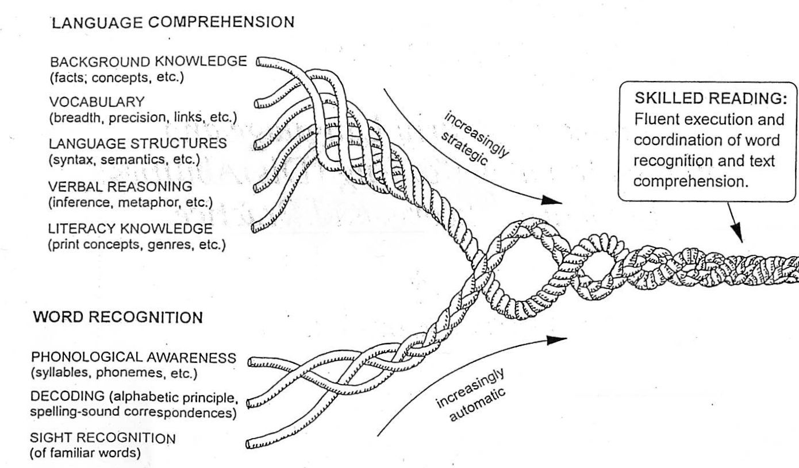
Reading is complex…
(Scarborough, 2001)

Slide 23
…and expertise is specific…
 | Reading vocabulary | Reading comprehension | Math computation | Math concepts
Reading vocabulary
Reading comprehension | 0.27
Math computation | 0.16 | 0.46
Math concepts | 0.32 | 0.58 | 0.67
(Rockoff, 2004)

Slide 24
Reading instruction competency test
Which of the following informal assessments would be most appropriate to use to assess an individual student's phonemic awareness?
  asking the student to identify the sound at the beginning, middle, or end of a spoken word (e.g., "What sound do you hear at the end of step?")
  having the student listen to a tape- recorded story while looking at the book and then answer several simple questions about the story
  asking the student to identify the letters in the alphabet that correspond to the initial consonant sounds of several familiar spoken words
  having the student listen to the teacher read aloud a set of words with the same beginning sound (e.g., train, trap, trouble) and then repeat the words
RICA practice test, item #10

Slide 25
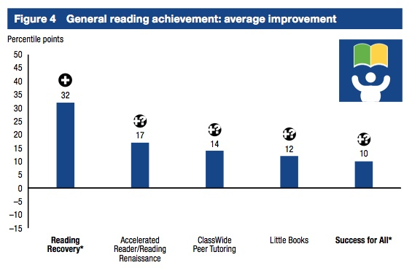
What works in early reading?
(What Works Clearinghouse, 2007)

Slide 26
Improving teacher quality takes time…
A classic labor force issue with 2 (non-exclusive) solutions
  Replace existing teachers with better ones
  Help existing teachers become even more effective
Replace existing teachers with better ones?
  Increasing the quality of entrants to exclude the lowest performing 30% of teachers would in result in one extra student passing a test per class every three years…
So we have to help the teachers we have improve
  The “love the one you’re with” strategy

Slide 27
Teachers do improve, but slowly…
Leigh, A. (2007). Estimating teacher effectiveness from two-year changes in student test scores.

Slide 28
And at different rates for different skills…
Vocabulary
(Rockoff, 2004)

Slide 29
Getting serious about professional development
Left to their own devices, teachers will improve, but slowly
  The average improvement in student value-added by a teacher over 20 years is one-tenth of the difference between a good teacher and a weak teacher on the first day of their teaching career.
Because we have been doing the wrong kind of professional development
  100 “Baker days”
  Professional “updating”
  Recertification (e.g., PA Act 48)
Bigger improvements are possible
  Provided we focus rigorously on the things that matter
  Even when they’re hard to do

Slide 30
People like neuroscience
Descriptions of 18 psychological phenomena
  Examples: mutual exclusivity, attentional blink
Designed to be comprehensible without scientific training
Each phenomenon was given four possible explanations
  Basic (without neuroscience)
    Good explanation (provided by the researchers)
    Bad explanation (e.g., circular reasoning)
  Enhanced (with neuroscience explanation)
    Good explanation
    Bad explanation
Added neuroscience did not change the logic of the explanation
Participants randomly given one of the four explanations
Asked to rate this on a 7-point scale (-3 to +3).

Slide 31
Sample explanations
 | Good explanation | Bad explanation
Without neuroscience | The researchers claim that this ‘curse’ happens because subjects have trouble switching their point of view to consider what someone else might know, mistakenly projecting their own knowledge onto others. | The researchers claim that this ‘curse’ happens because subjects make more mistakes when they have to judge the knowledge of others. People are much better at judging what they themselves know.
With neuroscience | Brain scans indicate that this ‘curse’ happens because of the frontal lobe brain circuitry known to be involved in self-knowledge. Subjects have trouble switching their point of view to consider what someone else might know, mistakenly projecting their own knowledge onto others. | Brain scans indicate that this ‘curse’ happens because of the frontal lobe brain circuitry known to be involved in self-knowledge. subjects make more mistakes when they have to judge the knowledge of others. People are much better at judging what they themselves know.

Slide 32
Seductive allure
 | Without neuroscience |  | With neuroscience
Explanation | Good | Bad | Good | Bad
Novices (n=81) | +0.9 | –0.7 | +0.9 | +0.2
Students (n=22) | +0.1 | –1.1 | +0.7 | +0.2
Experts (n=48) | +0.5 | –1.1 | –0.2 | –0.8
(Weisberg et al., 2008)

Slide 33
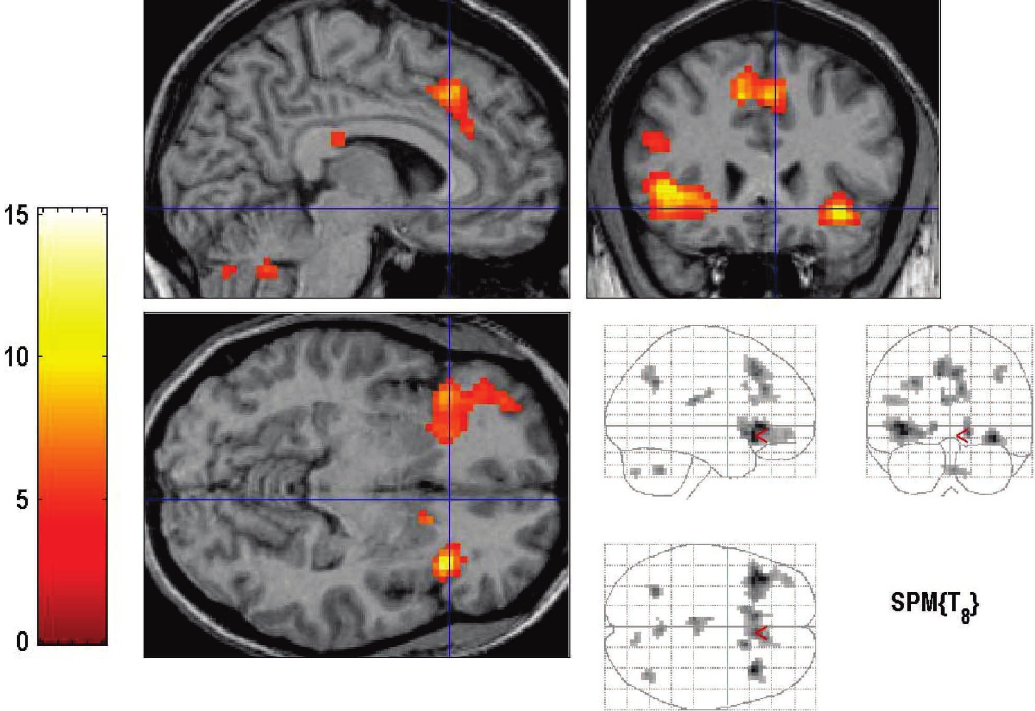
Brains recognizing words
Group-level activations for recognition of words versus a baseline condition (Miller, et al., 2002)

Slide 34
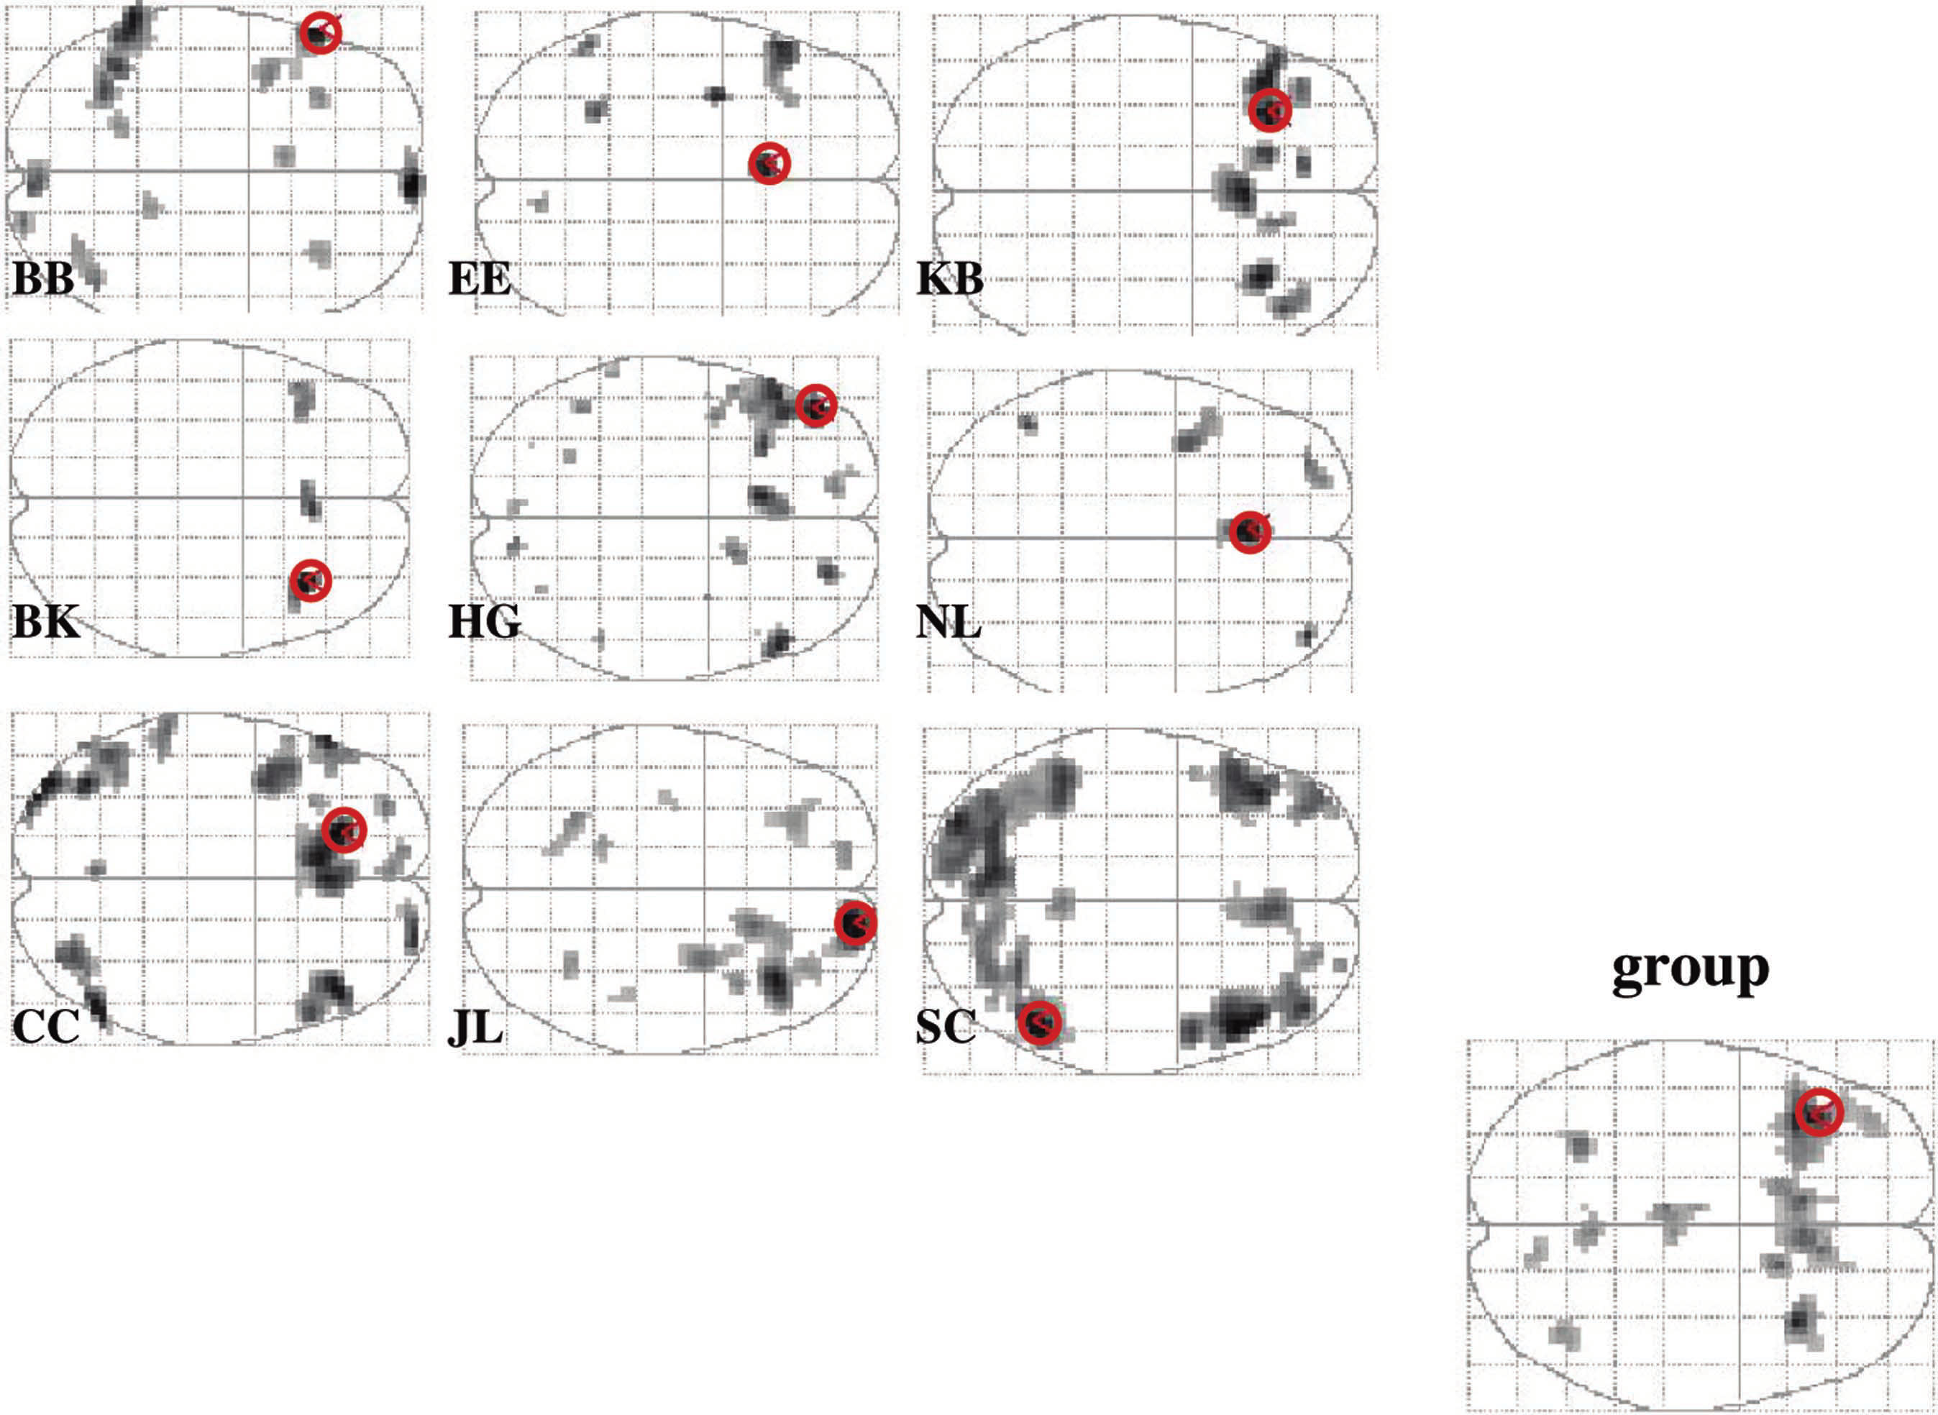

Slide 35
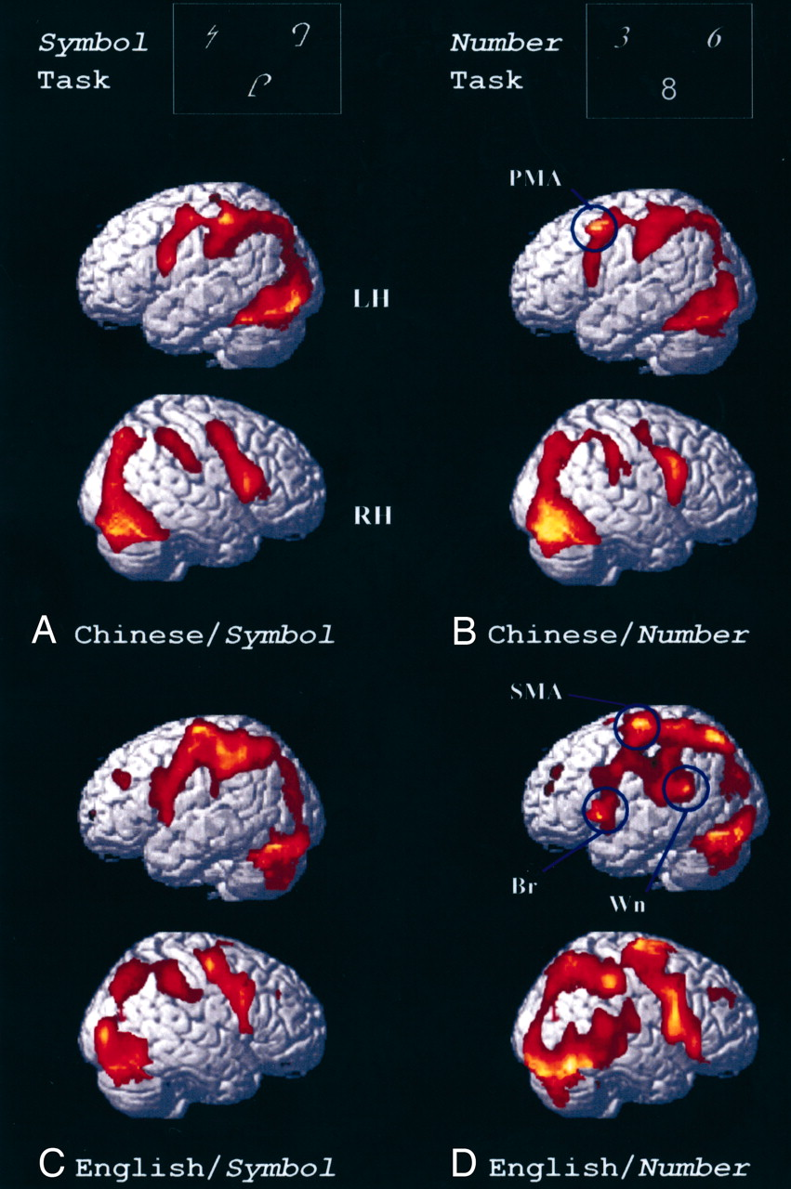
Dissociation in the brain representation of Arabic numbers between native Chinese speakers and native English speakers (Tang et al., 2008)

Slide 36
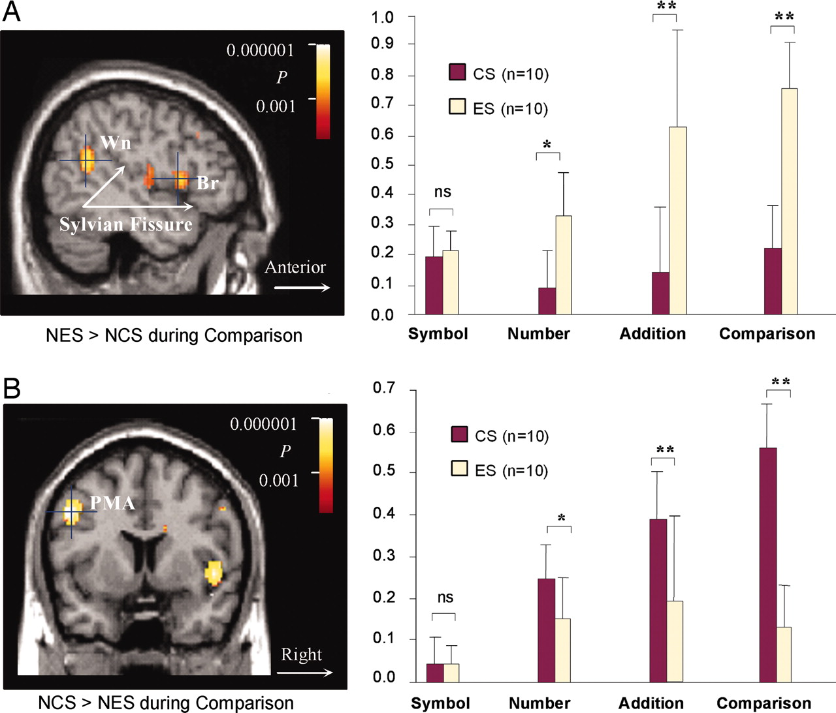
Differences in activation intensity between native Chinese speakers and native English speakers in the perisylvian language region (A) and the premotor association area (B) of the brain (Tang et al., 2008).

Slide 37
Sustaining teacher development with professional learning communities

Slide 38
A model for teacher learning
Content, then process
Content (what we want teachers to change)
  Evidence
  Ideas (strategies and techniques)
Process (how to go about change)
  Choice
  Flexibility
  Small steps
  Accountability
  Support

Slide 39
Example: CPR (Klein & Klein, 1981)
Six video extracts of a person delivering cardio-pulmonary resuscitation (CPR)
  5 of the video extracts are students
  1 of the video extracts is an expert
Videos shown to three groups: students, experts, instructors
Success rate in identifying the expert:
  Experts: 90%
  Students: 50%
  Instructors: 30%

Slide 40
Looking at the wrong knowledge…
The most powerful teacher knowledge is not explicit
  That’s why telling teachers what to do doesn’t work
  What we know is more than we can say
  And that is why most professional development has been relatively ineffective
Improving practice involves changing habits, not adding knowledge
  That’s why it’s hard
    And the hardest bit is not getting new ideas into people’s heads
    It’s getting the old one’s out
  That’s why it takes time
But it doesn’t happen naturally
  If it did, the most experienced teachers would be the most productive, and that’s not true (Hanushek, 2005)

Slide 41
Hand hygiene in hospitals (Pittet, 2001)
Study | Focus | Compliance rate
Preston, Larson & Stamm (1981) | Open ward | 16%
 | ICU | 30%
Albert & Condie (1981) | ICU | 28% to 41%
Larson (1983) | All wards | 45%
Donowitz (1987) | Pediatric ICU | 30%
Graham (1990) | ICU | 32%
Dubbert (1990) | ICU | 81%
Pettinger & Nettleman (1991) | Surgical ICU | 51%
Larson et al. (1992) | Neonatal ICU | 29%
Doebbeling et al. (1992) | ICU | 40%
Zimakoff et al. (1992) | ICU | 40%
Meengs et al. (1994) | ER (Casualty) | 32%
Pittet, Mourouga & Perneger (1999) | All wards | 48%
 | ICU | 36%

Slide 42
We need to create time and space for teachers to reflect on their practice in a structured way, and to learn from mistakes
(Bransford, Brown & Cocking, 1999)
“Always make new mistakes”
Esther Dyson
“Ever tried. Ever failed. No matter. Try again. Fail again. Fail better.”
Samuel Beckett, Worstward Ho

Slide 43
Knowledge transfer…or creation?
(Nonaka & Takeuchi, 1995)

Slide 44
Supportive accountability
Teacher learning is just like any other learning in a highly complex area
  In the same way that teachers cannot do the learning for their learners, leaders cannot do the learning for their teachers
What is needed from teachers
  A commitment to the continuous improvement of practice; and
  A focus on those things that make a difference to students
What is needed from leaders
  A commitment to engineer effective learning environments for teachers :
    creating expectations for the continuous improvement of practice
    keeping the focus on the things that make a difference to students
    providing the time, space, dispensation and support for innovation
    supporting risk-taking

Slide 45
Summary
Raising achievement is important
Raising achievement requires improving teacher quality
Improving teacher quality requires teacher professional development
To be effective, teacher professional development must address
  What teachers do in the classroom
  How teachers change what they do in the classroom
Research evidence + Professional learning communities
  A point of (uniquely?) high leverage
  A “Trojan Horse” into wider issues of pedagogy, psychology, and curriculum

Slide 46
Comments?
Questions?

