Slide 1
How to Build Learning Progressions:
Formative Assessment’s Basic Blueprints
Presentation 3
Siobhán Leahy
Dylan Wiliam

Slide 2
Learning hierarchies
Universal
  Addition before multiplication
Natural (apparently)
  Multiplication before division
  Differentiation before integration
Arbitrary
  Areas of triangles before areas of parallelograms
Optional
  The Romans before the Vikings

Slide 3
Progression in early number skills
Denvir & Brown (1986a,b)
Learning hierarchies
  Empirical basis: almost all students demonstrating a skill must also demonstrate sub-ordinate skills
  Logical basis: there must be a clear theoretical rationale for why the sub-ordinate skills are required

Slide 4
SMILE network
2000 individual tasks
Written as engaging activities, and then ordered by levels
Levels determined logically and empirically

Slide 6
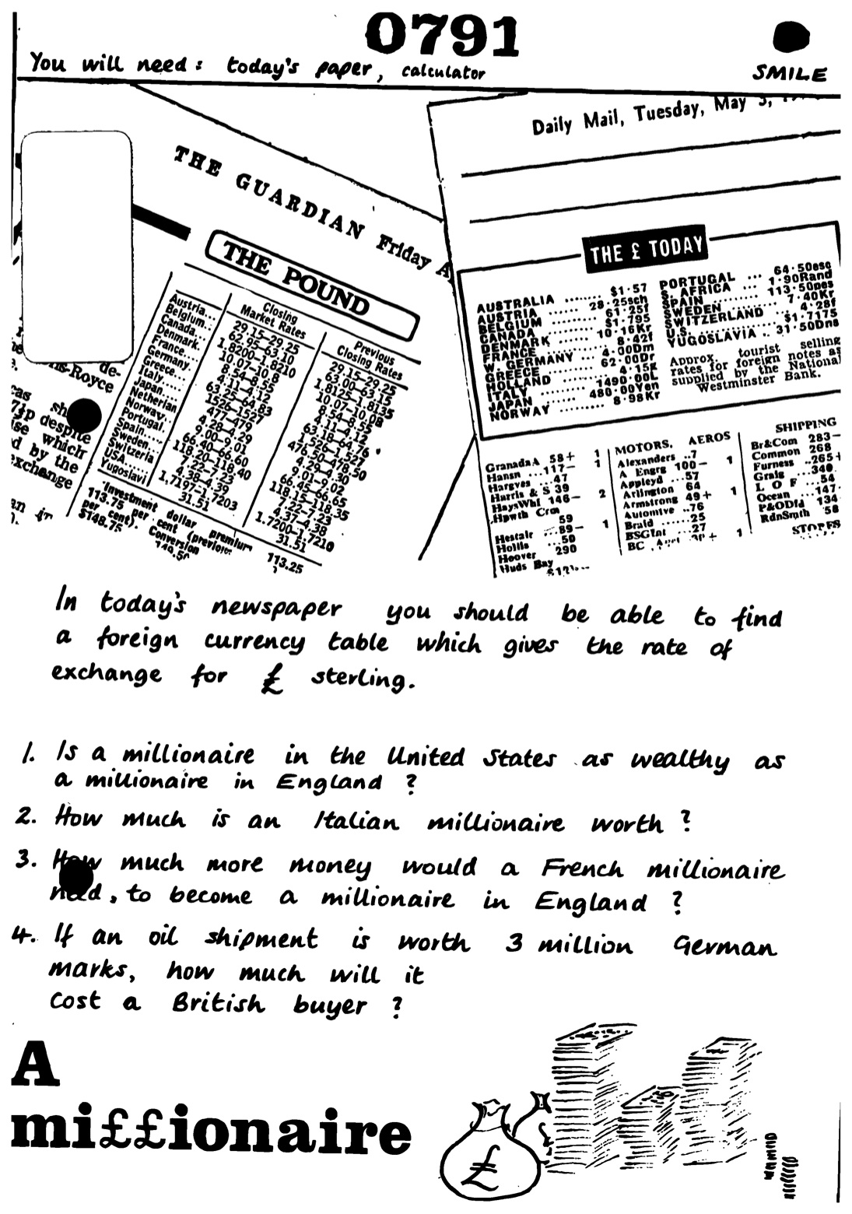
“A millionaire”
Task on exchange rates and their inverses
Originally placed at level 3 (average 11 year olds)
Found to be too hard at that level, and moved up, and up, eventually ending up at level 6 (average 15 year olds)

Slide 7
Why develop progressions locally?
Learning progressions only make sense with respect to particular sequences of instructional materials
Learning progressions are therefore inherently local
Learning progressions developed by state or national experts are likely to be difficult to use
and often just plain wrong

Slide 8
Proposed process
A group of teachers teaching the same grade
  identifies one substantive skill or concept in the standards for the grade they teach
  identifies a pre-requisite skill or concept in the standards for each of two preceding grades
  identifies a skill or concept in the two following grades for which the focal skill or concept is a pre-requisite.
  generates, for each of the five elements, six test items, with each item at one grade intended to be more difficult than each of the items for earlier grades
  administers the test to their own students

Slide 9
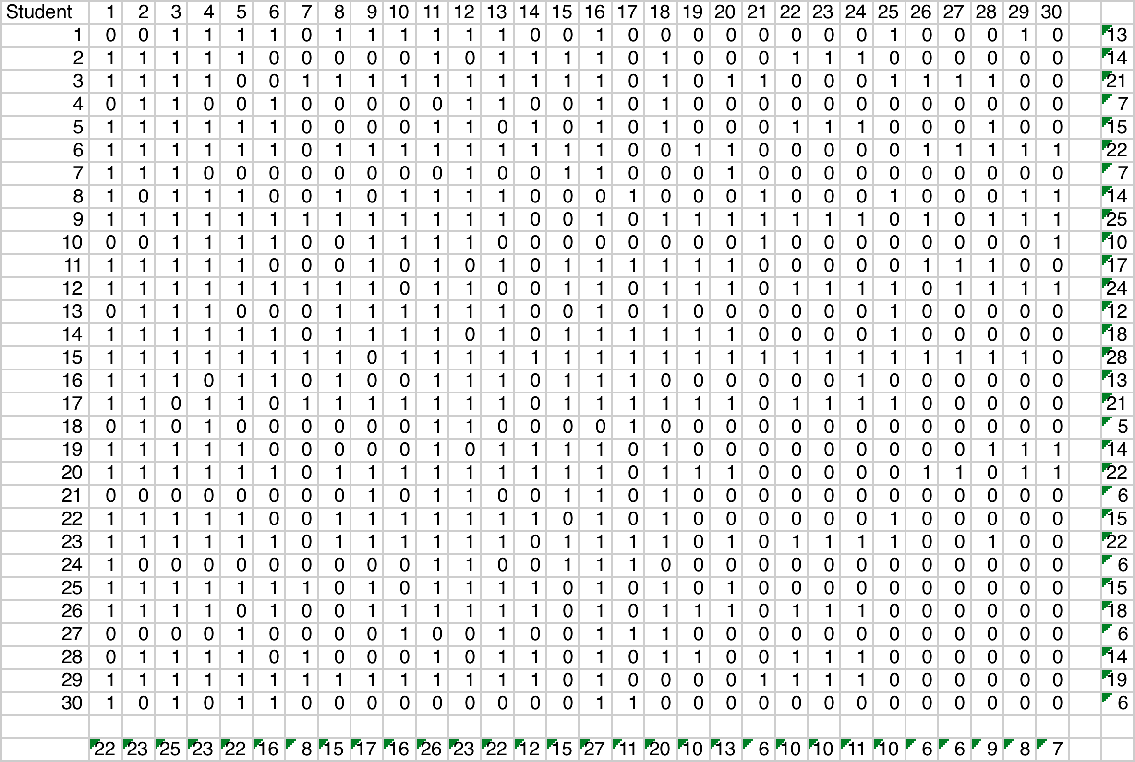
Raw student data

Slide 10
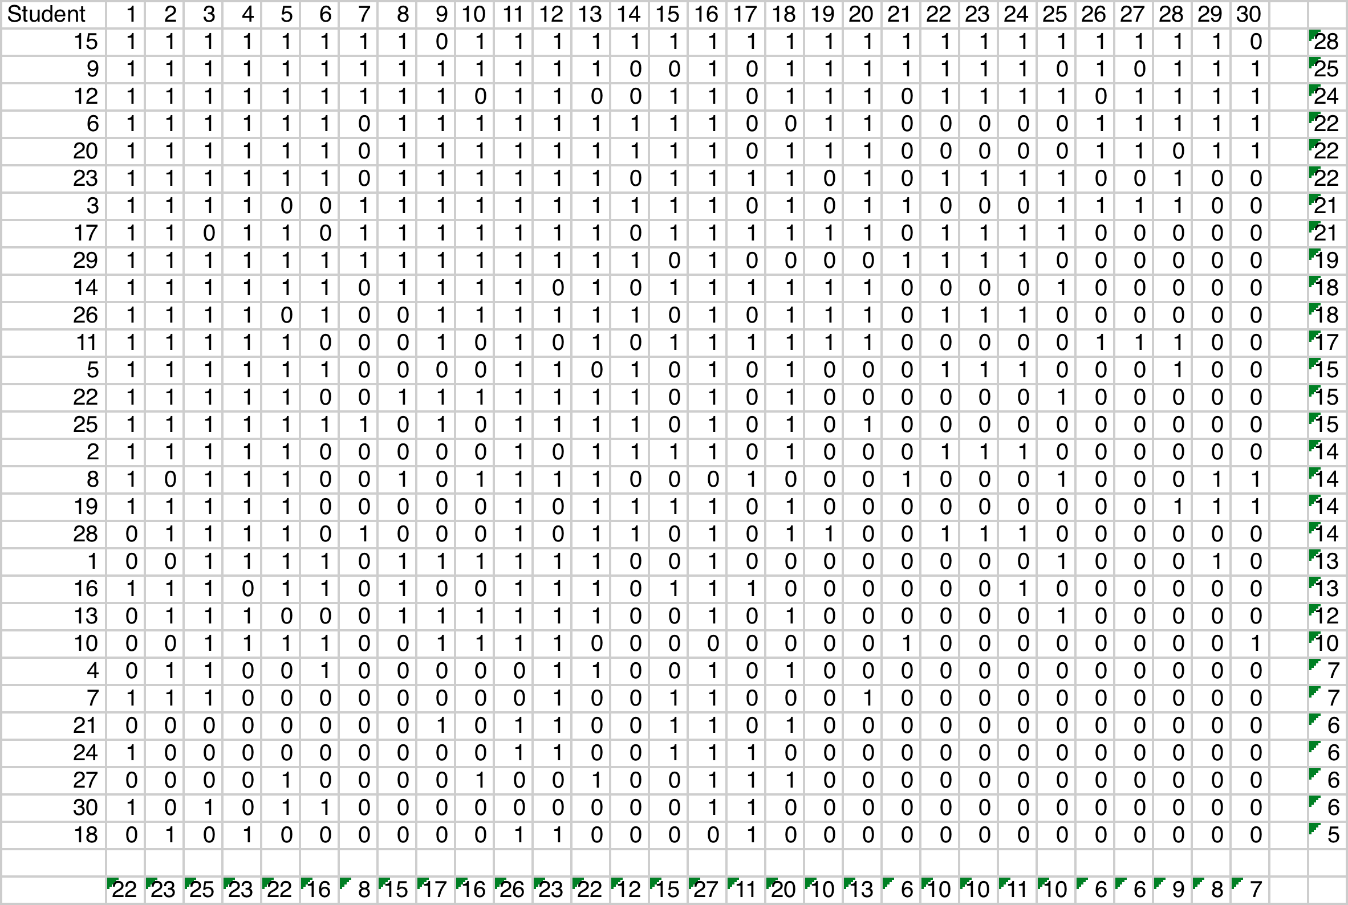
Sort students by raw score…

Slide 11
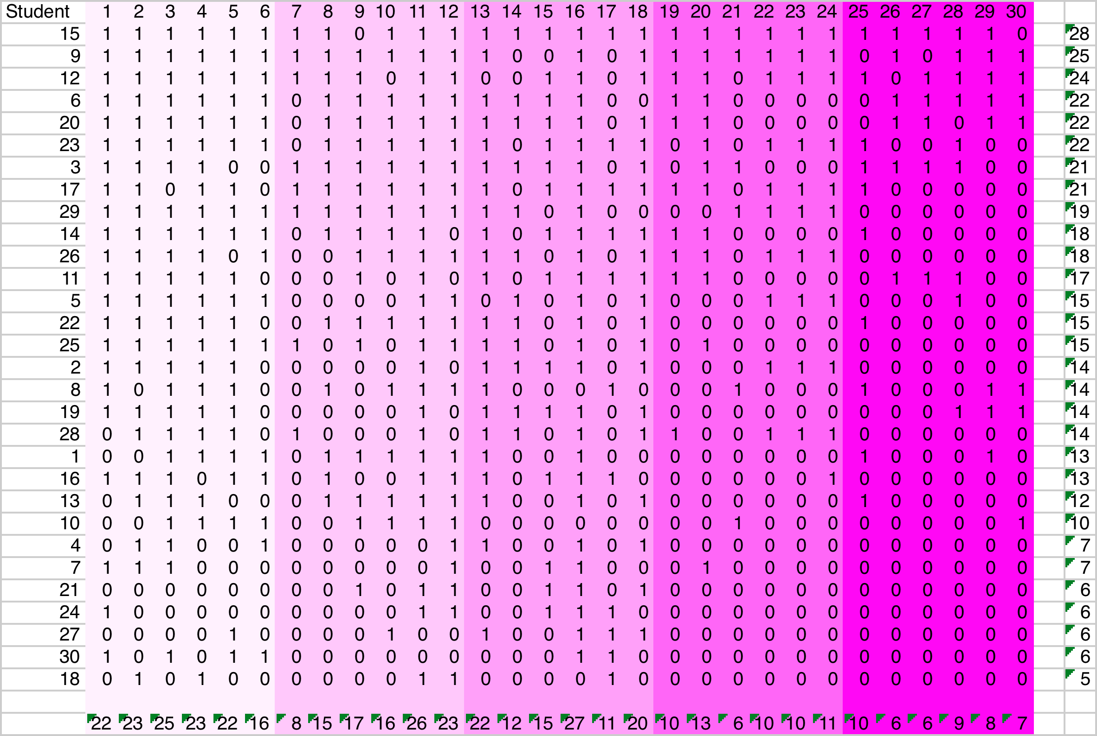
…highlight items by grade…

Slide 12
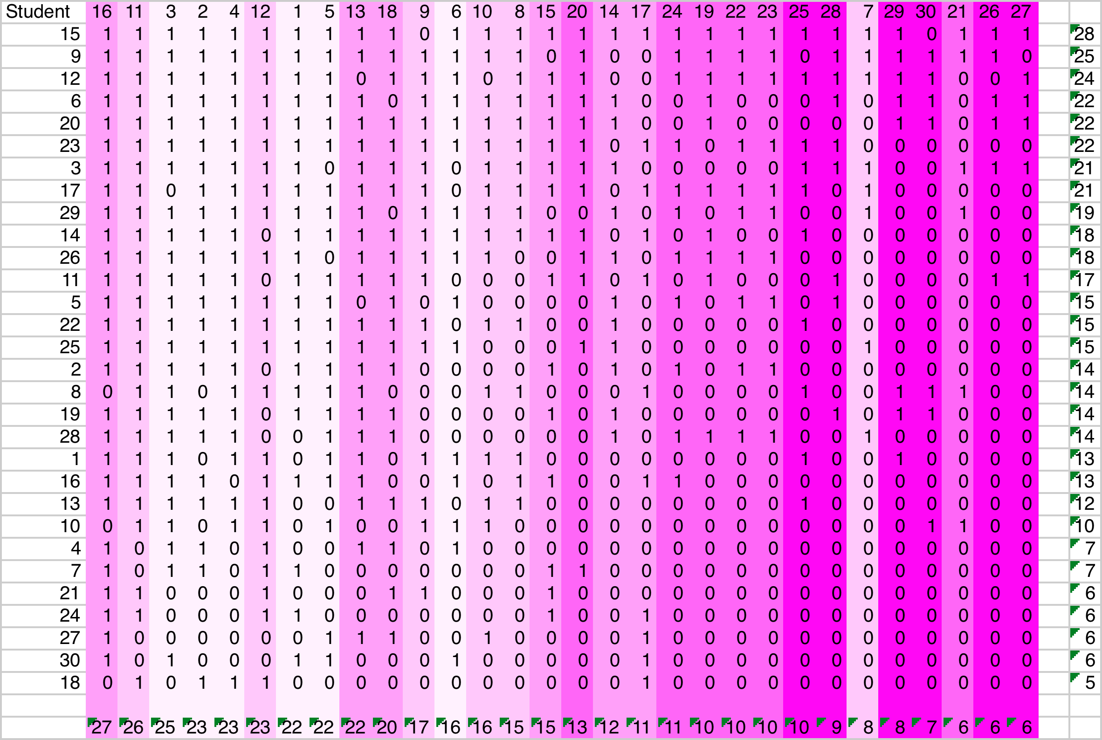
… sort items by difficulty…

Slide 13
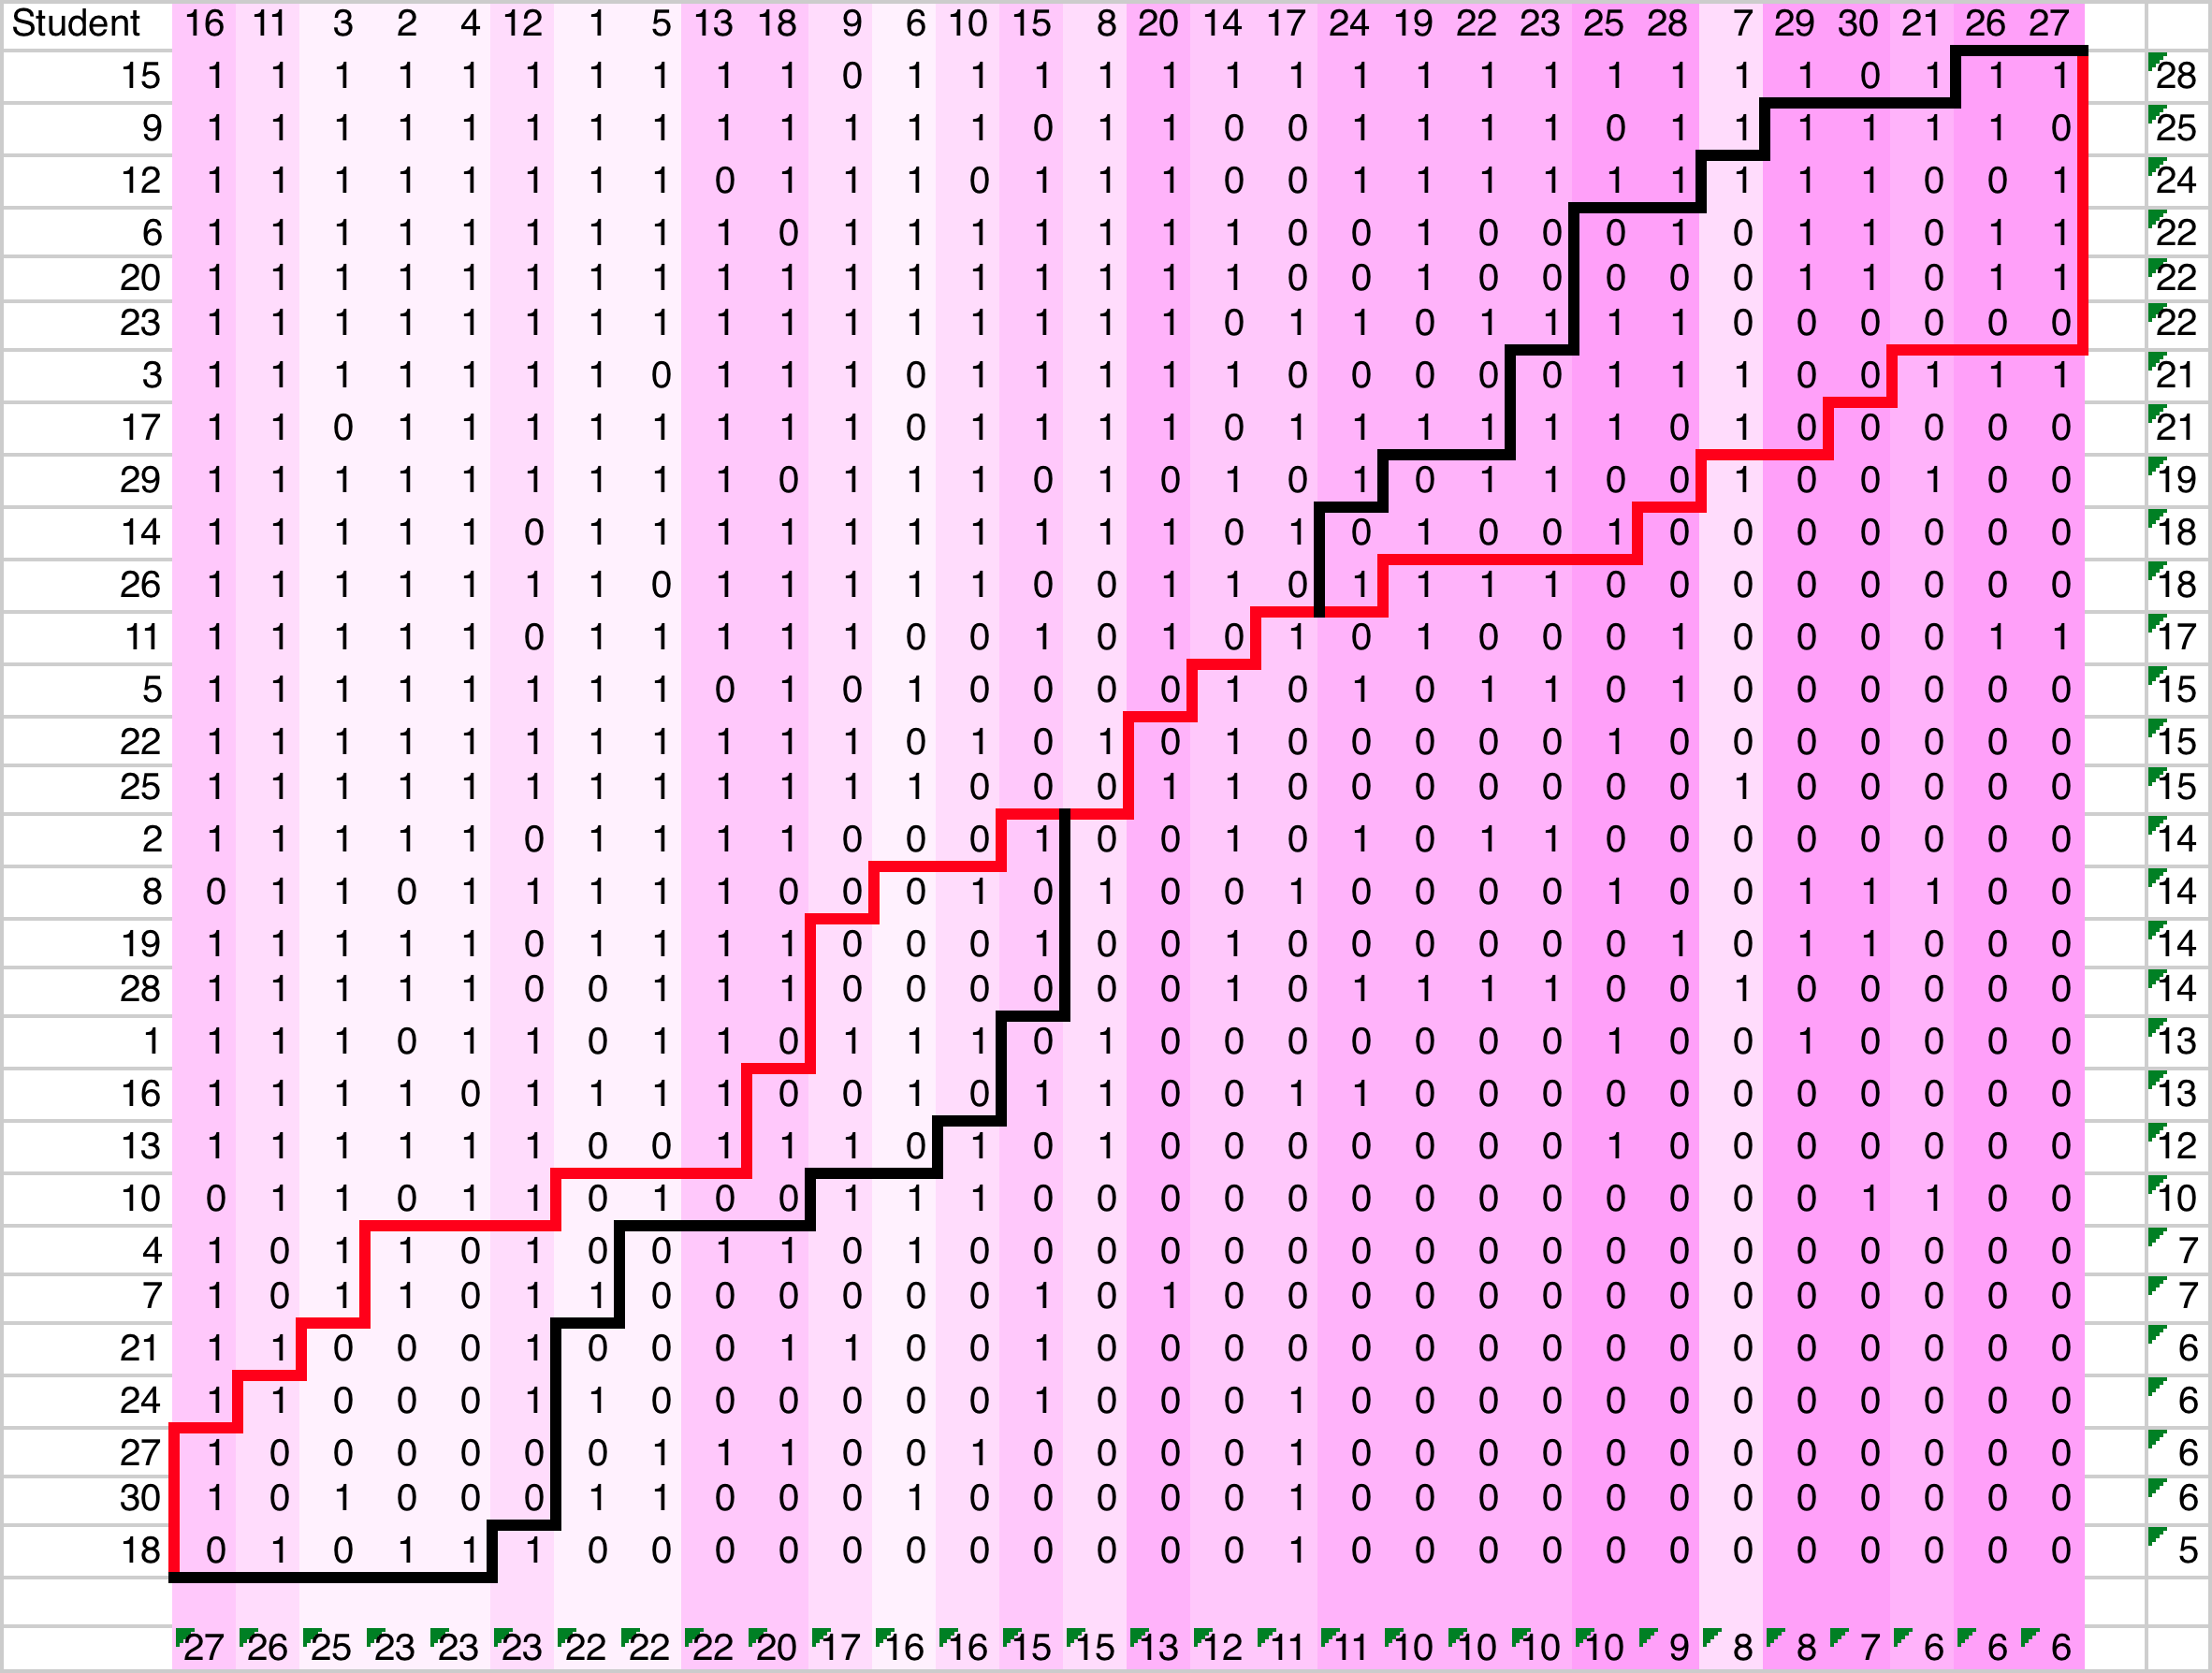
…add student and problem curves…

Slide 14
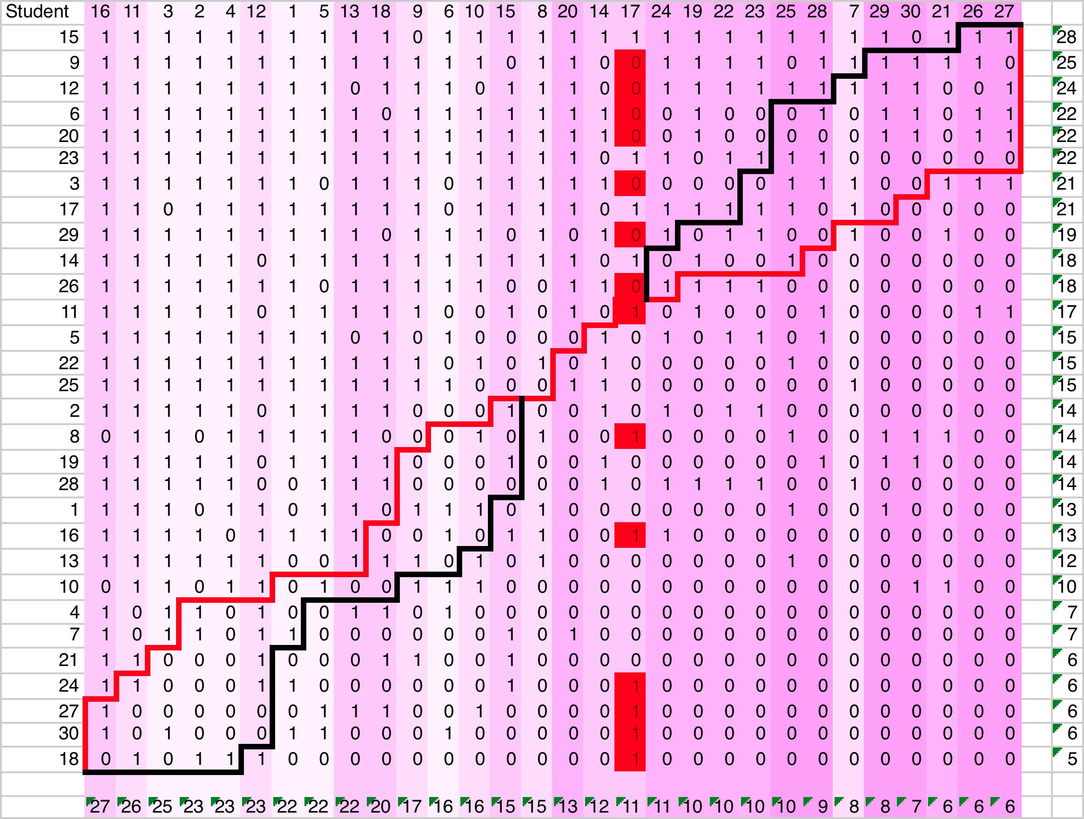
…and highlight non-scaling items…

Slide 15
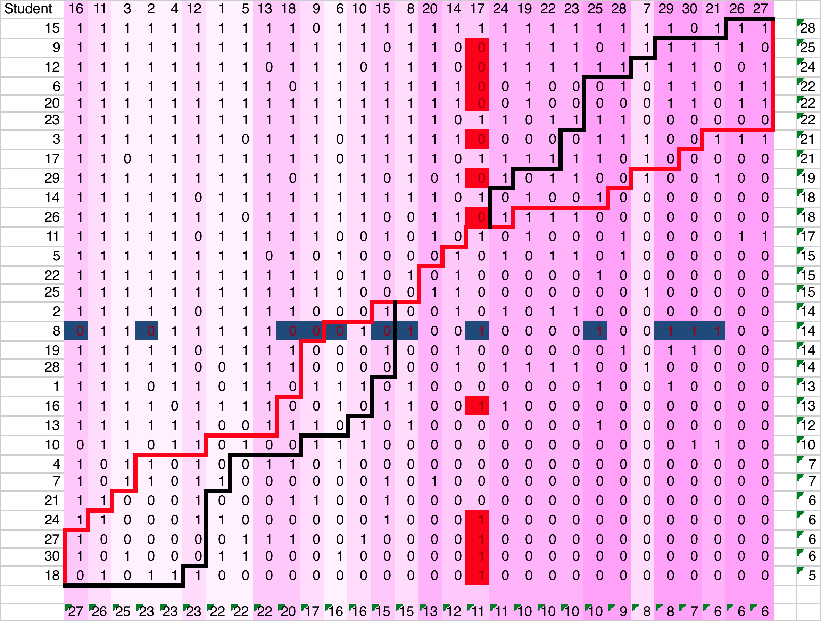
…and non-scaling students

Slide 16
Focus for teachers’ discussion
Two kinds of misfit
  Items too hard or easy for the concept
  Items do not scale (e.g., high-scorers fail to get easy items)
Possible reasons
  Unrelated to the progression
  The progression is wrong
  The item is ambiguous
  Confusing or incomplete instruction

Slide 17
What next?
If everything’s OK
  improved feedback to students
More likely, improve:
  Items
  allocation of items to grades
  curricular sequencing
  Instruction
  feedback to students

