Slide 1
How do we prepare our students for a world we cannot possibly imagine?
Dylan Wiliam
www.dylanwiliam.net

Slide 2
What is the purpose of education?
Four main philosophies of education
Personal empowerment
Cultural transmission
Preparation for citizenship
Preparation for work
All are important
Any education system is a (sometimes uneasy) compromise between these four forces

Slide 3
The coming war for jobs (Clifton, 2011)
Right now
7 billion people on earth
5 billion adults
3 billion people who want to work
90% of these want to work full time
As a consequence
2.7 billion full-time formal jobs are wanted
with only 1.2 billion full-time formal jobs available
A shortfall of 1.5 billion jobs
So, for every UK worker, there are 50 people who would like their job…

Slide 4
Meet Maddie Parlier…
Davidson (2012)
Notes:
Madelyn (Maddie) Parlier runs the laser welding machine at Standard Motor Products, Greenville, SC, welding caps on to fuel injector bodies.
Davidson, A. (2012, January/February). Making it in America. The Atlantic Magazine

Slide 5
How flat is the world?
Percentage crossing national boundaries
Physical mail:
Telephone minutes:
Internet traffic:
First generation immigrants:
University students:
People, ever in their lives:
Goods and services:
1. 2%
2. 5%
3. 10%
4. 20%
5. 50%
Ghemawat (2011)

Slide 6
Mostly round; some flat bits
Percentage crossing national boundaries
Physical mail: | 1
Telephone minutes: | 2
Internet traffic: | 17
First generation immigrants: | 3
University students: | 2
People, ever in their lives: | 10
Goods and services: | 10
Ghemawat (2011)

Slide 7
There is only one 21st century skill
So the model that says learn while you’re at school, while you’re young, the skills that you will apply during your lifetime is no longer tenable. The skills that you can learn when you’re at school will not be applicable. They will be obsolete by the time you get into the workplace and need them, except for one skill. The one really competitive skill is the skill of being able to learn. It is the skill of being able not to give the right answer to questions about what you were taught in school, but to make the right response to situations that are outside the scope of what you were taught in school. We need to produce people who know how to act when they’re faced with situations for which they were not specifically prepared. (Papert, 1998)

Slide 8
Successful education?
The test of successful education is not the amount of knowledge that a pupil takes away from school, but his appetite to know and his capacity to learn. If the school sends out children with the desire for knowledge and some idea how to acquire it, it will have done its work. Too many leave school with the appetite killed and the mind loaded with undigested lumps of information. The good schoolmaster is known by the number of valuable subjects which he declines to teach.
The Future of Education (Livingstone, 1941 p. 28)

Slide 9
Getting smart(er) about school improvement
Key failures
Failure to take into account relevant variables
Policy tourism (“Post hoc ergo propter hoc”)
Failing to consider the role of chance

Slide 10
Between-school effects are small…
In England, as long as you go to school, it doesn’t matter very much which school you go to
93% of the variation in the proportion of 16-year olds gaining 5 A*-C at GCSE is outside the school’s control
If 15 students in a class get 5 A*-C in the average school:
17 students will do so at a “good” school (1sd above mean)
13 students will do so at a “bad” school (1sd below mean)
For passing a threshold (e.g., 5 A*-C), only 10% of students are close enough for the difference between an average and a good school to make a difference
Wiliam (2010); Allen and Burgess (2010)

Slide 11
…because they are dwarfed by other factors
Between-school effects are small, because
Differences between students are huge
Teacher effects are large, but
Good teachers are randomly distributed across schools
This is why policies focused on schools have had little impact

Slide 12
Learning from other countries
Learning from other countries—selectively
 | Example | Counter-example
School choice | Singapore | Korea
Teacher pay | Korea | Australia
School autonomy | Netherlands | Singapore
Teacher quality | Finland | Ireland
High-stakes testing | Canada | Finland
Strategy | Example
School choice | Singapore
Teacher pay | Korea
School autonomy | Netherlands
Teacher quality | Finland
High-stakes testing | Canada

Slide 13
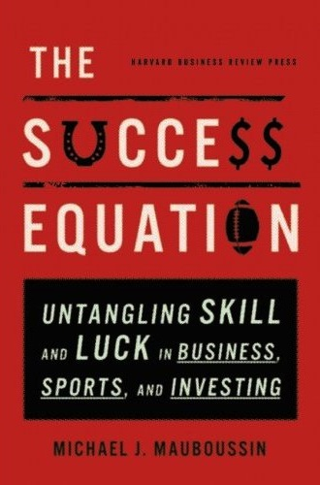
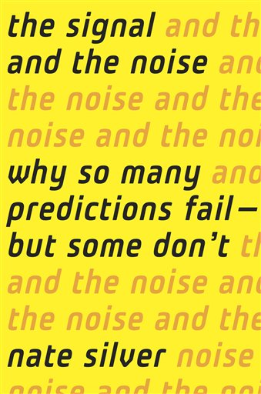
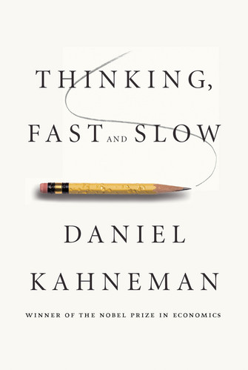
Understanding the role of chance…

Slide 14
“Fooled by randomness” (Taleb, 2001)
Reliability in public examinations
Small high schools
From good to great (or not)
“Secrets of your success”
Teacher observations

Slide 15
Here’s what we know about teaching
We don’t know who will be good teachers
We can’t tell good teaching:
when we see it
by looking at “value-added” test scores

Slide 16
The ‘dark matter’ of teacher quality
 | Mathematics |  |  | Reading
 | Primary | Middle | High | Primary | Middle | High
General theory of education courses |  |  |  |  | –ve
Teaching practice courses |  |  |  | –ve | +ve
Pedagogical content courses | +ve | +ve
Advanced university courses |  |  | –ve |  |  | +ve
Aptitude test scores |  |  | –ve
Harris and Sass (2007)

Slide 17
Observations and teacher quality
So, the highest rated teachers are 30% more productive than the lowest rated
But the best teachers are 400% more productive than the least effective
Sartain, Stoelinga, Brown, Luppescu, Matsko, Miller, Durwood, Jiang, and Glazer (2011)

Slide 18
So what’s to be done?

Slide 19
Expertise
Grandmaster chess players don’t have higher IQs than average chess players
Top surgeons don’t have higher IQs, medical school grades, or higher manual dexterity than average surgeons
In general, measures of general ability account for 4% of the variability in performance

Slide 20
The role of deliberate practice
Music professors at the Hochschule der Kuenst (Academy of Music) Berlin identified 10 violin students who had the potential for careers as international soloists (“best” students)
The professors also identified a sample of 10 good, but not outstanding students (“good” students)
Researchers recruited another 10 students training to be music teachers who specialised in the violin (“Music Ed” students)
An additional 10 middle-aged professional violinists from two local orchestras were recruited to the study
Groups were matched in sex (7f, 3m) and for the first three groups, age

Slide 21
How much do violinists practice?
Ericsson, Krampe, and Tesch-Römer (1993)

Slide 22
Violinists’ hours of practice (cumulative)

Slide 23
These differences are substantial…
 | Hours of practice by age 18
Music Education students | 3420
Good violin students | 5301
Best violin students | 7410
Professional musicians | 7336
By the age of 18, the best violinists have accumulated 40% more practice than good violinists
Since the amount of deliberate practice being undertaken by the best students once they are adults is close to the maximum possible, it is, essentially, impossible for the good students to catch up to the best.

Slide 24
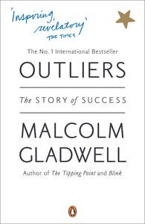
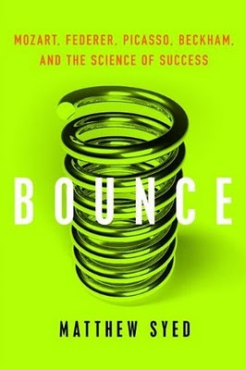
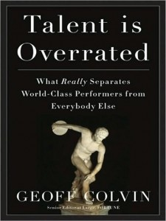
Talent is over-rated…

Slide 25
General conclusions about expertise
Elite performance is the result of at least a decade of maximal efforts to improve performance through an optimal distribution of deliberate practice
What distinguishes experts from others is the commitment to deliberate practice
Deliberate practice is
an effortful activity that can be sustained only for a limited time each day
neither motivating nor enjoyable—it is instrumental in achieving further improvement in performance

Slide 26
Effects of experience in teaching
Mathematics
Reading
Rivkin, Hanushek and Kain (2005)

Slide 27
Implications for education systems
Pursuing a strategy of getting the “best and brightest” into teaching is unlikely to succeed
Currently all teachers slow, and most actually stop, improving after two or three years in the classroom
Expertise research therefore suggests that they are only beginning to scratch the surface of what they are capable of
What we need is to persuade those with a real passion for working with young people to become teachers, and to continue to improve as long as they stay in the job.
There is no limit to what we can achieve if we support our teachers in the right way

Slide 28
Thank you

