Slide 1
Getting better together: the role of professional learning communities
Annual Conference of The Schools Network 2011
Dylan Wiliam
www.dylanwiliam.net

Slide 2
A case study in one district
Cannington
Urban school district serving ~20,000 students
Approximately 20% of the population non-white
No schools under threat of re-constitution, but all under pressure to improve test scores
Funding for a project on “Better learning through smarter teaching”
Focus on mathematics, science and modern foreign languages (MFL)
Commitment from Principals in November 2007
Initial workshops in July 2008

Slide 3
Progress of TLCs in Cannington
 | Maths |  | Science |  | MFL
Ash | 1 | — | 1 | — | 0 | —
Cedar | 5 | ▮ | 1 | ▮ | 3 | ▮ ▮
Hawthorne | 4 | ▮ ▮ | 10 | ▮ ▮ | 5 | ▮ ▮ ▮ ▮
Hazel | 7 | — | 12 | — | 2 | —
Larch | 1 | ▮ ▮ ▮ ▮ | 0 | ▮ | 0 | ▮
Mallow | 6 | ▮ ▮ ▮ | 7 | ▮ | 3 | ▮ ▮
Poplar | 11 | ▮ | 3 | ▮ ▮ ▮ | 1 | ▮ ▮ ▮
Spruce | 7 | ▮ ▮ ▮ ▮ | 8 | ▮ ▮ ▮ | 5 | ▮ ▮ ▮
Willow | 2 | ▮ | 5 | ▮ | 2 | ▮ ▮ ▮ ▮
Totals | 44 |  | 47 |  | 21
Black nos. show teachers attending launch event; blue bars show progress of TLC

Slide 4
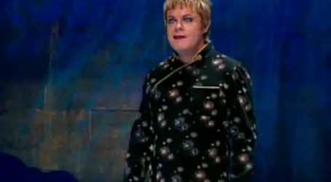
Cake or death?

Slide 5
Teacher learning
Teacher learning is just like any other learning in a highly complex area
In the same way that teachers cannot do the learning for their learners
Leaders cannot do the learning for their teachers
Two extreme responses
“It’s hopeless”
Let a thousand flowers bloom..
Neither will work
What leaders can do is engineer effective learning environments for teachers
‘Servant’ leadership

Slide 6
The knowing-doing gap
Statement | We know we should do this | We are doing this
Getting good ideas from other units in the chain | 4.9 | 4.0
Instituting an active suggestions program | 4.8 | 3.9
Using a detailed assessment process for new hires | 5.0 | 4.2
Posting all jobs internally | 4.2 | 3.5
Talking openly about learning from mistakes | 4.9 | 4.3
Providing employees with frequent feedback | 5.7 | 5.2
Sharing information about financial performance | 4.3 | 3.8
Pfeffer, J. (2000). The knowing-doing gap. Cambridge, MA: Harvard Business School Press.

Slide 7
Control and impact
 |  | Control
 |  | Inside | Outside
Impact | Low
 | High

Slide 8
Why people shouldn’t work on their own
Strangers predict your IQ better than you do (Borkenau & Liebler, 1993)
Most of us think we are above average drivers (Svenson, 1981)
Only 2% of high school seniors believe their leadership skills are below average (College Board, 1976/1977)
…and 25% of them believe they are in the top 1% in their ability to get along with others (College Board, 1976/1977)
94% of college professors report doing above average work (Cross, 1997)
People think they are at lower risk than their peers for heart attacks, cancer, food poisoning, etc. (Weinstein, 1980)
And, most surprisingly…
People believe they are better than their peers at providing accurate self assessment (Pronin, Lin, & Ross, 2002)

Slide 9
What is a Professional Learning Community?
“…an inclusive group of people, motivated by a shared learning vision, who support and work with each other, finding ways, inside and outside their immediate community, to enquire on their practice and together learn new and better approaches that will enhance all pupils’ learning.” (Stoll et al., 2006)

Slide 10
Professional learning communities
Professional
Decision-making under uncertainty
Accountable to a community of peers
Learning
Focused on improvement in student outcomes
Communities
Joint enterprise
Mutual engagement
Shared repertoire

Slide 11
Professions in comparative perspective
 | Medical education | Teacher education
People-centred profession? | ✔ | ✔
Agreed body of knowledge? | ✔ | ✘
Shared language of description? | ✔ | ✘
Cumulating research? | ✔ | ✘
Practitioners involved in research | ✔ | ✘
Expected to ‘keep up with research’ ? | ✔ | ✘

Slide 12
Context matters

Slide 13
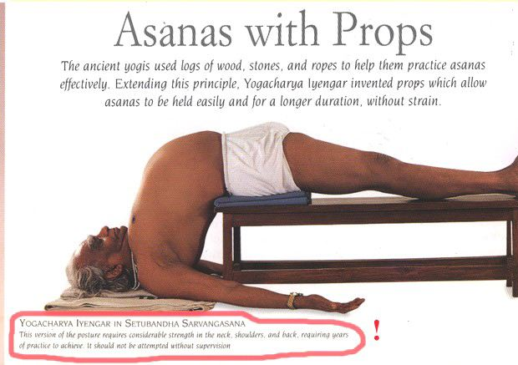

Slide 14
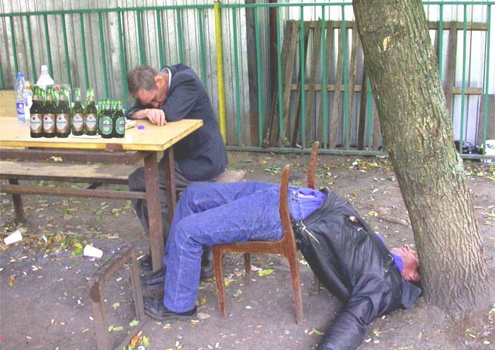

Slide 15
Tight, but loose
Two opposing factors in any school reform
Need for flexibility to adapt to local constraints and affordances
Need to maintain fidelity to the theory of action of the reform, to minimise “lethal mutations”
Different innovations have different approaches to flexibility
Some reforms are too loose (e.g., ‘Effective schools’ movement)
Others are too tight (e.g., Montessori Schools)
The “tight but loose” formulation:
… an obsessive adherence to central design principles (the “tight” part) with accommodations to the needs, resources, constraints, and affordances that occur in any school or district (the “loose” part), but only where these do not conflict with the theory of action of the intervention.

Slide 16
Design and intervention
Our design process
cognitive/affective
insights
synergy/
comprehensiveness
set of components
Teachers’ implementation process
set of
components
synergy/
comprehensiveness
cognitive/affective
insights

Slide 17
The happiness hypothesis (Haidt, 2005)
 | + | –
The rider | Rational Good at complex analysis Focused on the long-term Thinks about the future | Weak Easily distracted Gets bogged down in detail Tires quickly
The elephant | Instinctive Compassionate Sympathetic Loyal Protective Powerful | Emotional Skittish Focused on the short-term Thinks about the present

Slide 18
Strategies for change (Heath & Heath, 2010)
Direct the rider
Follow the bright spots
Script the critical moves
Point to the destination
Motivate the elephant
Find the feeling
Shrink the change
Grow your people
Shape the path
Tweak the environment
Build habits
Rally the herd
Notes:
Direct the rider
Follow the bright spots (malnutrition in Vietnam)
Script the critical moves (1% milk; 25 points)
Point to the destination (No dry holes)
Motivate the elephant
Find the feeling (Gloves on the table)
Shrink the change (5-minute room makeover)
Grow your people (Dweck’s mindset)
Shape the path
Tweak the environment (popcorn study, one-click ordering)
Build habits (action triggers: don’t tax the rider; checklists)
Rally the herd (free spaces in hospitals)

Slide 19
Teacher Quotes
“I have been the most impressed with how much more involved my students have been in their own learning…their confidence in their efforts has been wonderful.”
Here [school based TLC] we had techniques sort of embedded in this group where, you know, we are talking about problems. And our group really actually talked about problems, and we were all GUYS, and older guys too. We actually talked and that doesn’t happen. That doesn’t happen, so I enjoyed the group a lot and thought it was very useful.”
“This work, has really changed what I do – more than most things. When you stop grading papers with numbers, that’s a big deal!”

Slide 20
Teacher Quotes
“We don’t have to have ‘cookie cutter’ classrooms, where we’re all on the same page. There’s an atmosphere here that supports innovation. We can individualize…we’re encouraged to try new things and we’re given time to share with our colleagues.”

Slide 21
Membership of PLCs
 | Benefits | Risks
Volunteers | Culture deepens quickly Appealing to ‘keen’ teachers | Non-volunteers left behind
Conscripts | Oppositional sub-culture less likely Differences in approach can be used to deepen conversations | ‘Project mentality’ disconnected from practice Tokenistic adoption

Slide 22
When is change sustainable?
Understanding what it means to scale (Coburn, 2003)
Depth
Sustainability
Spread
Shift in reform ownership
Consideration of the diversity of contexts of application
Clarity about components, and the theory of action

Slide 23
Key stakeholders’ reactions
Departmental sub-cultures
Unions
Professional associations
Teaching assistants
Ofsted
Parents
Governors
Community leaders

Slide 24
Managing disappointments
Failure: opportunity for learning or blame
Falling down: failing or learning?
High-reliability organizations embrace failure
$1m dollar club
“A complaint is a gift”
Group-work is hard for teachers, … and for teachers of teachers…

Slide 25
A case study in risk
Transposition of the great arteries (TGA)
A rare, but extremely serious, congenital condition in newborn babies (~25 per 100,000 live births) in which
the aorta emerges from the right ventricle and so receives oxygen-poor blood, which is carried back to the body without receiving more oxygen
the pulmonary artery emerges from the left ventricle and so receives the oxygen-rich blood, which is carried back to the lungs
Traditional treatment: the ‘Senning’ procedure which involves:
the creation of a ‘tunnel’ between the ventricles, and
the insertion of a ‘baffle’ to divert oxygen-rich blood from the left ventricle (where it shouldn’t be) to the right ventricle (where it should)
Prognosis
Early death rate (first 30 days): 12%
Life expectancy: 46.6 years

Slide 26
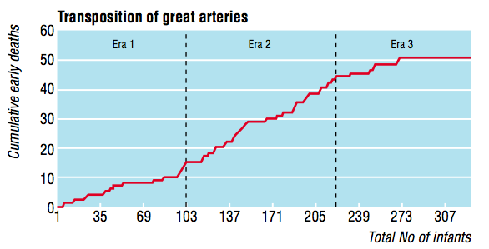
The introduction of the ‘switch’ procedure
Senning
Transitional
Switch
Early death rate
Senning 12%
Transitional 25%
Bull, et al (2000). BMJ, 320, 1168-1173.

Slide 27
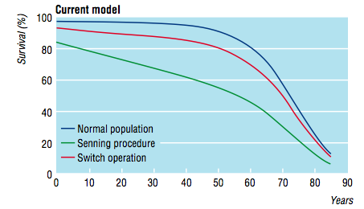
Impact on life expectancy
Life expectancy:
Senning: 46.6 years
Switch: 62.6 years

Slide 28
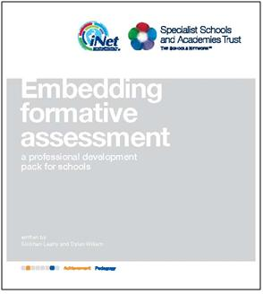
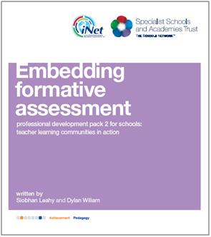
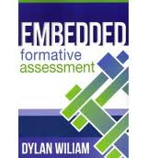
To find out more…
www.dylanwiliam.net

