Slide 1
Stopping people doing good things: the essence of effective leadership
Dylan Wiliam
SSAT 18th National Conference
24 November 2010
www.dylanwiliam.net

Slide 2
Raising achievement matters…
For individuals
Increased lifetime salary (13% for a degree)
Improved health (60% reduction in ill health for a degree)
Longer life (1.7 years of life per extra year of schooling)
For society
Lower criminal justice costs
Lower health-care costs
Increased economic growth (Hanushek & Wößman, 2010)
Present value to UK of raising PISA scores by 25 points: £4trn
Present value of ensuring all students score 400 on PISA: £5trn

Slide 3
Which of the following categories of skill is disappearing from the work-place most rapidly?
Routine manual
Non-routine manual
Routine cognitive
Complex communication
Expert thinking/problem-solving

Slide 4
…but what is learned matters too…
Skill category | Percentage change 1969-1999
Complex communication | +14%
Expert thinking/problem solving | +8%
Routine manual | –3%
Non-routine manual | –5%
Routine cognitive | –8%
Autor, Levy & Murnane, 2003

Slide 5
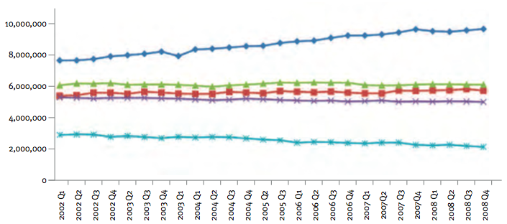
In fact low skill jobs are vanishing
Over the last eight years, the UK economy has shed 400 no-qualification jobs every day
Beyond Leitch (Patel et al., 2009)

Slide 6
We still make things in Britain
Country | Manufacturing value 2008 ($bn)
 | National total ($bn) |  | Per person ($)
United States | 1831 |  | 5926
China | 1794 |  | 1342
Japan | 1045 |  | 8197
Germany | 767 |  | 9384
Italy | 381 |  | 6322
United Kingdom | 323 |  | 5206
France | 306 |  | 4680
Russian Federation | 256 |  | 1805
Brazil | 237 |  | 1232
Republic of Korea | 231 |  | 4636

Slide 7
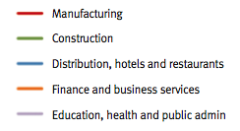
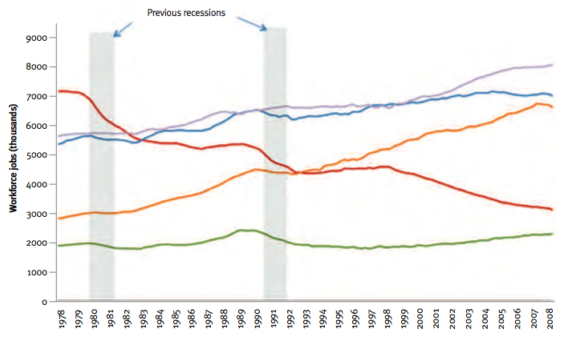
We just don’t use so many people to do so
Beyond Leitch (Patel et al., 2009)

Slide 8
Real-terms changes in salary: 1978 to 2003
Education level | Change in salary
Postgraduate qualification | +28%
BA/BSc | +19%
Some college | 0%
Upper secondary education | 0%
High-school dropout | -16%
(Economic Policy Institute, 2010)

Slide 9
Where’s the solution?
Private schools?
Controlling for social class, students in the UK taught in classes of 13 in private schools achieve the same as students taught in classes of 25 in state schools (OECD, 2008)
Charter schools
In the US, 17% of charter schools achieved better learning gains than traditional schools, and 37% did worse, so on average charter schools lowered student achievement (CREDO, 2009)
National strategies?
The national roll-out of the National Literacy and Numeracy Strategies resulted in approximately one extra student reaching level 4 per primary school per year, at a cost of around £500m (Machin & McNally, 2009)
Interactive white boards?
Doubling the number of interactive white-boards in London schools produced no increase in student achievement (Moss et al., 2007)

Slide 10
Why do smart people do dumb things?
Three generations of school effectiveness research
Raw results approaches
Different schools get different results
Conclusion: Schools make a difference
Demographic-based approaches
School factors account for only 7% of the variation
Conclusion: Schools don’t make a difference
If 15 students in a class get 5 A*-C in the average school:
17 students will do so at a “good” school (1sd above mean)
13 students will do so at a “bad” school (1sd below mean)
Value-added approaches
School-level differences in value-added are relatively small
Teacher-level differences in value-added are large
Conclusion: An effective school is a school full of effective teachers

Slide 11
Teachers make the difference
The commodification of teachers has received widespread support:
From teacher unions (who understandably resist performance-related pay)
From politicians (who are happy that the focus is on teacher supply, rather than teacher quality)
But has resulted in the pursuit of policies with poor benefit to cost

Slide 12
Class size reduction
Reducing class sizes by 30% (from 30 to 20) results in an extra 4 months of learning per year
At a cost of £20,000 per classroom per year
Plus the cost of building 150,000 new classrooms
And only if the teachers are on average as good as the teachers we have
Adding 150,000 weak teachers to the system will reduce student learning by 5 months a year.
So we could spend an extra £5bn and lower student achievement…

Slide 13
…a big difference
To see how big the difference is, take a group of 50 teachers
Students taught by the best teacher learn twice as fast as average
Students taught by the worst teacher learn half as fast average
And in the classrooms of the best teachers
Students from disadvantaged backgrounds learn as much as those from advantaged backgrounds
Students with behavioral difficulties learn as much as those without
The value of having had an outstanding Reception teacher can be detected in the annual salaries of 35-year-olds
Economic value contributed by an outstanding Reception teacher each year: £200,000

Slide 14
Improving teacher quality
A classic labour force issue with 2 (non-exclusive) solutions
Replace existing teachers with better ones
Improve the effectiveness of existing teachers

Slide 15
The ‘dark matter’ of teacher quality
Teachers make a difference
But what makes the difference in teachers?
Source of variation | Extra weeks of learning per year
Advanced content matter knowledge | 0
Further professional qualifications (MA) | 0
Experience (10 years) | 2
Pedagogical content knowledge (2 sd) | 4

Slide 16
Impact on achievement
If we could replace the least effective 15,000 teachers with average teachers, the net impact on student achievement at GCSE would be an increase of one-fortieth of a grade in each subject.
Raising the bar for entry into the profession so that we no longer recruit the lowest performing 30% of teachers would increase achievement at GCSE by one grade

Slide 17
Impact on achievement
If we could replace the least effective 15,000 teachers with average teachers, the net impact on student achievement at GCSE would be an increase of one-fortieth of a grade in each subject.
Raising the bar for entry into the profession so that we no longer recruit the lowest performing 30% of teachers would increase achievement at GCSE by one grade—by 2030.

Slide 18
Or make the teachers we have better…
Improve the effectiveness of existing teachers
The “love the one you’re with” strategy
It can be done
Provided we focus rigorously on the things that matter
Even when they’re hard to do

Slide 19
The formative assessment hi-jack…
Long-cycle
Span: across units, terms
Length: four weeks to one year
Impact: Student monitoring; curriculum alignment
Medium-cycle
Span: within and between teaching units
Length: one to four weeks
Impact: Improved, student-involved, assessment; teacher cognition about learning
Short-cycle
Span: within and between lessons
Length:
day-by-day: 24 to 48 hours
minute-by-minute: 5 seconds to 2 hours
Impact: classroom practice; student engagement

Slide 20
A model for teacher learning
Content, then process
Content (what we want teachers to change)
Evidence
Ideas (strategies and techniques)
Process (how to go about change)
Choice
Flexibility
Small steps
Accountability
Support

Slide 21
Choice
Belbin inventory (Management teams: why they succeed or fail)
Eight team roles (defined as “A tendency to behave, contribute and interrelate with others in a particular way.”)
Company worker; Innovator; Shaper; Chairperson; Resource investigator; Monitor/evaluator; Completer/finisher; Team worker
Key ideas
People rarely sustain “out of role” behavior, especially under stress
Each role has strengths and allowable weaknesses
Each teacher’s personal approach to teaching is similar
Some teachers’ weaknesses require immediate attention
For most, however, students benefit more by developing teachers’ strengths

Slide 22
Flexibility
Two opposing factors in any school reform
Need for flexibility to adapt to local constraints and affordances
Implies there is appropriate flexibility built into the reform
Need to maintain fidelity to the theory of action of the reform, to minimise “lethal mutations”
So you have to have a clearly articulated theory of action

Slide 23
Strategies and techniques
Distinction between strategies and techniques
Strategies define the territory of formative assessment (no brainers)
Teachers are responsible for choice of techniques
Allows for customization and caters for local context
Creates ownership and shares responsibility
Key requirements of techniques
embody what we know about how learning takes place
relevant
feasible
acceptable

Slide 24
Examples of techniques
Learning intentions
“sharing exemplars”
Eliciting evidence
“mini white-boards”
Providing feedback
“match the comments to the essays”
Students as owners of their learning
“coloured cups”
Students as learning resources
“pre-flight checklist”

Slide 25
Small steps
According to Berliner (1994), expert teachers
excel mainly in their own domain.
often develop automaticity for the repetitive operations that are needed to accomplish their goals.
are more sensitive to the task demands and social situation when solving problems.
are more opportunistic and flexible in their teaching than novices.
represent problems in qualitatively different ways than novices.
have fast and accurate pattern recognition capabilities. Novices cannot always make sense of what they experience.
perceive meaningful patterns in the domain in which they are experienced.
begin to solve problems slower but bring richer and more personal sources of information to bear on the problem that they are trying to solve.

Slide 26
Example: CPR (Klein & Klein, 1981)
Six video extracts of a person delivering cardio-pulmonary resuscitation (CPR)
5 of the video extracts are students
1 of the video extracts is an expert
Videos shown to three groups: students, experts, instructors
Success rate in identifying the expert:
Experts: 90%
Students: 50%
Instructors: 30%

Slide 27
Looking at the wrong knowledge…
The most powerful teacher knowledge is not explicit
That’s why telling teachers what to do doesn’t work
What we know is more than we can say
And that is why most professional development has been relatively ineffective
Improving practice involves changing habits, not adding knowledge
That’s why it’s hard
And the hardest bit is not getting new ideas into people’s heads
It’s getting the old ones out
That’s why it takes time
But it doesn’t happen naturally
If it did, the most experienced teachers would be the most productive, and that’s not true (Hanushek, 2005)

Slide 28
We need to create time and space for teachers to reflect on their practice in a structured way, and to learn from mistakes (Bransford, Brown & Cocking, 1999)
“Always make new mistakes” (Esther Dyson)
“Ever tried. Ever failed. No matter. Try again. Fail again. Fail better.”
(Samuel Beckett, Worstward Ho)

Slide 29
Hand hygiene in hospitals (Pittet, 2001)
Study | Focus | Compliance rate
Preston, Larson & Stamm (1981) | Open ward | 16%
 | ICU | 30%
Albert & Condie (1981) | ICU | 28% to 41%
Larson (1983) | All wards | 45%
Donowitz (1987) | Pediatric ICU | 30%
Graham (1990) | ICU | 32%
Dubbert (1990) | ICU | 81%
Pettinger & Nettleman (1991) | Surgical ICU | 51%
Larson et al. (1992) | Neonatal ICU | 29%
Doebbeling et al. (1992) | ICU | 40%
Zimakoff et al. (1992) | ICU | 40%
Meengs et al. (1994) | ER (Casualty) | 32%
Pittet, Mourouga & Perneger (1999) | All wards | 48%
 | ICU | 36%

Slide 30
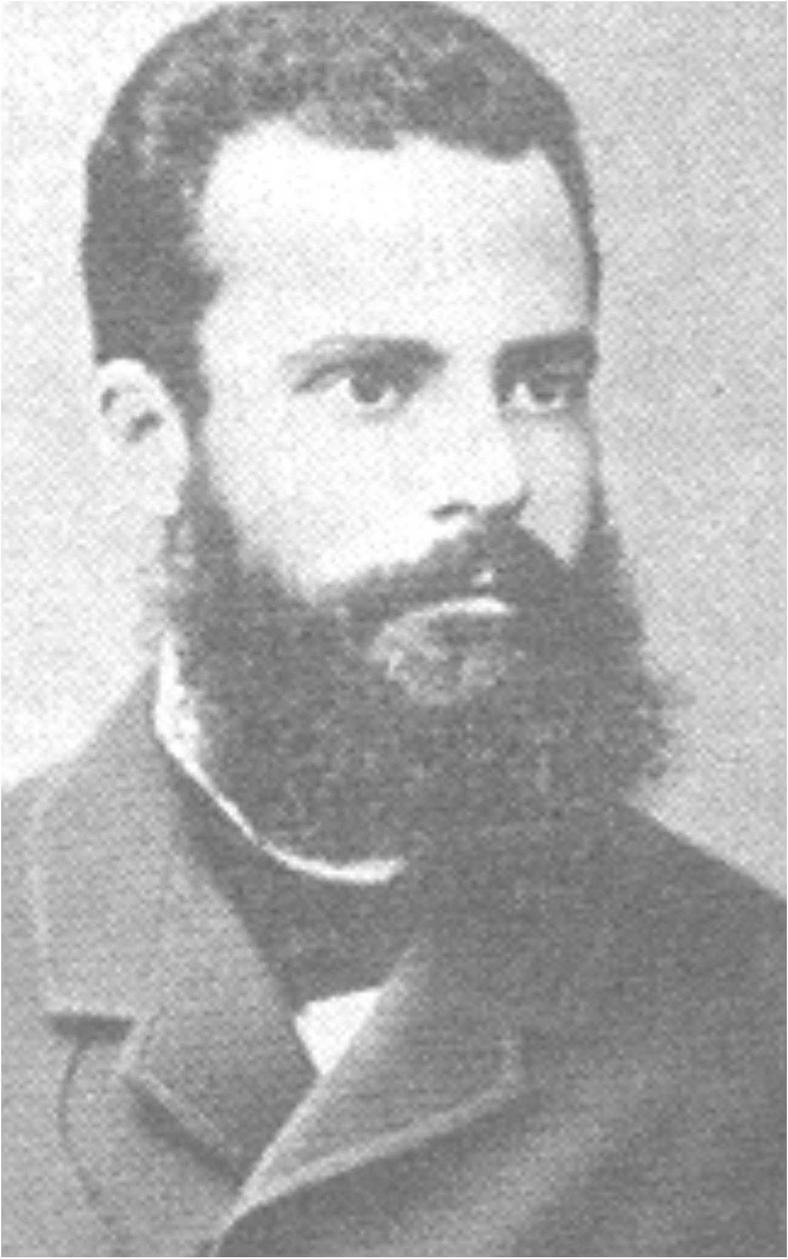
Pareto analysis
Vilfredo Pareto (1848-1923)
Economist, philosopher, etc
Pareto improvement
A change that can make at least one person (e.g., a student) better off without making any- one else (e.g., a teacher) worse off.
Obstacles to Pareto improvements
In professional settings, it is incredibly hard to stop people doing valuable things in order to give them time to do even more valuable things
e.g., “Are you saying what I am doing is no good?”

Slide 31
Support
What is needed from teachers
A commitment to:
the continuous improvement of practice
focus on those things that make the most difference to student outcomes
What is needed from leaders
A commitment to:
creating expectations for the continuous improvement of practice
ensuring that the the focus stays on those things that make the most difference to student outcomes
providing the time, space, dispensation and support for innovation
supporting risk-taking

